Slide 1

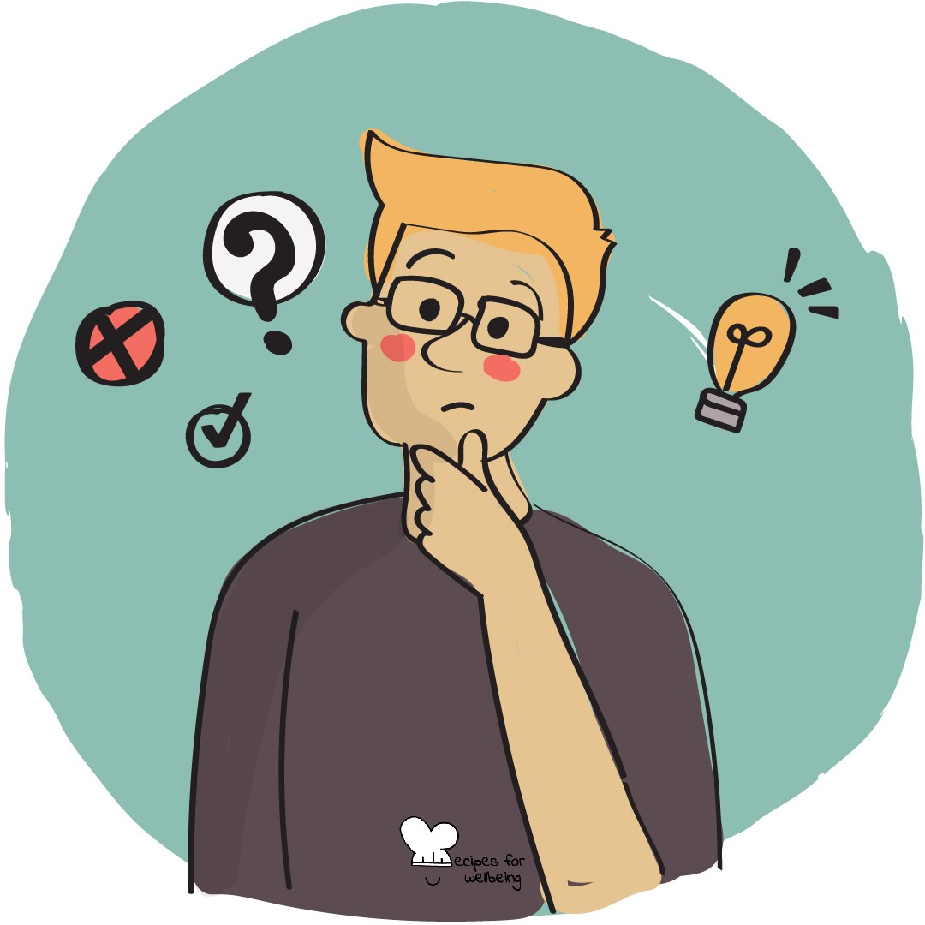
WHOLEBEING FOR EDUCATORS · LESSON
Finding shape in a complicated situation
The skill of sense-making · one class period · ages 13 to 18
Project or adapt these slides freely — the full plan is in the DOCX.
Recipes for Wellbeing · CC BY-NC 4.0 · free for classroom use

Slide 2
THE BIG IDEA
Some experiences arrive without a clear story: an unexpected result, a disagreement or information that does not fit. Sense-making helps us hold several parts together, recognise what we do not know and build a provisional understanding. It does not require every mess to become meaningful or every question to be resolved.
Recipes for Wellbeing · CC BY-NC 4.0 · free for classroom use · rfweducators.netlify.app/lessons/sense-making/

Slide 3
OPENER
First attempts
1. Think of one low-stakes attempt from this year that did not go as you hoped, whether it was a task, a game or a plan that changed.
2. Ask quietly what you know now because you made that attempt and what you might choose differently another time.
3. An unsuccessful attempt can provide information while disappointment and real consequences remain.
4. You do not need to share the memory or turn it into a positive story.
Recipes for Wellbeing · CC BY-NC 4.0 · free for classroom use · rfweducators.netlify.app/lessons/sense-making/

Slide 4
TALK ABOUT IT
• What is the difference between a quick take and a developed understanding?
• Why can uncertainty feel difficult to leave open?
• How do other perspectives improve sense-making, and when should an account not be treated as merely one side among many?
Recipes for Wellbeing · CC BY-NC 4.0 · free for classroom use · rfweducators.netlify.app/lessons/sense-making/

Slide 5
ACTIVITY · 18 MIN
The mess map
1. Offer broad questions such as why misinformation spreads, why scrolling is hard to stop or why a rule can affect groups differently. Students may pass on a topic.
2. Place one question in the centre of a large page and agree not to race towards a verdict.
3. Build four branches: the parts involved, the positions people hold, the open questions and the connections between them.
4. Mark evidence separately from assumptions and write "not sure" wherever the group does not know.
Recipes for Wellbeing · CC BY-NC 4.0 · free for classroom use · rfweducators.netlify.app/lessons/sense-making/

Slide 6
ACTIVITY · 18 MIN
The mess map
5. Visit two other maps and add one missing position, piece of evidence or question, without trying to correct the whole map.
6. Share one connection that became clearer and one part that became more complex.
Recipes for Wellbeing · CC BY-NC 4.0 · free for classroom use · rfweducators.netlify.app/lessons/sense-making/

Slide 7
REFLECT
When something stops making sense, which move may help you next: asking another question, drawing the parts, checking evidence or listening to a position you missed?
Recipes for Wellbeing · CC BY-NC 4.0 · free for classroom use · rfweducators.netlify.app/lessons/sense-making/

Slide 8
Not everything needs to be solved before it can be understood more carefully. Sense-making lets us build the clearest picture available and leave space for what has not yet found a place.
Recipes for Wellbeing · CC BY-NC 4.0 · free for classroom use · rfweducators.netlify.app/lessons/sense-making/

Slide 9
BEFORE YOU GO
Exit ticket
1. Why might a first explanation of a complicated situation be unreliable?
a) We always wait until we have every fact before deciding anything
b) It may be shaped by what we already expected, or by wanting to escape not knowing
c) We only make sense of things once someone else explains them to us
d) We rarely form an opinion about anything until much later
2. In The mess map activity, what are the four branches?
a) Heroes, villains, victims and winners
b) Facts, opinions, rumours and verdicts
c) Causes, blame, punishment and solutions
d) The parts involved, the positions people hold, the open questions and the connections between them
3. What does the sense-making skill actually involve doing?
a) Deciding on an explanation as fast as possible and moving on
b) Ignoring other people's viewpoints to focus only on your own instinct
c) Pausing the first quick verdict to notice the pieces, the different sides, and what is still unclear
d) Avoiding confusing situations altogether
Recipes for Wellbeing · CC BY-NC 4.0 · free for classroom use · rfweducators.netlify.app/lessons/sense-making/

