Slide 1

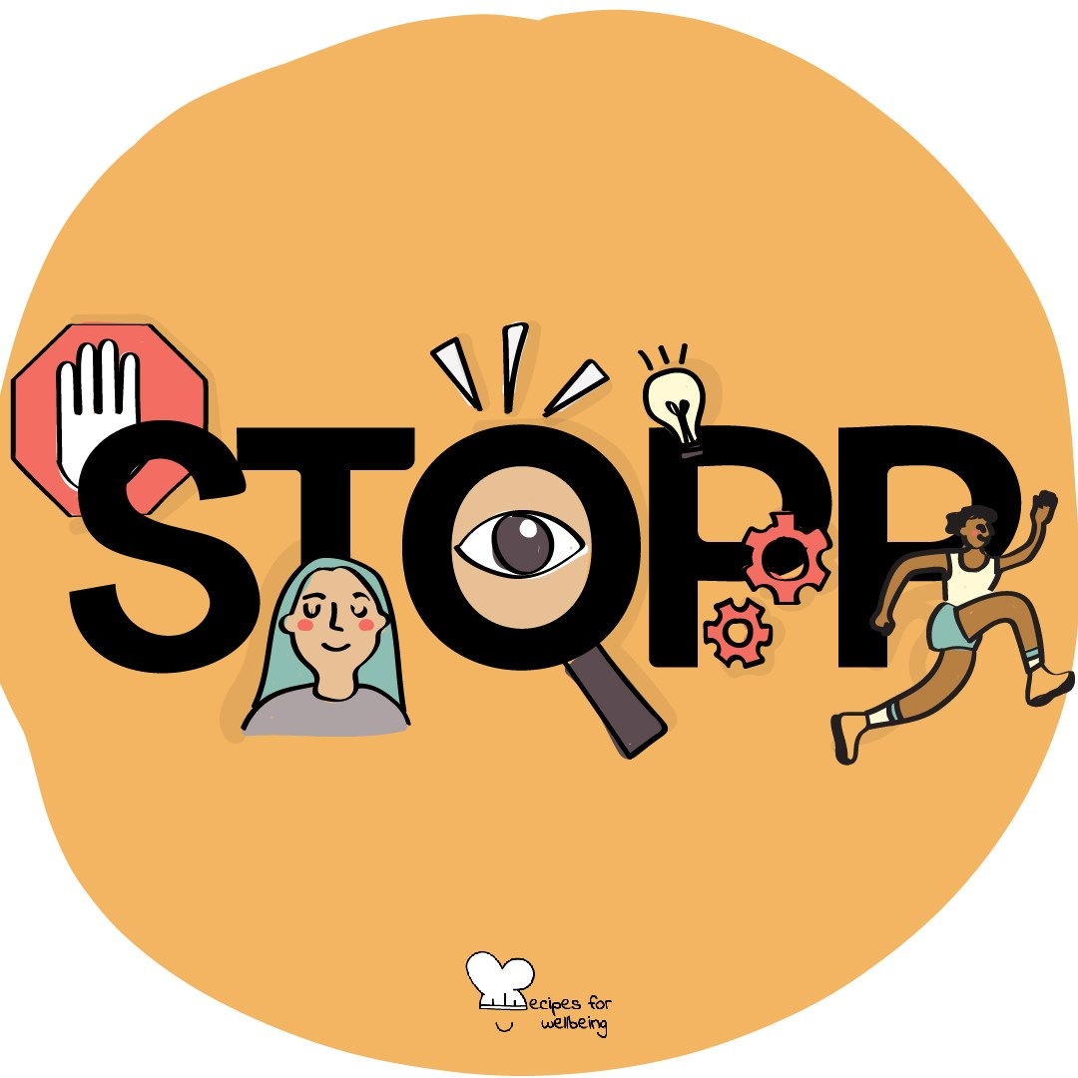
WHOLEBEING FOR EDUCATORS · LESSON
Finding a steadier next step
The skill of relaxation · one class period · ages 13 to 18
Project or adapt these slides freely — the full plan is in the DOCX.
Recipes for Wellbeing · CC BY-NC 4.0 · free for classroom use

Slide 2
THE BIG IDEA
Pressure can narrow attention and make the next reaction feel immediate. Self-regulation is the practice of noticing what is happening, making a little space and choosing from the support that is available. Nobody is calm all the time, and some situations need safety, help or a change in conditions.
Recipes for Wellbeing · CC BY-NC 4.0 · free for classroom use · rfweducators.netlify.app/lessons/self-regulation/

Slide 3
OPENER
The full stop
1. We are going to practise a short pause called STOPP, which can help create a little room before the next response.
2. S is stop for a moment, and T is take one comfortable breath or simply notice the breath you already have.
3. O is observe what is present, such as planning, worrying or replaying, without deciding that it should be different.
4. The first P is pull back enough to see the wider situation, and the final P is proceed with the next safe and useful step.
Recipes for Wellbeing · CC BY-NC 4.0 · free for classroom use · rfweducators.netlify.app/lessons/self-regulation/

Slide 4
TALK ABOUT IT
• What is the difference between looking regulated and having what you need?
• Which pressures are personal, and which are created by the environment?
• When might proceeding mean pausing longer or asking another person to step in?
Recipes for Wellbeing · CC BY-NC 4.0 · free for classroom use · rfweducators.netlify.app/lessons/self-regulation/

Slide 5
ACTIVITY · 17 MIN
Build a rest and support menu
1. Offer broad categories such as physical, mental, sensory, creative, social and emotional rest, explaining that they are prompts rather than a complete scientific model.
2. Give each group one or two categories and ask for realistic options that cost little, fit different bodies and do not assume a supportive home environment.
3. Add a column for changes other people or the setting can make, such as quieter space, clearer instructions, a break, fewer notifications or adjusted workload.
4. Build one class menu that includes self-directed practices, relational support and environmental change.
Recipes for Wellbeing · CC BY-NC 4.0 · free for classroom use · rfweducators.netlify.app/lessons/self-regulation/

Slide 6
ACTIVITY · 17 MIN
Build a rest and support menu
5. Invite students to notice privately what they may reach for and what would require an adult's help or permission.
6. Keep the menu available without asking anyone to promise that they will use it.
Recipes for Wellbeing · CC BY-NC 4.0 · free for classroom use · rfweducators.netlify.app/lessons/self-regulation/

Slide 7
REFLECT
When life speeds up, what form of rest, support or change is easiest to forget, and which part of today's menu may be worth remembering?
Recipes for Wellbeing · CC BY-NC 4.0 · free for classroom use · rfweducators.netlify.app/lessons/self-regulation/

Slide 8
The full stop at the beginning did not solve the pressures around us. It offered enough room to notice them and consider what next step or support may be needed.
Recipes for Wellbeing · CC BY-NC 4.0 · free for classroom use · rfweducators.netlify.app/lessons/self-regulation/

Slide 9
BEFORE YOU GO
Exit ticket
1. What does self-regulation mean, according to the lesson?
a) Being calm and relaxed at all times, no matter what happens
b) Avoiding any situation that might cause stress
c) Noticing what is happening, making a little space and choosing from the support available
d) Completing more tasks so you feel productive
2. In the STOPP sequence from the lesson, what does the O stand for?
a) Observe what is present
b) Organise your tasks
c) Overcome the feeling
d) Open a conversation
3. Which of these is one of the forms of rest named in the lesson?
a) Academic rest
b) Sensory rest
c) Financial rest
d) Competitive rest
Recipes for Wellbeing · CC BY-NC 4.0 · free for classroom use · rfweducators.netlify.app/lessons/self-regulation/

