Slide 1

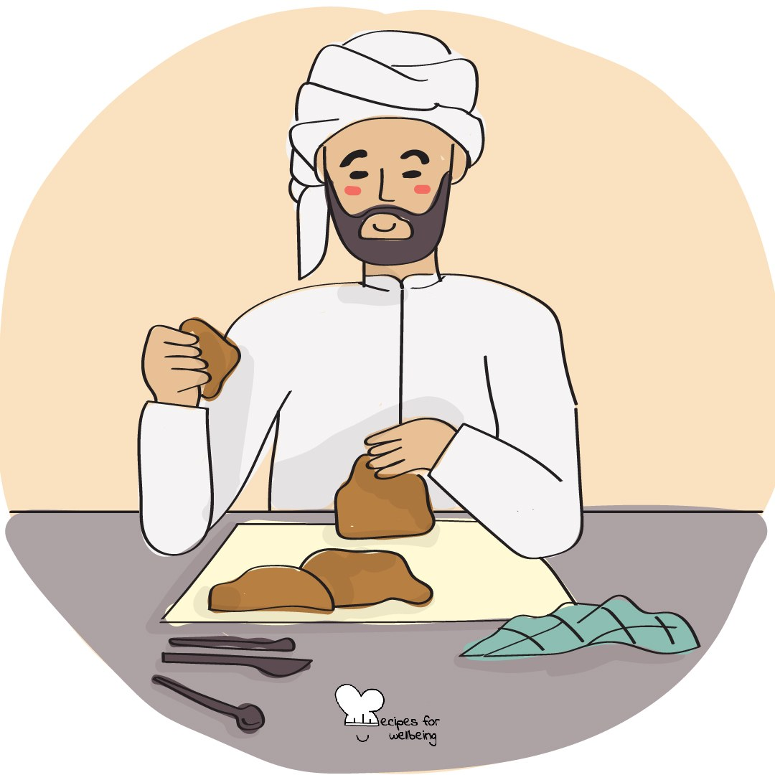
WHOLEBEING FOR EDUCATORS · LESSON
What else is also true?
The skill of reframing · one class period · ages 13 to 18
Project or adapt these slides freely — the full plan is in the DOCX.
Recipes for Wellbeing · CC BY-NC 4.0 · free for classroom use

Slide 2
THE BIG IDEA
When something goes wrong, the first story about it can feel like the only truth. Reframing keeps the facts and the difficult feeling. It asks whether another part of the situation is also true, and whether that wider view makes another response possible.
Recipes for Wellbeing · CC BY-NC 4.0 · free for classroom use · rfweducators.netlify.app/lessons/reframing/

Slide 3
OPENER
Stress, reintroduced
1. Notice whether pressure is present in your body today, perhaps as a faster heartbeat, a busy stomach or no clear sensation at all.
2. One possible way to read these sensations is that the body is preparing to meet a demand. That interpretation may be useful, and it may not fit every situation.
3. If you would like to, take an ordinary breath and try the sentence, "My body is responding, and I can decide what support I need."
4. The sensation does not need to disappear, and you can return your attention to the room whenever you choose.
Recipes for Wellbeing · CC BY-NC 4.0 · free for classroom use · rfweducators.netlify.app/lessons/reframing/

Slide 4
TALK ABOUT IT
• How can the same event support more than one honest story?
• Why might the first frame be especially narrow during pressure?
• How can we recognise when a reframe has become denial or forced positivity?
Recipes for Wellbeing · CC BY-NC 4.0 · free for classroom use · rfweducators.netlify.app/lessons/reframing/

Slide 5
ACTIVITY · 15 MIN
The frame swap
1. Model a low mark by separating the fact from a first frame such as "I am incapable" and another truth such as "This gives me information about where I need help."
2. Give each group one fictional, low-disclosure situation, such as a missed bus, changed plan, disappointing result or place on the bench.
3. Write the first narrow frame, then find two or three other frames that remain supported by the situation.
4. Reject any wording that minimises the loss, blames the person or requires gratitude.
Recipes for Wellbeing · CC BY-NC 4.0 · free for classroom use · rfweducators.netlify.app/lessons/reframing/

Slide 6
ACTIVITY · 15 MIN
The frame swap
5. Choose the frame that opens a realistic next step, including asking for help, resting, appealing a decision or doing nothing yet.
6. Share the scenario, the wider frame and the possible next step, while leaving room for other interpretations.
Recipes for Wellbeing · CC BY-NC 4.0 · free for classroom use · rfweducators.netlify.app/lessons/reframing/

Slide 7
REFLECT
Bring to mind a small, low-stakes hassle without writing what it was. What else is also true, and does that additional truth change anything you may choose next?
Recipes for Wellbeing · CC BY-NC 4.0 · free for classroom use · rfweducators.netlify.app/lessons/reframing/

Slide 8
You do not need to argue with the first story or replace it with a brighter one. You can ask what else is true and let a fuller picture shape the next choice.
Recipes for Wellbeing · CC BY-NC 4.0 · free for classroom use · rfweducators.netlify.app/lessons/reframing/

Slide 9
BEFORE YOU GO
Exit ticket
1. According to the lesson, what does a frame do?
a) It directs attention towards some parts of a situation and away from others
b) It turns a fact into something that cannot be questioned
c) It decides who is right and who is wrong
d) It helps you memorise facts before a test
2. According to the lesson, which is an honest reframe of a low mark?
a) "The result does not matter at all."
b) "This gives me information about where I need help."
c) "I am incapable."
d) "I should be grateful this happened."
3. What does reframing actually involve, according to the lesson?
a) Deciding the hard feeling was never really there
b) Replacing the facts of a situation with more pleasant ones
c) Asking what else is also true and finding a frame that opens up a next step
d) Waiting until a situation resolves itself before responding
Recipes for Wellbeing · CC BY-NC 4.0 · free for classroom use · rfweducators.netlify.app/lessons/reframing/

