Slide 1

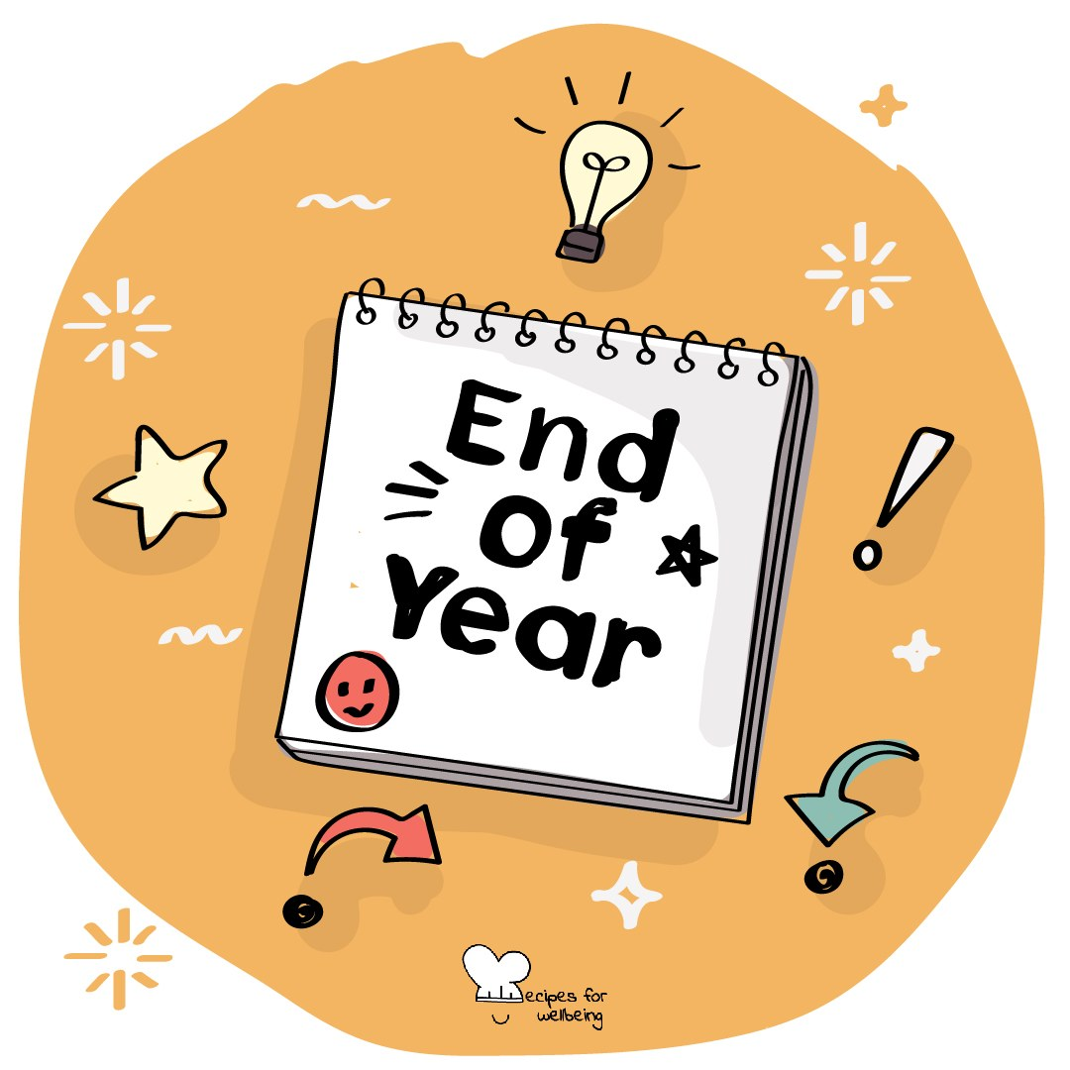
WHOLEBEING FOR EDUCATORS · LESSON
Looking back with care
The skill of reflection · one class period · ages 13 to 18
Project or adapt these slides freely — the full plan is in the DOCX.
Recipes for Wellbeing · CC BY-NC 4.0 · free for classroom use

Slide 2
THE BIG IDEA
Days can pass quickly, leaving little time to notice what changed, helped or needs attention. Reflection creates a deliberate look back. It is different from rumination, because we do not replay every detail. We look for understanding, a choice or a question that can travel with us.
Recipes for Wellbeing · CC BY-NC 4.0 · free for classroom use · rfweducators.netlify.app/lessons/reflection/

Slide 3
OPENER
The term, looking back
1. Take a moment to look back across the term from where you are now.
2. Finish three sentences silently: something I moved through, something that surprised me, and something I am ready to leave here.
3. Comfortable and difficult experiences both belong, and you do not need to turn either into a lesson.
4. If you would like to, offer one word from your reflection. Passing is always available.
Recipes for Wellbeing · CC BY-NC 4.0 · free for classroom use · rfweducators.netlify.app/lessons/reflection/

Slide 4
TALK ABOUT IT
• How does reflection differ from replaying a moment on a loop?
• When can distance make looking back easier or harder?
• What makes a reflective question curious rather than blaming?
Recipes for Wellbeing · CC BY-NC 4.0 · free for classroom use · rfweducators.netlify.app/lessons/reflection/

Slide 5
ACTIVITY · 17 MIN
Moment, question, takeaway
1. Fold a page into three boxes labelled Moment, Question and Takeaway.
2. Model the process with a neutral shared event, using a question that seeks understanding rather than fault.
3. Give each pair a fictional low-stakes situation, such as missing a bus, sending an unclear message or revising the wrong topic.
4. Pairs complete the three boxes and check whether the takeaway is information, a possible action or a request for support rather than a telling-off.
Recipes for Wellbeing · CC BY-NC 4.0 · free for classroom use · rfweducators.netlify.app/lessons/reflection/

Slide 6
ACTIVITY · 17 MIN
Moment, question, takeaway
5. Invite several pairs to share the takeaway only, showing that one moment can lead to different understandings.
6. Offer an optional private round with a small personal moment. The paper is not collected and students may leave the boxes blank.
Recipes for Wellbeing · CC BY-NC 4.0 · free for classroom use · rfweducators.netlify.app/lessons/reflection/

Slide 7
REFLECT
What kind of moment from a week may be worth looking back on, and what gentle question could help you learn from it without getting stuck inside it?
Recipes for Wellbeing · CC BY-NC 4.0 · free for classroom use · rfweducators.netlify.app/lessons/reflection/

Slide 8
Looking back does not have to mean living the moment again. We can ask with care, and carry forward only what is useful or ready.
Recipes for Wellbeing · CC BY-NC 4.0 · free for classroom use · rfweducators.netlify.app/lessons/reflection/

Slide 9
BEFORE YOU GO
Exit ticket
1. According to the lesson, how is reflection different from rumination?
a) Reflection looks for understanding, a choice or a question to carry forward
b) Reflection means replaying every detail until it feels better
c) Reflection and rumination are two names for the same thing
d) Reflection only happens after something has gone badly
2. What are the three moves of reflection, in order, as the lesson describes them?
a) Judge the moment, ask a hard question, decide on a punishment
b) Pause on a moment, ask a curious question, take something away
c) Ignore the moment, wait for it to pass, forget about it
d) Rate the moment, compare it to others, move on quickly
3. In the Moment, question, takeaway activity, what might a useful takeaway be?
a) A telling-off for the person involved
b) A score for how well the moment went
c) Information, a possible action or a request for support
d) A full replay of every detail
Recipes for Wellbeing · CC BY-NC 4.0 · free for classroom use · rfweducators.netlify.app/lessons/reflection/

