Slide 1

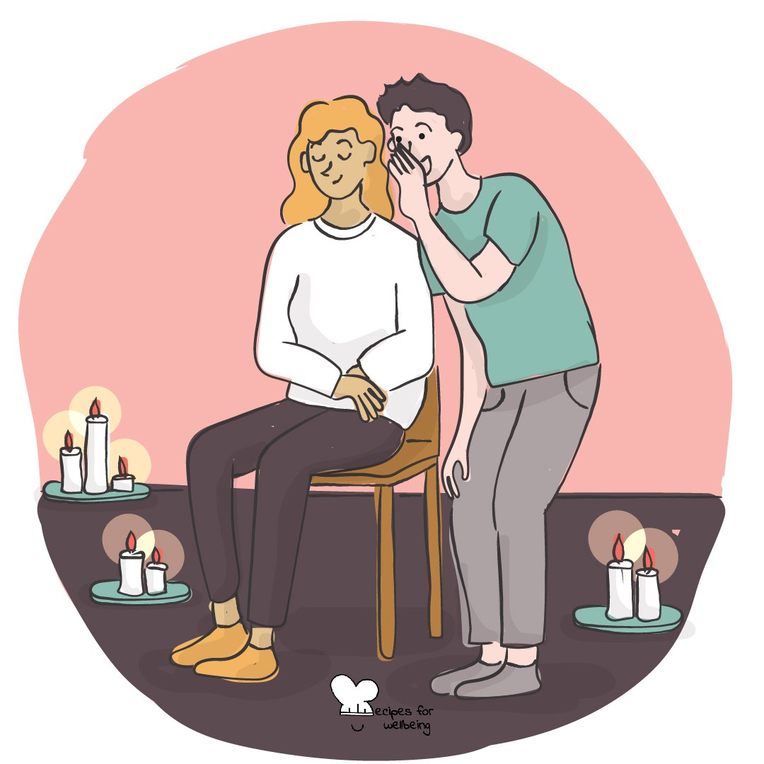
WHOLEBEING FOR EDUCATORS · LESSON
Keeping the flow going both ways
The skill of non-extracting · one class period · ages 13 to 18
Project or adapt these slides freely — the full plan is in the DOCX.
Recipes for Wellbeing · CC BY-NC 4.0 · free for classroom use

Slide 2
THE BIG IDEA
Friendships, teams, shared spaces and living systems depend on movement in more than one direction. Reciprocity asks what we receive, what we return and whether the arrangement remains fair over time. Nobody is asked to give endlessly. Limits and rest are part of what keeps a relationship going.
Recipes for Wellbeing · CC BY-NC 4.0 · free for classroom use · rfweducators.netlify.app/lessons/reciprocity/

Slide 3
OPENER
Giving and receiving
1. We often practise giving, while receiving can take a different kind of attention.
2. Think of one true and specific appreciation for the person beside you based on something you observed in class, or choose an appreciation for the group as a whole.
3. Offer it in one sentence if you would like to. The receiver only needs to say "thank you", and passing is available to both people.
4. Swap roles, then notice privately which part felt more familiar.
Recipes for Wellbeing · CC BY-NC 4.0 · free for classroom use · rfweducators.netlify.app/lessons/reciprocity/

Slide 4
TALK ABOUT IT
• What makes an exchange reciprocal even when both sides do not give the same thing?
• How can a group notice when one person is carrying too much?
• What is the difference between reciprocity and keeping score?
Recipes for Wellbeing · CC BY-NC 4.0 · free for classroom use · rfweducators.netlify.app/lessons/reciprocity/

Slide 5
ACTIVITY · 16 MIN
Redesign the flow
1. Offer fictional one-way flows, such as one person organising every group chat, a shared fridge never being restocked, a student contacted only for notes or an app taking attention without supporting a stopping point.
2. Groups choose two scenarios and identify what is being received, who supplies it and where the hidden cost sits.
3. Redesign one scenario so the need can still be met while responsibility, acknowledgement or resources move more fairly.
4. Include a boundary for the person or system that has been giving too much.
Recipes for Wellbeing · CC BY-NC 4.0 · free for classroom use · rfweducators.netlify.app/lessons/reciprocity/

Slide 6
ACTIVITY · 16 MIN
Redesign the flow
5. Summarise the redesign in one sentence: "Instead of..., the group could..., so that..."
6. Share the recipes and test whether each redesign asks the least powerful person to do even more work.
Recipes for Wellbeing · CC BY-NC 4.0 · free for classroom use · rfweducators.netlify.app/lessons/reciprocity/

Slide 7
REFLECT
Think of an everyday flow you are part of without naming anyone. What could put something back, and what boundary would keep the exchange from becoming draining?
Recipes for Wellbeing · CC BY-NC 4.0 · free for classroom use · rfweducators.netlify.app/lessons/reciprocity/

Slide 8
Reciprocity means noticing the flow and sharing the load, so that care can keep going. No one has to give until nothing remains.
Recipes for Wellbeing · CC BY-NC 4.0 · free for classroom use · rfweducators.netlify.app/lessons/reciprocity/

Slide 9
BEFORE YOU GO
Exit ticket
1. What does reciprocity mean in this lesson?
a) Always giving without ever receiving anything back
b) Things flowing both ways, rather than only one way
c) Taking as much as possible from a shared resource
d) Avoiding group work altogether
2. According to the lesson, does reciprocity need an exact exchange every time?
a) Yes, every gift must be repaid straight away with something equal
b) Yes, it means keeping a careful score of who gave what
c) No, it only applies to friendships and never to living systems
d) No, care can flow over time and is not a debt to repay at once
3. In the Redesign the flow activity, what did groups do with a one-way scenario, such as a shared fridge that is never restocked?
a) Decided who was most to blame
b) Removed the scenario from the discussion
c) Redesigned it so the need is still met while responsibility, acknowledgement or resources move more fairly
d) Ranked it against the other scenarios for how serious it was
Recipes for Wellbeing · CC BY-NC 4.0 · free for classroom use · rfweducators.netlify.app/lessons/reciprocity/

