Slide 1

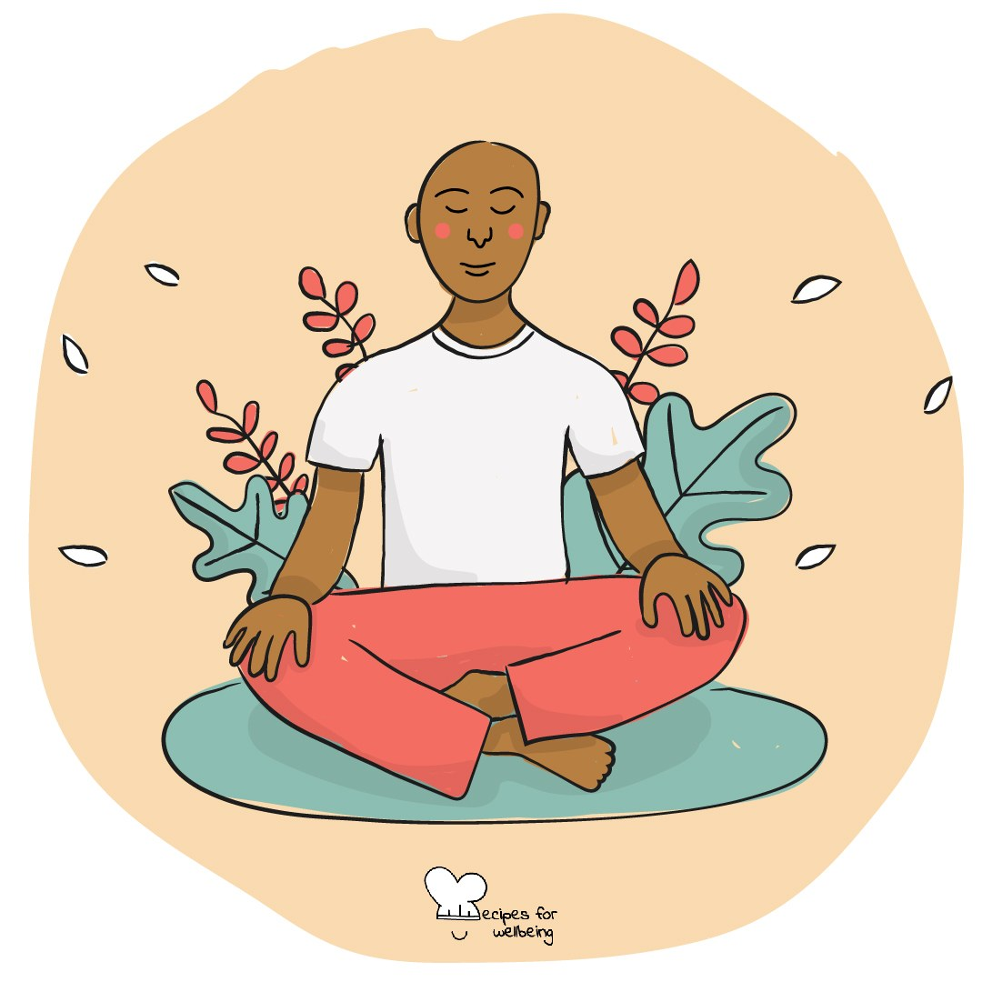
WHOLEBEING FOR EDUCATORS · LESSON
For the sake of what?
The skill of purpose · one class period · ages 13 to 18
Project or adapt these slides freely — the full plan is in the DOCX.
Recipes for Wellbeing · CC BY-NC 4.0 · free for classroom use

Slide 2
THE BIG IDEA
When tasks and expectations pile up, it can be difficult to remember what any of them are for. Purpose asks what an action serves and whether that direction still matters to us. It can be small, uncertain and shared with others; no young person is expected to identify one grand reason for their life.
Recipes for Wellbeing · CC BY-NC 4.0 · free for classroom use · rfweducators.netlify.app/lessons/purpose/

Slide 3
OPENER
For the sake of what
1. Choose one thing from today that you care about doing with attention, however ordinary it may be.
2. Ask yourself quietly, "For the sake of what?" Who or what might this action serve?
3. Follow the answer one step deeper if that feels useful. A small reason counts, and "I am not sure" is complete.
4. Keep the answer private and notice whether it changes how you see the task.
Recipes for Wellbeing · CC BY-NC 4.0 · free for classroom use · rfweducators.netlify.app/lessons/purpose/

Slide 4
TALK ABOUT IT
• Why might the same action feel meaningful to one person and empty to another?
• What makes people lose contact with what an activity is for?
• Where does pressure to have a life purpose figured out come from?
Recipes for Wellbeing · CC BY-NC 4.0 · free for classroom use · rfweducators.netlify.app/lessons/purpose/

Slide 5
ACTIVITY · 17 MIN
The why ladder
1. Model a neutral action on the bottom rung of a ladder, then ask "For the sake of what?" three times to explore possible values beneath it.
2. Groups choose a low-disclosure action such as learning to cook, saving money, practising a sport, studying or supporting a friend.
3. Build at least three rungs, allowing branches where different reasons are possible.
4. Mark which parts depend on personal choice and which depend on resources, other people or wider conditions.
Recipes for Wellbeing · CC BY-NC 4.0 · free for classroom use · rfweducators.netlify.app/lessons/purpose/

Slide 6
ACTIVITY · 17 MIN
The why ladder
5. Each group shares only one top rung, and the class notices where different ladders meet or remain different.
6. Students privately take one ordinary action from their week and ask the question once, with "not sure yet" available.
Recipes for Wellbeing · CC BY-NC 4.0 · free for classroom use · rfweducators.netlify.app/lessons/purpose/

Slide 7
REFLECT
Choose one ordinary thing you will do this week. For whose or what sake might you do it, and is that reason one you want to keep?
Recipes for Wellbeing · CC BY-NC 4.0 · free for classroom use · rfweducators.netlify.app/lessons/purpose/

Slide 8
Purpose does not need to arrive as one large answer. For now, it may be enough to ask what the next action serves and allow the answer to keep changing with you.
Recipes for Wellbeing · CC BY-NC 4.0 · free for classroom use · rfweducators.netlify.app/lessons/purpose/

Slide 9
BEFORE YOU GO
Exit ticket
1. In this lesson, what is purpose described as?
a) A fixed life plan that never changes
b) A flexible sense of direction, like a compass rather than a map
c) A list of exam results to achieve
d) Something only adults are allowed to have
2. In The why ladder activity, what does adding a new rung involve?
a) Asking "For the sake of what?" about the rung below
b) Choosing a completely different action to start again
c) Ranking classmates from most to least motivated
d) Listing every subject on the school timetable
3. In The why ladder activity, what do groups mark on their ladders?
a) Which reasons are right and which are wrong
b) Which classmate gave the best answer
c) Which rung took the longest to write
d) Which parts depend on personal choice and which depend on resources, other people or wider conditions
Recipes for Wellbeing · CC BY-NC 4.0 · free for classroom use · rfweducators.netlify.app/lessons/purpose/

