Slide 1

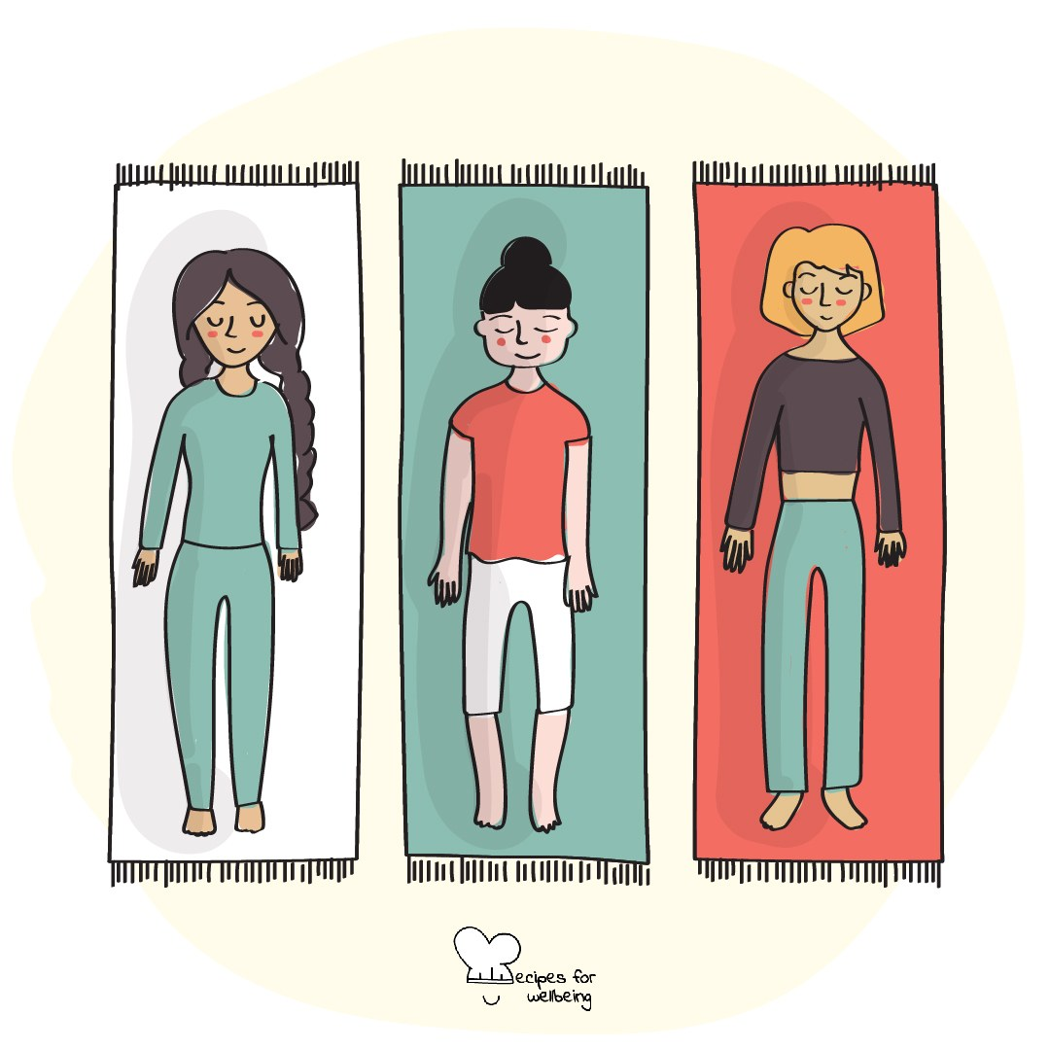
WHOLEBEING FOR EDUCATORS · LESSON
Returning to where you are
The skill of presence · one class period · ages 13 to 18
Project or adapt these slides freely — the full plan is in the DOCX.
Recipes for Wellbeing · CC BY-NC 4.0 · free for classroom use

Slide 2
THE BIG IDEA
Attention moves between memories, plans, screens and whatever is happening in front of us. Presence is the repeated practice of noticing where attention has gone and deciding whether to return. Nobody holds attention perfectly or empties the mind.
Recipes for Wellbeing · CC BY-NC 4.0 · free for classroom use · rfweducators.netlify.app/lessons/presence/

Slide 3
OPENER
Arriving here
1. Before we begin, take a moment to arrive in this room and sit in whatever way feels comfortable.
2. Let your attention rest on three things: a sound in the room, a sensation in your body and a thought passing through your mind.
3. You do not need to change any of them, because noticing is the whole practice.
4. When you are ready, bring your attention back to the room and look up.
Recipes for Wellbeing · CC BY-NC 4.0 · free for classroom use · rfweducators.netlify.app/lessons/presence/

Slide 4
TALK ABOUT IT
• What most often competes for people's attention?
• How does an absorbed experience differ from one met with divided attention?
• When might external rather than internal attention feel safer or more useful?
Recipes for Wellbeing · CC BY-NC 4.0 · free for classroom use · rfweducators.netlify.app/lessons/presence/

Slide 5
ACTIVITY · 16 MIN
Three ways back to now
1. Introduce anchors as present details that attention can rest on, with sitting, standing and movement available.
2. Try a contact anchor by noticing the floor, chair or another surface supporting the body for five seconds.
3. Try a sound anchor by identifying several separate sounds, or use visual details if listening closely is uncomfortable.
4. Try one ordinary breath without changing its depth or pace.
Recipes for Wellbeing · CC BY-NC 4.0 · free for classroom use · rfweducators.netlify.app/lessons/presence/

Slide 6
ACTIVITY · 16 MIN
Three ways back to now
5. In pairs, each person describes a neutral object for one minute while their partner listens. The task is detailed attention, not an impressive description.
6. Discuss how often attention wandered and how it returned, without ranking anyone's concentration.
Recipes for Wellbeing · CC BY-NC 4.0 · free for classroom use · rfweducators.netlify.app/lessons/presence/

Slide 7
REFLECT
Where does your attention become absorbed naturally, and which anchor might help when you want to return to what is in front of you?
Recipes for Wellbeing · CC BY-NC 4.0 · free for classroom use · rfweducators.netlify.app/lessons/presence/

Slide 8
Attention will wander again, because that is what minds do. Presence is the moment you notice and choose where to place it next.
Recipes for Wellbeing · CC BY-NC 4.0 · free for classroom use · rfweducators.netlify.app/lessons/presence/

Slide 9
BEFORE YOU GO
Exit ticket
1. What does presence mean, as explored in this lesson?
a) Feeling relaxed and happy at all times
b) Noticing when attention has drifted and bringing it back to the present moment
c) Predicting what will happen in the future
d) Remembering every detail of the past
2. According to the lesson, what is true when attention wanders and comes back many times?
a) The practice has failed and needs to start again
b) It shows the person is not good at presence
c) The mind should be emptied before trying again
d) Each return is part of the practice
3. Which of these is an example of an anchor used in the lesson to bring attention back to the present?
a) Feeling your feet pressing into the floor
b) Planning next weekend in detail
c) Replaying an earlier conversation
d) Scrolling through a phone
Recipes for Wellbeing · CC BY-NC 4.0 · free for classroom use · rfweducators.netlify.app/lessons/presence/

