Slide 1

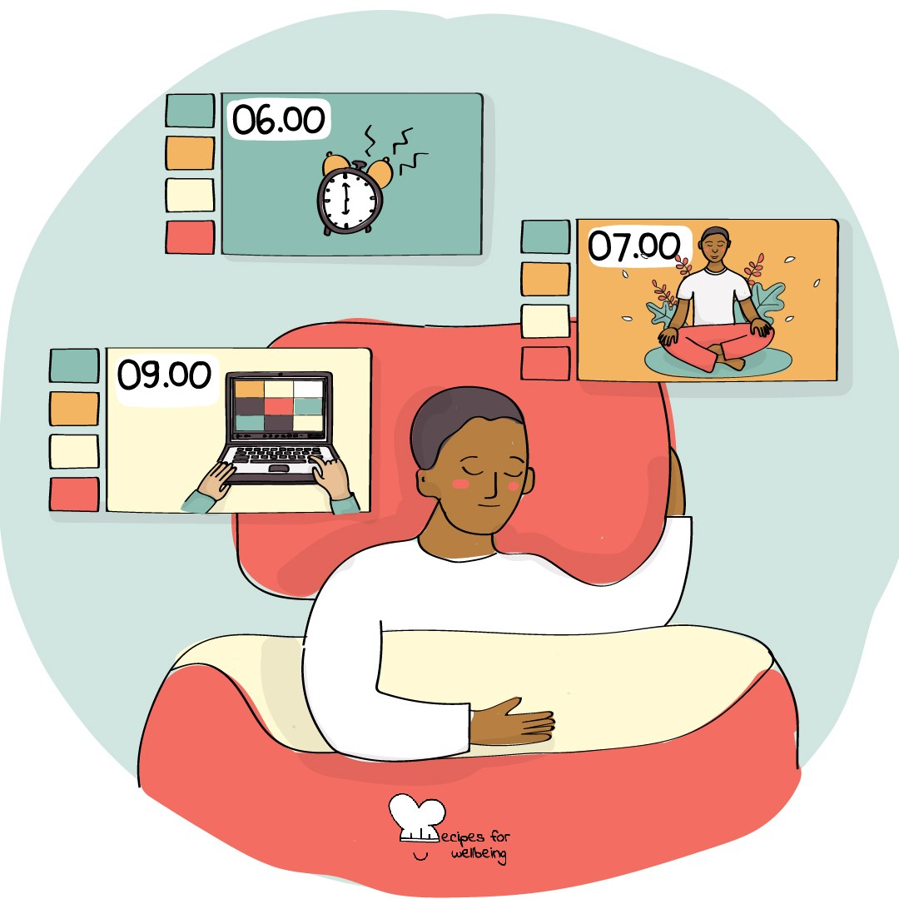
WHOLEBEING FOR EDUCATORS · LESSON
Making a little room
The skill of pausing · one class period · ages 13 to 18
Project or adapt these slides freely — the full plan is in the DOCX.
Recipes for Wellbeing · CC BY-NC 4.0 · free for classroom use

Slide 2
THE BIG IDEA
Many parts of the day arrive without a gap: one lesson follows another, messages ask for replies and a reaction can be expected immediately. A pause offers a small space in which nothing needs to be produced and the next response does not have to be automatic. The pressure around us stays. A pause may still give us time to notice what is needed.
Recipes for Wellbeing · CC BY-NC 4.0 · free for classroom use · rfweducators.netlify.app/lessons/pausing/

Slide 3
OPENER
Ninety seconds of nothing
1. For the next 90 seconds, there is nothing you need to produce and nothing you will be asked to show afterwards.
2. Let your eyes rest where they feel comfortable and allow your body to sit, shift or move as needed.
3. Your mind may call this pointless or remind you of something else, and you can notice the thought without following it.
4. I will keep the time so that you do not have to. We begin now.
Recipes for Wellbeing · CC BY-NC 4.0 · free for classroom use · rfweducators.netlify.app/lessons/pausing/

Slide 4
TALK ABOUT IT
• Where does the day leave little room between one demand and the next?
• Why can stopping feel uncomfortable or undeserved?
• When might a pause help before replying, and when is immediate action needed?
Recipes for Wellbeing · CC BY-NC 4.0 · free for classroom use · rfweducators.netlify.app/lessons/pausing/

Slide 5
ACTIVITY · 18 MIN
A menu of pauses
1. Explain that the class will try three pauses, with watching, adapting or passing available throughout.
2. First, trace a square while breathing at a comfortable pace. Students may remove every hold or trace while breathing normally.
3. Second, let the eyes look towards a distant point or close briefly if that feels safe. Avoid pressing or covering the eyes.
4. Third, place pens and devices down if possible and notice three sounds, or three visual details if sound is uncomfortable.
Recipes for Wellbeing · CC BY-NC 4.0 · free for classroom use · rfweducators.netlify.app/lessons/pausing/

Slide 6
ACTIVITY · 18 MIN
A menu of pauses
5. Students privately record which pauses felt usable, unusable or worth adapting, and where a minute may be possible.
6. Gather techniques rather than personal reactions, while noting that access to a pause also depends on timetables, spaces and adult expectations.
Recipes for Wellbeing · CC BY-NC 4.0 · free for classroom use · rfweducators.netlify.app/lessons/pausing/

Slide 7
REFLECT
If you had one minute tomorrow in which nothing needed to be completed, where might it fit and what kind of pause would feel possible there?
Recipes for Wellbeing · CC BY-NC 4.0 · free for classroom use · rfweducators.netlify.app/lessons/pausing/

Slide 8
A pause does not need to be long or productive to count. It can simply be a small piece of room before the day continues.
Recipes for Wellbeing · CC BY-NC 4.0 · free for classroom use · rfweducators.netlify.app/lessons/pausing/

Slide 9
BEFORE YOU GO
Exit ticket
1. What is pausing, as explored in this lesson?
a) Giving up on a task completely
b) Building small breaks into the day for rest, attention and choice
c) Sleeping for as long as possible
d) Avoiding all busyness in the day
2. According to the lesson, what may a pause create between an event and a response?
a) A guarantee that every reaction can be controlled
b) Extra time to argue with the other person
c) Some choice about how to respond
d) A reason to ignore the situation completely
3. Which of these was practised as a short pause in the 'A menu of pauses' activity?
a) Tracing a square while breathing at a comfortable pace
b) Running as fast as possible around the room
c) Writing a long essay about a stressful day
d) Checking messages on a phone
Recipes for Wellbeing · CC BY-NC 4.0 · free for classroom use · rfweducators.netlify.app/lessons/pausing/

