Slide 1

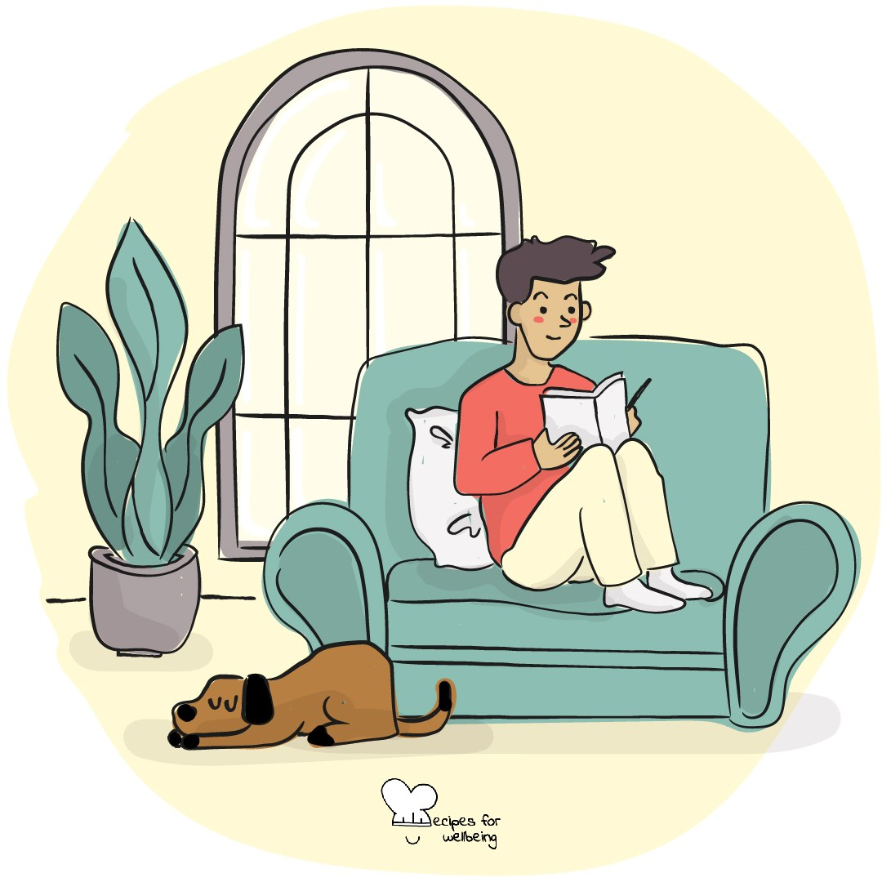
WHOLEBEING FOR EDUCATORS · LESSON
Letting an ordinary day count
The skill of ordinariness · one class period · ages 13 to 18
Project or adapt these slides freely — the full plan is in the DOCX.
Recipes for Wellbeing · CC BY-NC 4.0 · free for classroom use

Slide 2
THE BIG IDEA
Grades, applications, followers and public achievements can make ordinary life seem like the space between important events. Yet much of what holds a life is repeated and unremarkable: meals, journeys, familiar places, small kindnesses and time with other people. Ordinariness allows these parts to count without needing to turn them into highlights.
Recipes for Wellbeing · CC BY-NC 4.0 · free for classroom use · rfweducators.netlify.app/lessons/ordinariness/

Slide 3
OPENER
The done list
1. A to-do list keeps our attention on what remains, so before we leave we are going to notice some of what has already been done.
2. Count three things you did today on your fingers. Arriving in the room counts, and so does asking a question or making it through something difficult.
3. Take a moment to recognise the effort behind each one, including anything that other people may not have noticed.
4. Keep your items private or share one with a neighbour if you would like to.
Recipes for Wellbeing · CC BY-NC 4.0 · free for classroom use · rfweducators.netlify.app/lessons/ordinariness/

Slide 4
TALK ABOUT IT
• Where does pressure to be exceptional come from?
• What might highlight culture do to the way a normal day is experienced?
• Which ordinary parts of life deserve more care from schools and communities?
Recipes for Wellbeing · CC BY-NC 4.0 · free for classroom use · rfweducators.netlify.app/lessons/ordinariness/

Slide 5
ACTIVITY · 18 MIN
The ordinary gallery
1. Give each student two or three slips and invite general examples of ordinary moments that make life feel comfortable, interesting or connected.
2. Offer examples such as a familiar route, a warm drink, a song arriving at the right time or someone making space at a table.
3. Keep slips unsigned and free of private or identifying detail.
4. Groups read their slips without ranking them, then choose three that many kinds of people might recognise.
Recipes for Wellbeing · CC BY-NC 4.0 · free for classroom use · rfweducators.netlify.app/lessons/ordinariness/

Slide 6
ACTIVITY · 18 MIN
The ordinary gallery
5. Build a shared wall and read it quietly, noticing both common ground and different needs.
6. Ask which ordinary experience people your age are encouraged to overlook, and what would help it receive more care.
Recipes for Wellbeing · CC BY-NC 4.0 · free for classroom use · rfweducators.netlify.app/lessons/ordinariness/

Slide 7
REFLECT
What ordinary part of a normal day would you quietly miss if it disappeared? You do not need to explain or share it.
Recipes for Wellbeing · CC BY-NC 4.0 · free for classroom use · rfweducators.netlify.app/lessons/ordinariness/

Slide 8
Some days will hold milestones, while many will not. An ordinary day is part of the life those achievements sit in, and it counts too.
Recipes for Wellbeing · CC BY-NC 4.0 · free for classroom use · rfweducators.netlify.app/lessons/ordinariness/

Slide 9
BEFORE YOU GO
Exit ticket
1. What does the skill of ordinariness mean in this lesson?
a) Achieving something impressive every day
b) Noticing that ordinary, everyday moments can be genuinely valuable
c) Comparing yourself to other people less often
d) Avoiding all challenges and effort
2. According to the lesson, what idea does ordinariness push back against?
a) That friendships take a long time to build
b) That school days should be shorter
c) That a person must be exceptional, visible or always improving to deserve care and belonging
d) That everyone should enjoy the same hobbies
3. In The ordinary gallery activity, what kind of moment did students write on their slips?
a) A big personal achievement they were proud of
b) A private secret they had never told anyone
c) A general ordinary moment that makes life feel comfortable, interesting or connected
d) A complaint about something that had gone wrong that day
Recipes for Wellbeing · CC BY-NC 4.0 · free for classroom use · rfweducators.netlify.app/lessons/ordinariness/

