Slide 1

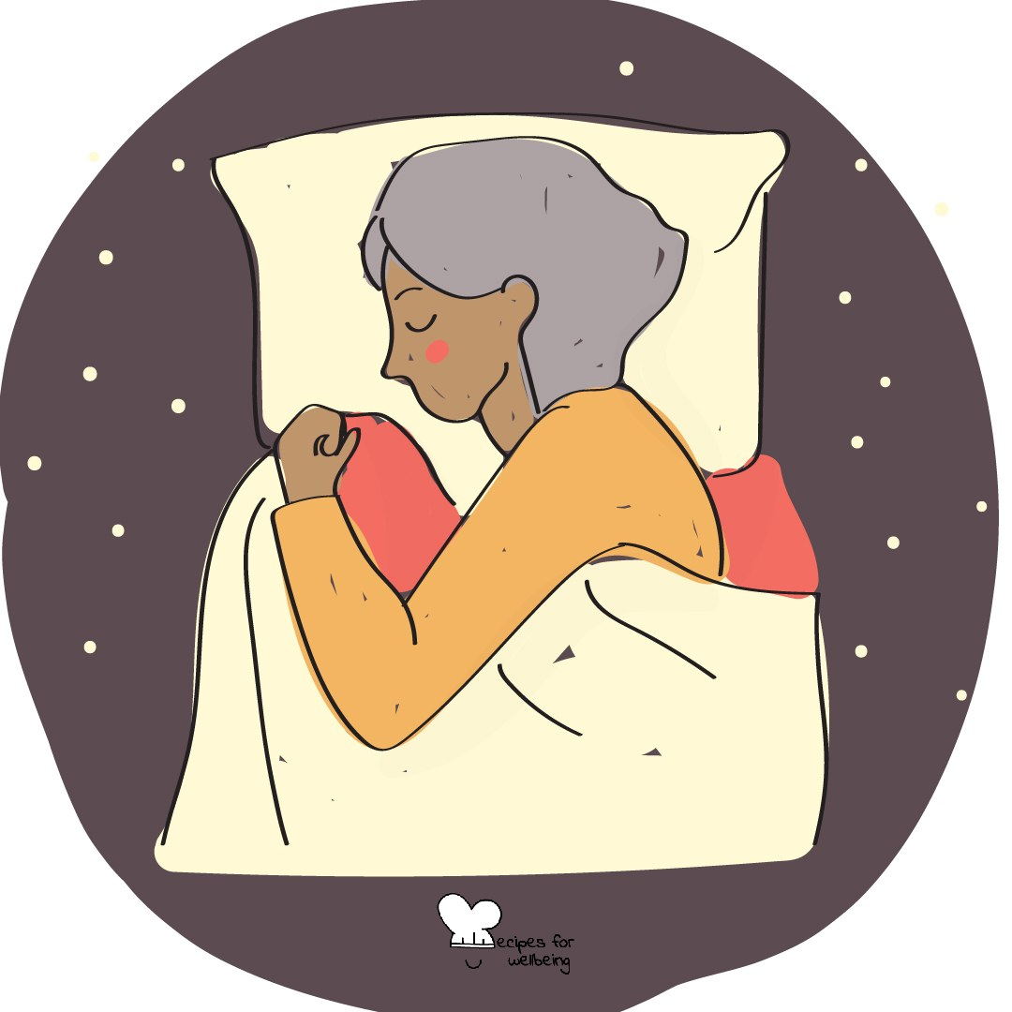
WHOLEBEING FOR EDUCATORS · LESSON
Rest without having to earn it
The skill of non-performing · one class period · ages 13 to 18
Project or adapt these slides freely — the full plan is in the DOCX.
Recipes for Wellbeing · CC BY-NC 4.0 · free for classroom use

Slide 2
THE BIG IDEA
School, work and online life can make worth feel tied to output, responsiveness and achievement. Non-performing reminds us that a person remains worthy when nothing is being produced or improved. Rest is a foundation of life. It does not have to earn its place by sending us back to work with more energy.
Recipes for Wellbeing · CC BY-NC 4.0 · free for classroom use · rfweducators.netlify.app/lessons/non-performing/

Slide 3
OPENER
The do-nothing minute
1. Some days ask a great deal of us, so for one minute this class will ask for nothing to be produced.
2. Sit, shift, doodle or let your eyes rest somewhere comfortable. You do not need to look calm or hold yourself still.
3. If your mind calls the minute a waste, notice the thought without arguing with it.
4. I will keep the time, and when it ends we will begin gently rather than testing how quickly anyone can return.
Recipes for Wellbeing · CC BY-NC 4.0 · free for classroom use · rfweducators.netlify.app/lessons/non-performing/

Slide 4
TALK ABOUT IT
• Where does pressure to stay useful or responsive come from?
• Why can doing nothing feel uncomfortable or guilty?
• What would a school that treated rest as foundational do differently?
Recipes for Wellbeing · CC BY-NC 4.0 · free for classroom use · rfweducators.netlify.app/lessons/non-performing/

Slide 5
ACTIVITY · 15 MIN
A menu with no useful outcome
1. Ask each group to create a menu of small, safe and enjoyable activities that do not need to achieve or improve anything.
2. Offer examples such as watching clouds, doodling without a plan, listening to one song or feeling sunlight on the face.
3. Include options for different bodies, sensory needs, living situations, budgets and levels of available time.
4. Ask which items may be difficult to allow without guilt and where that guilt may have been learned.
Recipes for Wellbeing · CC BY-NC 4.0 · free for classroom use · rfweducators.netlify.app/lessons/non-performing/

Slide 6
ACTIVITY · 15 MIN
A menu with no useful outcome
5. Name the difference between a personal pause and the structural need for humane workloads, breaks and access to rest.
6. Gather one idea from each group, then let students privately choose one, reject the menu or add their own.
Recipes for Wellbeing · CC BY-NC 4.0 · free for classroom use · rfweducators.netlify.app/lessons/non-performing/

Slide 7
REFLECT
Where do people your age meet pressure to be productive, and what is one form of rest that could be allowed to matter without becoming useful?
Recipes for Wellbeing · CC BY-NC 4.0 · free for classroom use · rfweducators.netlify.app/lessons/non-performing/

Slide 8
Nothing in the opening minute needed to be earned. Your value did not rise or fall with what you produced, and rest does not need to repay the time it takes.
Recipes for Wellbeing · CC BY-NC 4.0 · free for classroom use · rfweducators.netlify.app/lessons/non-performing/

Slide 9
BEFORE YOU GO
Exit ticket
1. According to the lesson, what is "non-performing" mainly about?
a) Avoiding responsibilities whenever possible
b) Being lazy instead of getting things done
c) Resting without needing to earn it through being useful or productive
d) Achieving more in less time
2. How does the lesson describe non-performing?
a) Avoiding every responsibility
b) Stepping out of the demand to demonstrate value for a while
c) Denying that work can carry meaning
d) Getting more done in less time
3. What point does the lesson make about rest?
a) Rest only counts if it makes you more productive afterwards
b) Rest has to be earned by finishing your to-do list first
c) Rest is only for people who are exhausted
d) Rest can count on its own, without needing to earn its place
Recipes for Wellbeing · CC BY-NC 4.0 · free for classroom use · rfweducators.netlify.app/lessons/non-performing/

