Slide 1

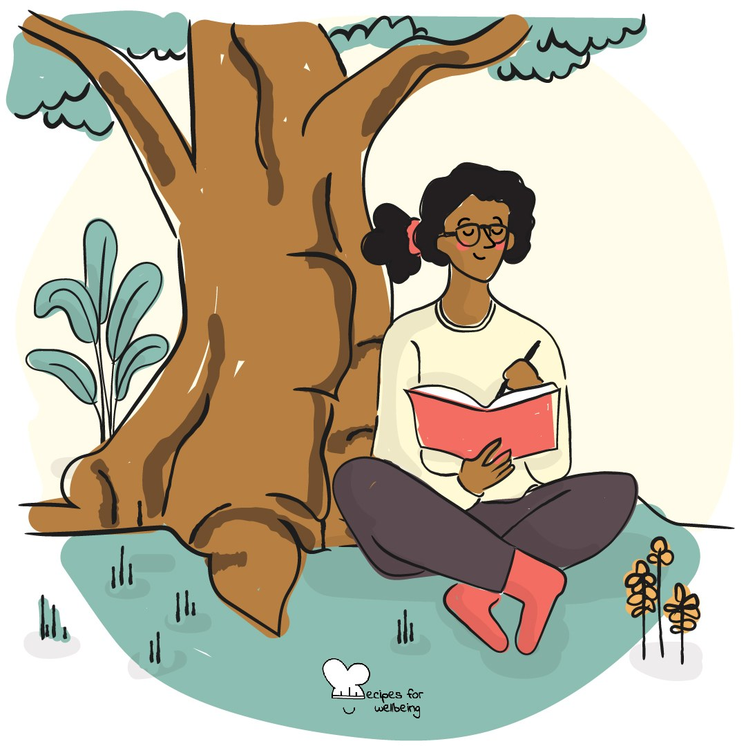
WHOLEBEING FOR EDUCATORS · LESSON
Belonging to the living world
The skill of nature kinship · one class period · ages 13 to 18
Project or adapt these slides freely — the full plan is in the DOCX.
Recipes for Wellbeing · CC BY-NC 4.0 · free for classroom use

Slide 2
THE BIG IDEA
The living world continues within and around busy school days, even when our attention is elsewhere. Noticing one living thing can remind us that human life depends on wider relationships with air, water, soil, plants and other species. Connection does not require access to a dramatic landscape; it can begin with what is already nearby.
Recipes for Wellbeing · CC BY-NC 4.0 · free for classroom use · rfweducators.netlify.app/lessons/nature-sensitivity/

Slide 3
OPENER
One sign of spring
1. The season is changing around us, whether the signs are obvious or easy to miss.
2. Find one sign you have noticed recently, or look through the window for one now.
3. Hold the detail in mind for a moment without asking it to mean anything more.
4. If you would like to, offer your sign in three words or fewer. Passing is welcome.
Recipes for Wellbeing · CC BY-NC 4.0 · free for classroom use · rfweducators.netlify.app/lessons/nature-sensitivity/

Slide 4
TALK ABOUT IT
• Where does the living world appear in an ordinary day, including in cities and indoors?
• What changes when people speak of belonging to nature instead of visiting it?
• Who has access to clean, safe and biodiverse spaces, and who is responsible for that access?
Recipes for Wellbeing · CC BY-NC 4.0 · free for classroom use · rfweducators.netlify.app/lessons/nature-sensitivity/

Slide 5
ACTIVITY · 18 MIN
Meet one living thing
1. Give each group one nearby or pictured living thing, such as a tree, bird, insect, moss or classroom plant.
2. Spend two quiet minutes observing colour, shape, movement, surroundings and change. Separate what can be observed from what is imagined.
3. Create a short profile of what the organism may need, what relationships sustain it and what it contributes to its surroundings.
4. Trace one connection between its life and human life, avoiding claims the group cannot support.
Recipes for Wellbeing · CC BY-NC 4.0 · free for classroom use · rfweducators.netlify.app/lessons/nature-sensitivity/

Slide 6
ACTIVITY · 18 MIN
Meet one living thing
5. As a creative option, write one or two lines the living thing might say to the school or city, clearly naming this as imagination.
6. Share one observation or connection from each group and collect questions that remain.
Recipes for Wellbeing · CC BY-NC 4.0 · free for classroom use · rfweducators.netlify.app/lessons/nature-sensitivity/

Slide 7
REFLECT
What is one small and possible way to remain in contact with the living world during a busy day, and what conditions would make that easier?
Recipes for Wellbeing · CC BY-NC 4.0 · free for classroom use · rfweducators.netlify.app/lessons/nature-sensitivity/

Slide 8
The living world does not begin at the edge of a city or a school. It is already part of the air, water, food and relationships that hold this day.
Recipes for Wellbeing · CC BY-NC 4.0 · free for classroom use · rfweducators.netlify.app/lessons/nature-sensitivity/

Slide 9
BEFORE YOU GO
Exit ticket
1. According to the lesson, what does nature sensitivity mean?
a) Admiring nature from a distance as scenery
b) Studying plants and animals scientifically
c) Recognising the living world as a relationship rather than scenery
d) Visiting wild, untouched places regularly
2. What does the lesson say about where connection with the living world can begin?
a) Only in dramatic landscapes such as forests or mountains
b) Only with animals, never plants
c) Only once nature's harsher sides, such as decay, are ignored
d) With what is already nearby, without needing a dramatic landscape
3. In Meet one living thing, what are groups asked to separate while observing?
a) What can be observed from what is imagined
b) Plants from animals
c) Beautiful features from ugly ones
d) Native species from introduced species
Recipes for Wellbeing · CC BY-NC 4.0 · free for classroom use · rfweducators.netlify.app/lessons/nature-sensitivity/

