Slide 1

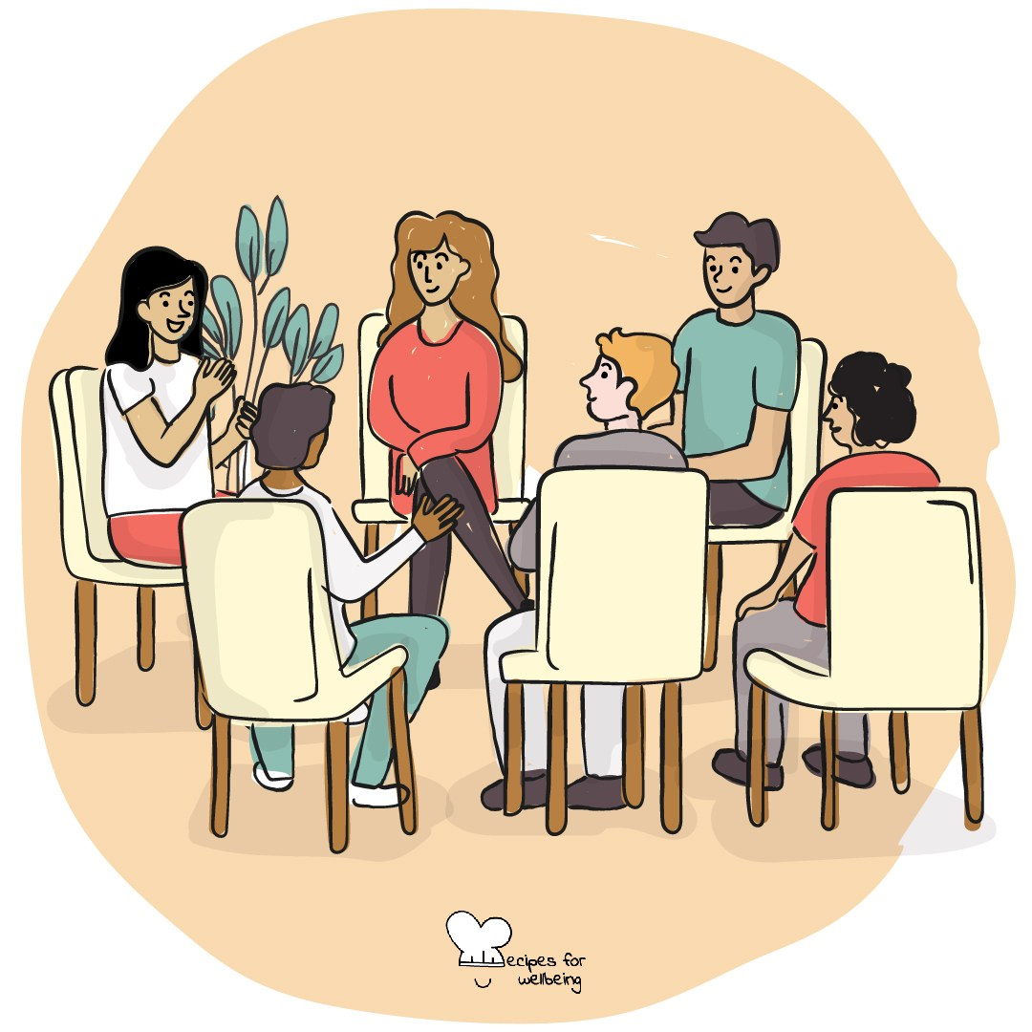
WHOLEBEING FOR EDUCATORS · LESSON
What it means to be heard
The skill of hosting conversations · one class period · ages 13 to 18
Project or adapt these slides freely — the full plan is in the DOCX.
Recipes for Wellbeing · CC BY-NC 4.0 · free for classroom use

Slide 2
THE BIG IDEA
Many conversations happen beside notifications, tiredness and the pressure to prepare a reply. Listening well means giving enough attention to understand what another person is trying to say. It will not settle every disagreement. It can make a conversation more accurate and more human.
Recipes for Wellbeing · CC BY-NC 4.0 · free for classroom use · rfweducators.netlify.app/lessons/listening/

Slide 3
OPENER
One word for the road
1. As we begin, find one word for how you are arriving today. Ordinary words such as tired, hungry or unsure are welcome.
2. Nobody needs to explain, and we will not respond to one another's words.
3. You can offer your word when it reaches you or say "pass".
4. Listen as the words travel through the room and allow each one to remain with the person who offered it.
Recipes for Wellbeing · CC BY-NC 4.0 · free for classroom use · rfweducators.netlify.app/lessons/listening/

Slide 4
TALK ABOUT IT
• What do people do that shows they are listening, and which signs may vary between people or cultures?
• What commonly pulls attention away from a conversation?
• How can someone repair a moment when they realise they stopped listening?
Recipes for Wellbeing · CC BY-NC 4.0 · free for classroom use · rfweducators.netlify.app/lessons/listening/

Slide 5
ACTIVITY · 18 MIN
An uninterrupted 90 seconds
1. Arrange pairs and offer light topics, such as a film to recommend, an ideal Saturday or something ordinary to look forward to. Students may choose another safe topic or pass.
2. Partner A speaks for up to 90 seconds while Partner B listens without interrupting, advising or moving the conversation to their own experience.
3. Partner B reflects one sentence beginning, "What I heard was..." or "What seemed important in what you said was..."
4. The speaker can correct the reflection, and the listener may ask one open question if it is welcome.
Recipes for Wellbeing · CC BY-NC 4.0 · free for classroom use · rfweducators.netlify.app/lessons/listening/

Slide 6
ACTIVITY · 18 MIN
An uninterrupted 90 seconds
5. Swap roles and repeat.
6. Discuss the process rather than the content: what supported attention, when did it wander and how did the listener return?
Recipes for Wellbeing · CC BY-NC 4.0 · free for classroom use · rfweducators.netlify.app/lessons/listening/

Slide 7
REFLECT
What tends to pull your attention away in a conversation, and what could help you return honestly when you notice it happening?
Recipes for Wellbeing · CC BY-NC 4.0 · free for classroom use · rfweducators.netlify.app/lessons/listening/

Slide 8
Full attention will not be possible in every moment. Listening is the practice of coming back, and letting the other person finish their own thought.
Recipes for Wellbeing · CC BY-NC 4.0 · free for classroom use · rfweducators.netlify.app/lessons/listening/

Slide 9
BEFORE YOU GO
Exit ticket
1. What does the lesson say listening well means?
a) Giving enough attention to understand what another person is trying to say
b) Agreeing with everything the other person says
c) Planning a clever reply while they talk
d) Settling every disagreement
2. What does the lesson say to do when our attention wanders while listening?
a) Pretend we heard what we missed
b) End the conversation
c) Come back honestly
d) Change the subject to our own experience
3. In the listening activity, what is the listener asked to do once their partner finishes speaking?
a) Give advice on how to solve the problem
b) Share a similar story of their own
c) Reflect back one sentence, such as "What I heard was..."
d) Move straight on to swap roles without responding
Recipes for Wellbeing · CC BY-NC 4.0 · free for classroom use · rfweducators.netlify.app/lessons/listening/

