Slide 1

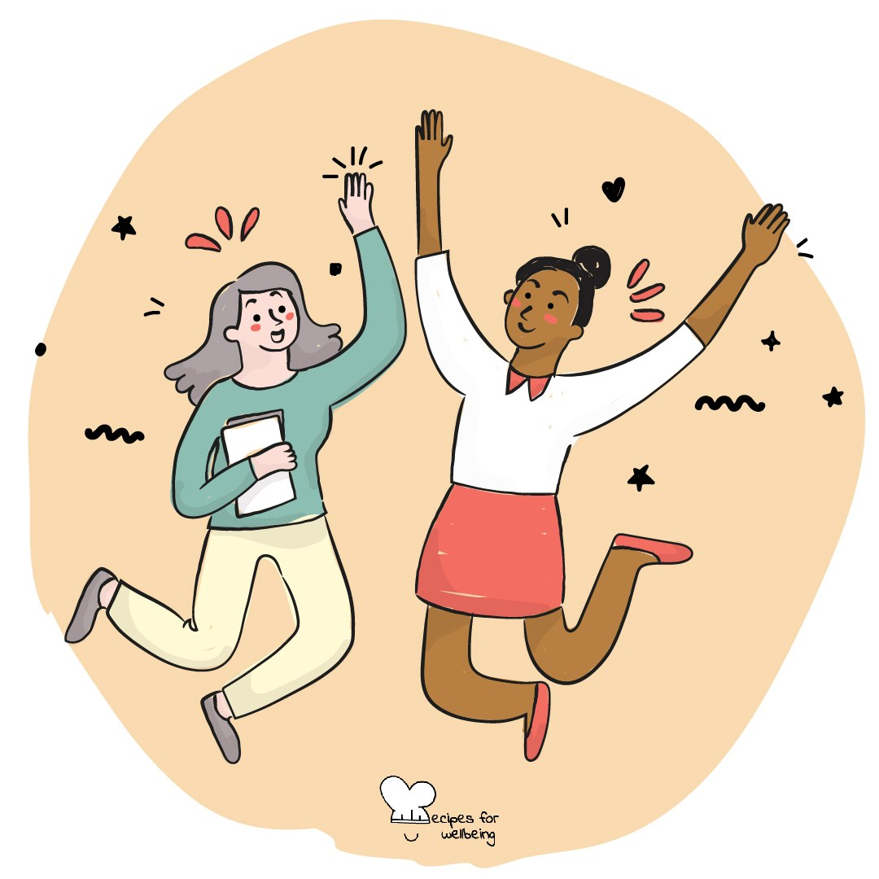
WHOLEBEING FOR EDUCATORS · LESSON
A small thing that helps
The skill of compassion · one class period · ages 13 to 18
Project or adapt these slides freely — the full plan is in the DOCX.
Recipes for Wellbeing · CC BY-NC 4.0 · free for classroom use

Slide 2
THE BIG IDEA
We rarely know everything another person is carrying. Kindness is an ordinary response that says their experience matters, whether through attention, practical help or a respectful gesture. It can be offered to ourselves too, especially when the usual inner response is harsh.
Recipes for Wellbeing · CC BY-NC 4.0 · free for classroom use · rfweducators.netlify.app/lessons/kindness/

Slide 3
OPENER
One breath for you, one for them
1. Take one comfortable breath and offer yourself something you need today, such as patience, steadiness or a little room.
2. Bring to mind someone who could use a kind day, without saying who they are.
3. As you breathe out normally, offer them a quiet wish in words that feel natural to you.
4. Repeat once or twice, keeping the wish with yourself whenever that feels safer.
Recipes for Wellbeing · CC BY-NC 4.0 · free for classroom use · rfweducators.netlify.app/lessons/kindness/

Slide 4
TALK ABOUT IT
• What small actions can make an ordinary day easier for another person?
• Why might someone hold back from offering or receiving kindness?
• How can we find out whether a person wants listening, practical help or space?
Recipes for Wellbeing · CC BY-NC 4.0 · free for classroom use · rfweducators.netlify.app/lessons/kindness/

Slide 5
ACTIVITY · 18 MIN
What might help?
1. Give each group several fictional situations, such as a student receiving a disappointing result, sitting alone, regretting an argument or arriving after a difficult morning.
2. For each situation, list responses that may minimise, embarrass or take over, and explain why they may not help.
3. Write one respectful question that could help the character say what they need.
4. Offer two possible responses: one small practical action and one way of staying alongside without fixing.
Recipes for Wellbeing · CC BY-NC 4.0 · free for classroom use · rfweducators.netlify.app/lessons/kindness/

Slide 6
ACTIVITY · 18 MIN
What might help?
5. Add a scenario in which the character speaks harshly to themselves. Students privately draft what they would say to a friend in the same position.
6. Gather one response from each group and notice how the most useful ideas leave room for the other person's choice.
Recipes for Wellbeing · CC BY-NC 4.0 · free for classroom use · rfweducators.netlify.app/lessons/kindness/

Slide 7
REFLECT
Think of one small kindness you could offer to yourself or someone else in the next few days. What would make it caring, realistic and free of pressure?
Recipes for Wellbeing · CC BY-NC 4.0 · free for classroom use · rfweducators.netlify.app/lessons/kindness/

Slide 8
We will not always know what another person is carrying, and we will not always be able to change it. We can still ask, and offer one small thing with care.
Recipes for Wellbeing · CC BY-NC 4.0 · free for classroom use · rfweducators.netlify.app/lessons/kindness/

Slide 9
BEFORE YOU GO
Exit ticket
1. According to the lesson, what does a kind intention still need?
a) A big gesture to show it is sincere
b) Consent and judgement
c) A promise to fix the whole problem
d) Someone else's approval first
2. Which of these does the lesson describe as genuine kindness in a hard moment?
a) Rushing in to fix the whole problem for someone
b) Telling someone to just cheer up
c) Noticing and offering one small thing that brings a bit of relief
d) Avoiding the person so things do not get worse
3. The lesson says kindness can be offered to ourselves too, especially when...
a) We already feel fine
b) Other people are watching
c) We have finished helping everyone else
d) Our usual inner response is harsh
Recipes for Wellbeing · CC BY-NC 4.0 · free for classroom use · rfweducators.netlify.app/lessons/kindness/

