Slide 1

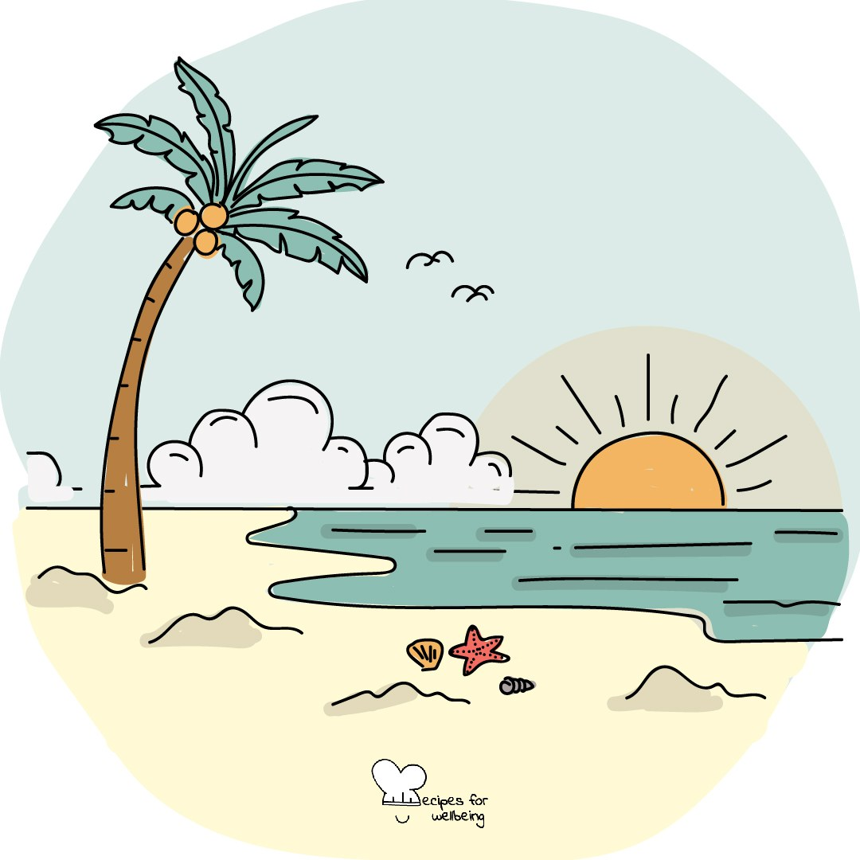
WHOLEBEING FOR EDUCATORS · LESSON
Making room for what brings you alive
The skill of zest · one class period · ages 13 to 18
Project or adapt these slides freely — the full plan is in the DOCX.
Recipes for Wellbeing · CC BY-NC 4.0 · free for classroom use

Slide 2
THE BIG IDEA
Joy can become something we postpone until the work is finished or life feels easier. This lesson treats it as part of a whole life rather than a reward for coping well. Joy does not cancel grief, stress or injustice, and no one is required to find it on demand.
Recipes for Wellbeing · CC BY-NC 4.0 · free for classroom use · rfweducators.netlify.app/lessons/joy/

Slide 3
OPENER
Hardwiring the good
1. Our attention can stay with what went wrong while an ordinary good moment passes quickly, so this practice gives one of those moments a little more time.
2. Recall something good from the last day or two, such as warmth from the sun, a welcome message or food you enjoyed.
3. Revisit the moment for twenty seconds and remember where you were, what happened and what made it feel good to you. A neutral detail in the room is also available if no memory comes to mind.
4. When the time ends, let the memory or detail go and notice what it was like to stay with it for a little longer.
Recipes for Wellbeing · CC BY-NC 4.0 · free for classroom use · rfweducators.netlify.app/lessons/joy/

Slide 4
TALK ABOUT IT
• Why is enjoyment often treated as something to earn after the work is done?
• What kinds of ordinary experiences bring people your age a sense of aliveness?
• How can a group make room for joy without demanding a cheerful mood?
Recipes for Wellbeing · CC BY-NC 4.0 · free for classroom use · rfweducators.netlify.app/lessons/joy/

Slide 5
ACTIVITY · 15 MIN
A menu of sparks
1. Explain that each student will make a private menu of small experiences that bring enjoyment, interest, comfort or energy. The page is not collected.
2. Offer three headings: quick sparks that take two minutes or less, larger sparks that need more time, and sparks that cost no money.
3. Add optional prompts involving beauty, trying something new, movement, rest, creativity, nature or time with people who feel safe.
4. In pairs, students may offer one idea they are happy for someone else to borrow. Passing needs no explanation.
Recipes for Wellbeing · CC BY-NC 4.0 · free for classroom use · rfweducators.netlify.app/lessons/joy/

Slide 6
ACTIVITY · 15 MIN
A menu of sparks
5. Gather anonymous ideas on the board to create a shared menu without attaching names.
6. Students privately mark one idea they would like to make room for, or note what currently makes joy difficult to reach.
Recipes for Wellbeing · CC BY-NC 4.0 · free for classroom use · rfweducators.netlify.app/lessons/joy/

Slide 7
REFLECT
Complete privately: "One spark I would like to make a little more room for is..." Then notice what may support or crowd out that possibility.
Recipes for Wellbeing · CC BY-NC 4.0 · free for classroom use · rfweducators.netlify.app/lessons/joy/

Slide 8
Joy does not have to wait until everything is resolved. When it is available, we can let an ordinary moment matter without asking it to carry the whole day.
Recipes for Wellbeing · CC BY-NC 4.0 · free for classroom use · rfweducators.netlify.app/lessons/joy/

Slide 9
BEFORE YOU GO
Exit ticket
1. How does this lesson treat joy?
a) As a reward for coping well
b) As something to wait for until the work is finished
c) As something everyone should find on demand
d) As part of a whole life, which does not cancel grief, stress or injustice
2. In Hardwiring the good, why does the practice ask us to revisit a good moment for twenty seconds?
a) To turn it into a story to share with others
b) Ordinary good moments can pass quickly while attention stays with what went wrong
c) To prove that only big achievements count as joy
d) To push away a difficult feeling from earlier
3. What are the three headings in A menu of sparks?
a) Quick sparks, larger sparks and sparks that cost no money
b) Morning sparks, evening sparks and weekend sparks
c) Happy sparks, calm sparks and exciting sparks
d) Sparks for school, sparks for home and sparks for friends
Recipes for Wellbeing · CC BY-NC 4.0 · free for classroom use · rfweducators.netlify.app/lessons/joy/

