Slide 1

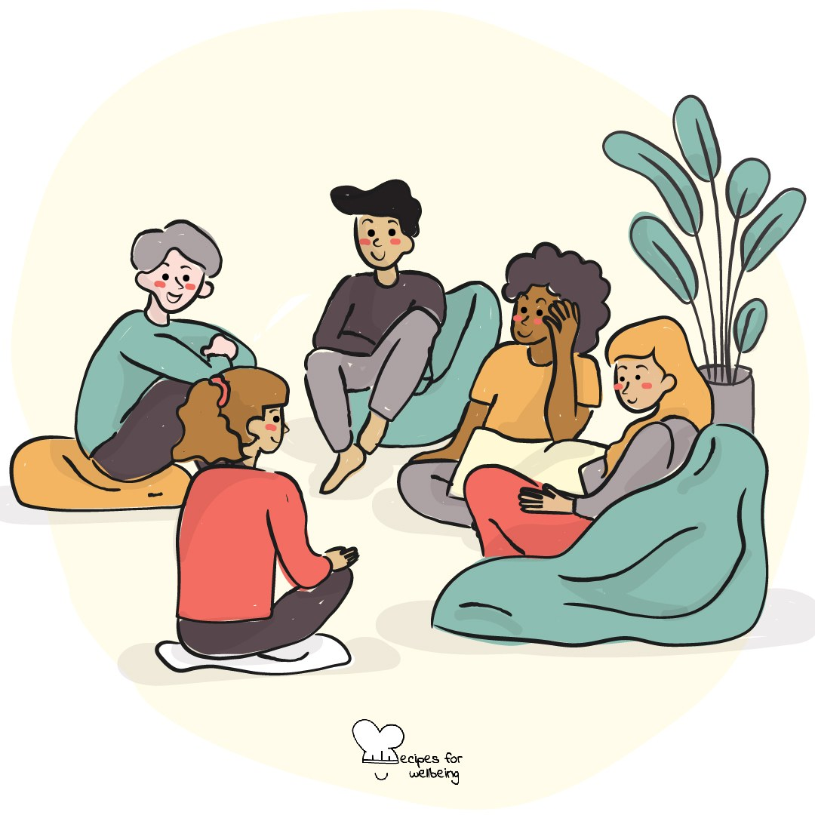
WHOLEBEING FOR EDUCATORS · LESSON
Looking beneath the first answer
The skill of sense-making · one class period · ages 13 to 18
Project or adapt these slides freely — the full plan is in the DOCX.
Recipes for Wellbeing · CC BY-NC 4.0 · free for classroom use

Slide 2
THE BIG IDEA
The first explanation for a confusing event can feel convincing because it arrives quickly. Inquiry asks us to slow down, notice our assumptions and look from more than one position. This can help us understand people and situations more fairly, while accepting that some uncertainty may remain.
Recipes for Wellbeing · CC BY-NC 4.0 · free for classroom use · rfweducators.netlify.app/lessons/inquiry/

Slide 3
OPENER
A question with no answer
1. Here is a question no one in this room can get wrong: what is something many people believe that may not be true?
2. Sit with the question without looking for the answer you think I want.
3. Notice what your mind does when a question cannot be finished quickly.
4. If you would like to, offer one half-formed thought to a neighbour. Passing is equally welcome.
Recipes for Wellbeing · CC BY-NC 4.0 · free for classroom use · rfweducators.netlify.app/lessons/inquiry/

Slide 4
TALK ABOUT IT
• How can we tell a quick opinion from a developed understanding?
• Why are simple explanations attractive when a situation is complicated?
• When is more inquiry useful, and when is timely action needed?
Recipes for Wellbeing · CC BY-NC 4.0 · free for classroom use · rfweducators.netlify.app/lessons/inquiry/

Slide 5
ACTIVITY · 17 MIN
The root-question tree
1. Give each group an external scenario, such as an unexpected school rule, a sudden online trend, a shop closing or two reports describing the same event differently.
2. Write the first conclusion someone might reach, then set it aside as one possible interpretation.
3. Generate as many genuine questions as possible for three minutes without answering them.
4. Draw a tree and place factual surface questions on the leaves and questions about causes, power, assumptions or perspectives on the roots.
Recipes for Wellbeing · CC BY-NC 4.0 · free for classroom use · rfweducators.netlify.app/lessons/inquiry/

Slide 6
ACTIVITY · 17 MIN
The root-question tree
5. Choose one root question and examine it from two positions within the scenario. Note what evidence each person might see or miss.
6. Each group shares one question and one way its understanding changed or remained uncertain.
Recipes for Wellbeing · CC BY-NC 4.0 · free for classroom use · rfweducators.netlify.app/lessons/inquiry/

Slide 7
REFLECT
What question could help you look beneath the surface the next time something feels confusing? Keep the situation itself private.
Recipes for Wellbeing · CC BY-NC 4.0 · free for classroom use · rfweducators.netlify.app/lessons/inquiry/

Slide 8
Inquiry does not ask us to have every answer. It asks us to stay with the question long enough to see what our first explanation left out.
Recipes for Wellbeing · CC BY-NC 4.0 · free for classroom use · rfweducators.netlify.app/lessons/inquiry/

Slide 9
BEFORE YOU GO
Exit ticket
1. What does the lesson mean by inquiry?
a) Waiting for someone else to explain what happened
b) Choosing to understand something confusing properly instead of grabbing the first explanation
c) Deciding immediately who is to blame in a situation
d) Only asking questions you already know the answer to
2. In the root-question tree activity, where do the deeper 'what is really going on underneath' questions go?
a) On the leaves
b) On the roots
c) In the trunk
d) They get crossed out
3. According to the lesson, why can the first explanation for a confusing event feel convincing?
a) It is usually the most accurate one
b) Someone with authority has always checked it
c) It arrives quickly
d) It includes every point of view
Recipes for Wellbeing · CC BY-NC 4.0 · free for classroom use · rfweducators.netlify.app/lessons/inquiry/

