Slide 1

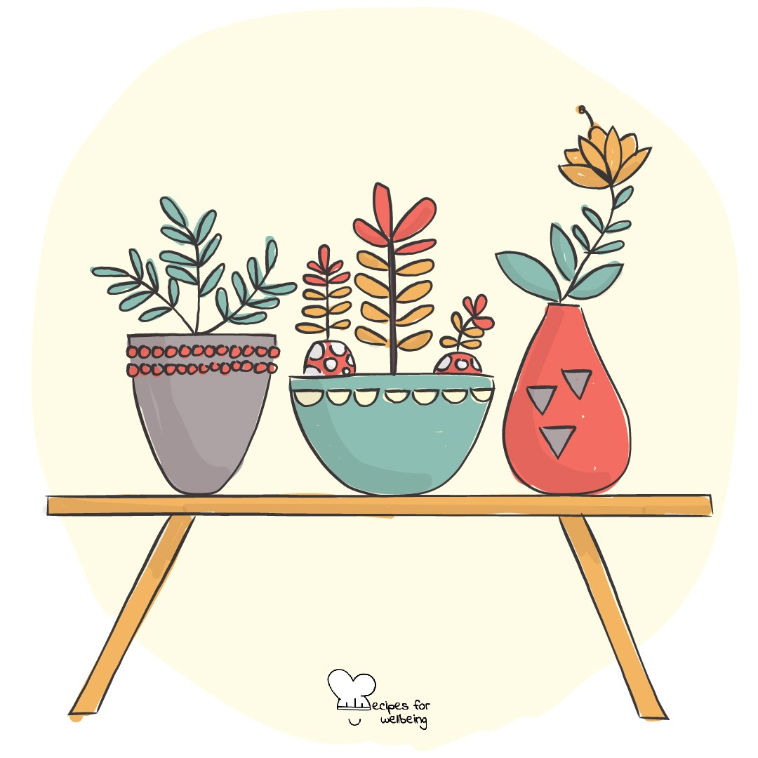
WHOLEBEING FOR EDUCATORS · LESSON
Noticing what is already here
The skill of celebration · one class period · ages 13 to 18
Project or adapt these slides freely — the full plan is in the DOCX.
Recipes for Wellbeing · CC BY-NC 4.0 · free for classroom use

Slide 2
THE BIG IDEA
Deadlines, comparison and worry can take up much of our attention, while ordinary sources of support pass without being named. Gratitude gives some attention to what is sustaining, welcome or good. It does not require anyone to feel positive, ignore injustice or be thankful for a difficult experience.
Recipes for Wellbeing · CC BY-NC 4.0 · free for classroom use · rfweducators.netlify.app/lessons/gratitude/

Slide 3
OPENER
Three good things
1. Before we continue, bring to mind three small things that went well or felt welcome today. They can be ordinary and do not need to matter to anyone else.
2. If you are comfortable, share one with the person next to you and listen to one of theirs.
3. Keep the other two for yourself, or keep all three private if that is what you need today.
4. If nothing comes to mind, you can simply notice that without forcing an answer.
Recipes for Wellbeing · CC BY-NC 4.0 · free for classroom use · rfweducators.netlify.app/lessons/gratitude/

Slide 4
TALK ABOUT IT
• Which ordinary forms of care or work often go unnoticed?
• What makes gratitude feel sincere rather than forced?
• When can asking for gratitude become unhelpful or unfair?
Recipes for Wellbeing · CC BY-NC 4.0 · free for classroom use · rfweducators.netlify.app/lessons/gratitude/

Slide 5
ACTIVITY · 15 MIN
What often goes unthanked
1. Invite students to notice ordinary things that support a day. Make clear that a blank slip is acceptable.
2. Offer prompts: something that made this week easier; an object or service you would miss; a role whose work often goes unseen; or a place that feels comfortable enough.
3. Students write one response per slip without names or identifying details.
4. Mix the slips on a shared board so authorship cannot be traced.
Recipes for Wellbeing · CC BY-NC 4.0 · free for classroom use · rfweducators.netlify.app/lessons/gratitude/

Slide 6
ACTIVITY · 15 MIN
What often goes unthanked
5. Read a selection or offer a slow gallery walk, noticing both repeated and different forms of appreciation.
6. Invite one final anonymous addition inspired by something another person noticed, without suggesting that the room should now feel a particular way.
Recipes for Wellbeing · CC BY-NC 4.0 · free for classroom use · rfweducators.netlify.app/lessons/gratitude/

Slide 7
REFLECT
Choose one small good you would like to notice for a little longer today or tomorrow. What do you appreciate about it, and what does it leave unchanged?
Recipes for Wellbeing · CC BY-NC 4.0 · free for classroom use · rfweducators.netlify.app/lessons/gratitude/

Slide 8
The things we named were already part of the day. Gratitude was the pause that allowed us to see them, while everything difficult and unfinished remained part of the picture too.
Recipes for Wellbeing · CC BY-NC 4.0 · free for classroom use · rfweducators.netlify.app/lessons/gratitude/

Slide 9
BEFORE YOU GO
Exit ticket
1. How does the lesson describe gratitude?
a) A way of noticing what we value, receive or would miss
b) Pretending everything in life is great
c) Saying thank you only to be polite
d) Focusing on problems so we can fix them
2. According to the lesson, why can ordinary sources of support pass without being named?
a) Good things happen far less often than bad things
b) Gratitude only counts for big events
c) Deadlines, comparison and worry can take up much of our attention
d) Ordinary things are rarely good
3. What does the lesson say about gratitude and discomfort?
a) Gratitude should be used to end a difficult conversation
b) They can exist together, and noticing support does not remove the need to change unfair conditions
c) Gratitude means being thankful for every hard experience
d) Discomfort must go away before gratitude is possible
Recipes for Wellbeing · CC BY-NC 4.0 · free for classroom use · rfweducators.netlify.app/lessons/gratitude/

