Slide 1

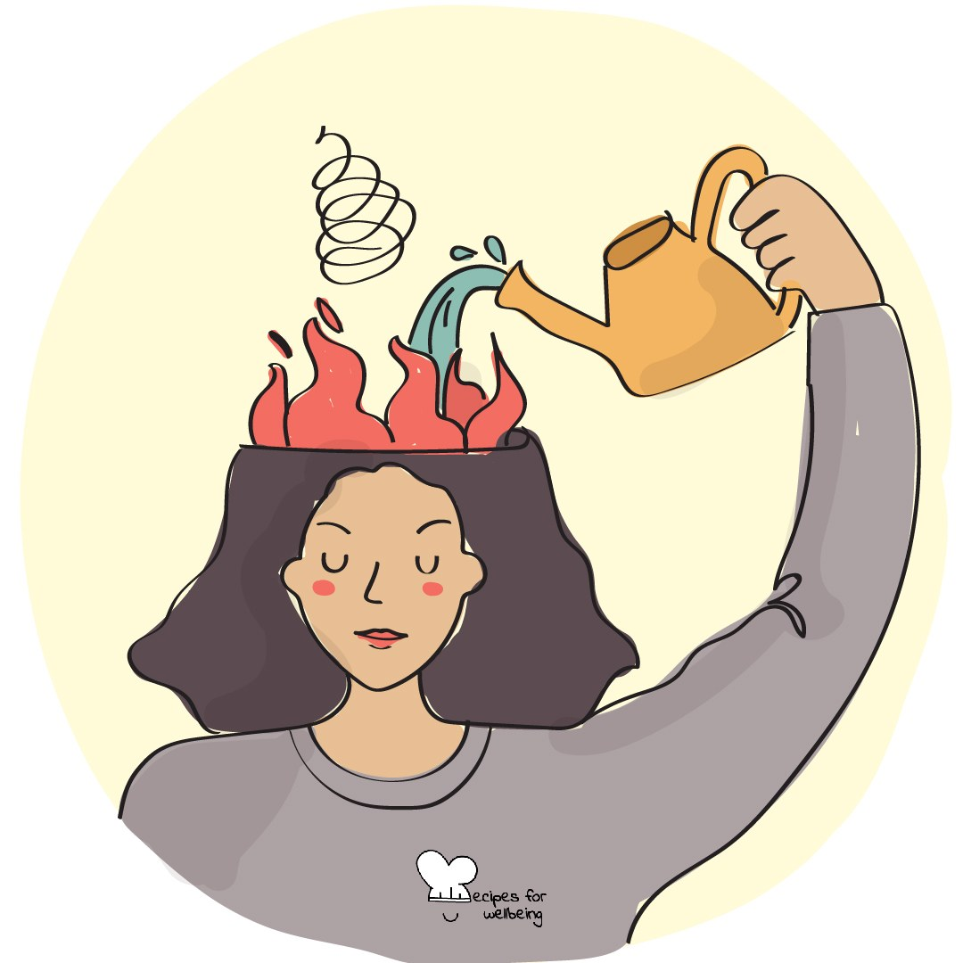
WHOLEBEING FOR EDUCATORS · LESSON
Staying with an ordinary hard moment
The skill of resilience · one class period · ages 13 to 18
Project or adapt these slides freely — the full plan is in the DOCX.
Recipes for Wellbeing · CC BY-NC 4.0 · free for classroom use

Slide 2
THE BIG IDEA
Nerves, embarrassment, restlessness and disappointment can create a strong wish to escape immediately. Distress tolerance is the ability to move through an ordinary hard moment without demanding that the feeling disappear first. It is not endurance of danger, abuse or overwhelming distress, and it includes asking for help or stepping away.
Recipes for Wellbeing · CC BY-NC 4.0 · free for classroom use · rfweducators.netlify.app/lessons/distress-tolerance/

Slide 3
OPENER
Befriending the wobble
1. Bring to mind a fictional student waiting for something ordinary but uncomfortable, such as a result, a reply or a turn to speak.
2. Imagine where they might notice the discomfort, while keeping your own attention outside your body if that feels better.
3. Ask what the feeling may be signalling and what would help the person remain safe while time moves.
4. Nothing needs to be fixed in this minute, and seeking support or stepping away can be part of staying with the moment.
Recipes for Wellbeing · CC BY-NC 4.0 · free for classroom use · rfweducators.netlify.app/lessons/distress-tolerance/

Slide 4
TALK ABOUT IT
• What do people commonly do when they want an uncomfortable feeling to stop at once?
• How can someone distinguish a manageable hard moment from one that needs immediate help?
• When can distraction, company or leaving be a caring response?
Recipes for Wellbeing · CC BY-NC 4.0 · free for classroom use · rfweducators.netlify.app/lessons/distress-tolerance/

Slide 5
ACTIVITY · 18 MIN
Chart a changing feeling
1. Explain that feelings can rise, level, return or ease in different ways; draw several possible shapes rather than one guaranteed wave.
2. Give each group a fictional ordinary situation, such as waiting outside an office, feeling embarrassed after a small mistake or waiting for a routine reply.
3. Sketch how the feeling might change over the next hour, allowing uncertainty and more than one possibility.
4. At the most difficult point, add three options: something the character can do alone, support from another person and a way to step away or get help.
Recipes for Wellbeing · CC BY-NC 4.0 · free for classroom use · rfweducators.netlify.app/lessons/distress-tolerance/

Slide 6
ACTIVITY · 18 MIN
Chart a changing feeling
5. Mark any response that could make the situation less safe, then revise it without judging the impulse behind it.
6. Each group shares one supportive option and one sign that the character needs more help than this lesson can offer.
Recipes for Wellbeing · CC BY-NC 4.0 · free for classroom use · rfweducators.netlify.app/lessons/distress-tolerance/

Slide 7
REFLECT
Without recording the event, think of a small and ordinary difficult feeling you have moved through before. What helped, and how did you know whether you could stay with it or needed support?
Recipes for Wellbeing · CC BY-NC 4.0 · free for classroom use · rfweducators.netlify.app/lessons/distress-tolerance/

Slide 8
A hard moment does not need to become a lesson or a positive story. We can meet what is here, use support and let safety guide whether we stay, step away or ask someone to help.
Recipes for Wellbeing · CC BY-NC 4.0 · free for classroom use · rfweducators.netlify.app/lessons/distress-tolerance/

Slide 9
BEFORE YOU GO
Exit ticket
1. What does distress tolerance mean in this lesson?
a) Getting rid of a hard feeling as quickly as possible
b) Moving through an ordinary hard moment without making it worse, which can include asking for help or stepping away
c) Only ever letting yourself feel positive emotions
d) Making sure nobody ever sees that you are upset
2. What does the lesson say about how an ordinary hard feeling changes over time?
a) It is dangerous and should always be avoided
b) It can rise, level, return or ease in different ways, with no single timetable
c) It always gets bigger the longer you wait
d) It disappears the moment you argue with it
3. In the 'Chart a changing feeling' activity, what did every group work with so that nobody had to share their own life?
a) Their own most difficult memory
b) A real classmate's problem
c) A fictional scenario about a made-up character
d) A private diary entry read aloud
Recipes for Wellbeing · CC BY-NC 4.0 · free for classroom use · rfweducators.netlify.app/lessons/distress-tolerance/

