Slide 1

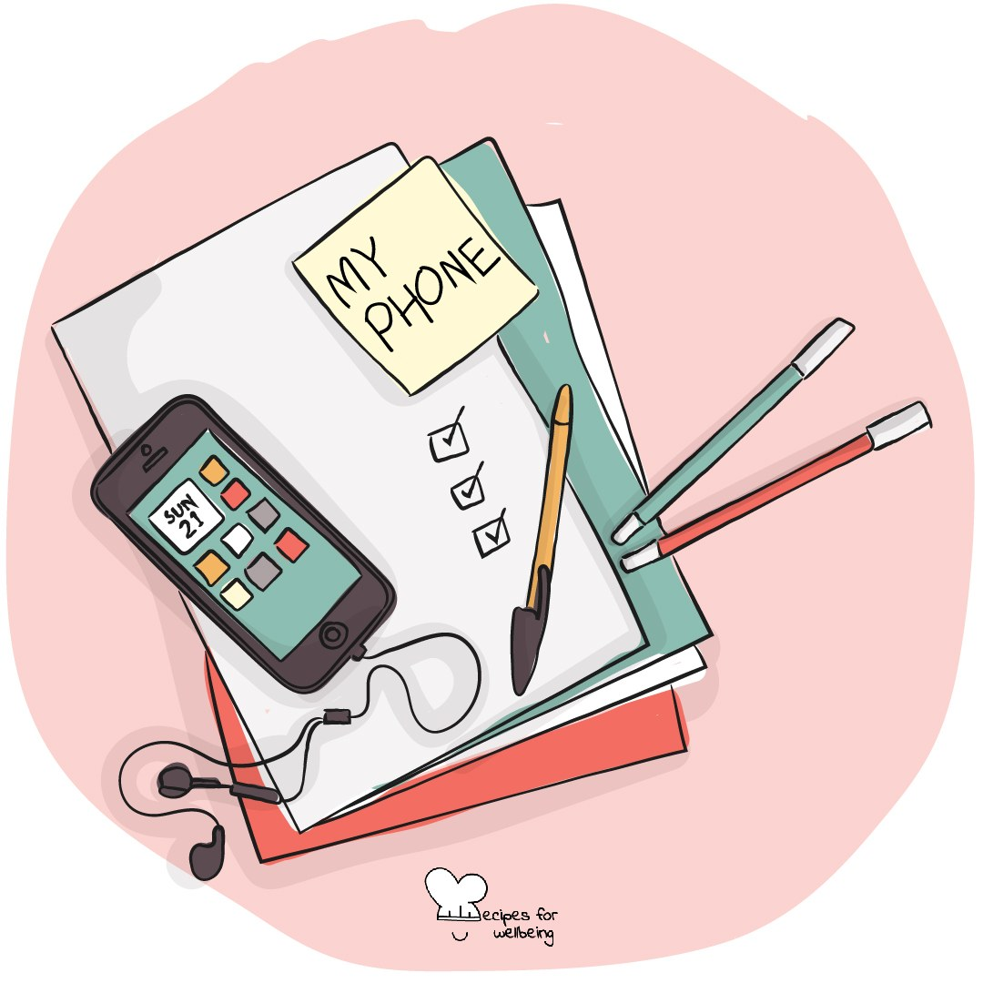
WHOLEBEING FOR EDUCATORS · LESSON
Choosing what deserves your attention
The skill of digital agency · one class period · ages 13 to 18
Project or adapt these slides freely — the full plan is in the DOCX.
Recipes for Wellbeing · CC BY-NC 4.0 · free for classroom use

Slide 2
THE BIG IDEA
Online content arrives quickly and often asks for an immediate reaction. Discernment gives us a pause in which to consider who made something, what it is asking from us and whether the information is reliable. We are aiming for thoughtful engagement, and we do not need to suspect everything we see.
Recipes for Wellbeing · CC BY-NC 4.0 · free for classroom use · rfweducators.netlify.app/lessons/digital-discernment/

Slide 3
OPENER
Where the scroll left you
1. Think back to a recent time online without opening a device or revisiting what you saw.
2. Find one private word for how the experience left you, such as connected, interested, tired, flat, unsettled or fine.
3. Let that word be information rather than a verdict on what you should do next.
4. Bring your attention back to the room and keep any details to yourself.
Recipes for Wellbeing · CC BY-NC 4.0 · free for classroom use · rfweducators.netlify.app/lessons/digital-discernment/

Slide 4
TALK ABOUT IT
• What techniques make a post, video or headline feel urgent?
• How can useful content and persuasive content look similar?
• Why might discernment be harder when someone is tired, lonely, angry or frightened?
Recipes for Wellbeing · CC BY-NC 4.0 · free for classroom use · rfweducators.netlify.app/lessons/digital-discernment/

Slide 5
ACTIVITY · 18 MIN
Use the filter
1. Introduce three possible responses: trust for now, pause and check, or let go.
2. Display the three questions about source and motive, personal impact, and supporting evidence. Model them with one fictional attention-grabbing headline.
3. Give each group six made-up items, such as an unsourced breaking claim, a quiz collecting data, an advert presented as advice, a viral dare, a chain message asking to be forwarded and a clear guide from a checkable source.
4. Ask groups to sort each item and record what evidence shaped the decision. Several placements may be reasonable if the explanation is sound.
Recipes for Wellbeing · CC BY-NC 4.0 · free for classroom use · rfweducators.netlify.app/lessons/digital-discernment/

Slide 6
ACTIVITY · 18 MIN
Use the filter
5. Each group chooses its hardest item and names what more it would need to know.
6. Gather patterns and emphasise that discernment includes updating a decision when better information appears.
Recipes for Wellbeing · CC BY-NC 4.0 · free for classroom use · rfweducators.netlify.app/lessons/digital-discernment/

Slide 7
REFLECT
Which of the three questions would be most useful to keep nearby the next time something online feels urgent, persuasive or difficult to place?
Recipes for Wellbeing · CC BY-NC 4.0 · free for classroom use · rfweducators.netlify.app/lessons/digital-discernment/

Slide 8
You do not need to trust everything or reject everything. You can pause and give your attention where the evidence and your values meet.
Recipes for Wellbeing · CC BY-NC 4.0 · free for classroom use · rfweducators.netlify.app/lessons/digital-discernment/

Slide 9
BEFORE YOU GO
Exit ticket
1. Which set of three categories did the lesson use to sort online content?
a) True, False, Unsure
b) Trust, Pause, Let go
c) Like, Share, Report
d) Fact, Opinion, Fake
2. Which of these is one of the three discernment questions taught in the lesson?
a) Who made this and what do they want from me?
b) How many likes does this have?
c) Would my friends find this funny?
d) Is this the newest post in my feed?
3. According to the lesson, what is digital discernment?
a) Distrusting everything you see online
b) Deleting every social media app
c) The ability to decide what deserves our trust and attention
d) Reporting any post that seems unusual
Recipes for Wellbeing · CC BY-NC 4.0 · free for classroom use · rfweducators.netlify.app/lessons/digital-discernment/

