Slide 1

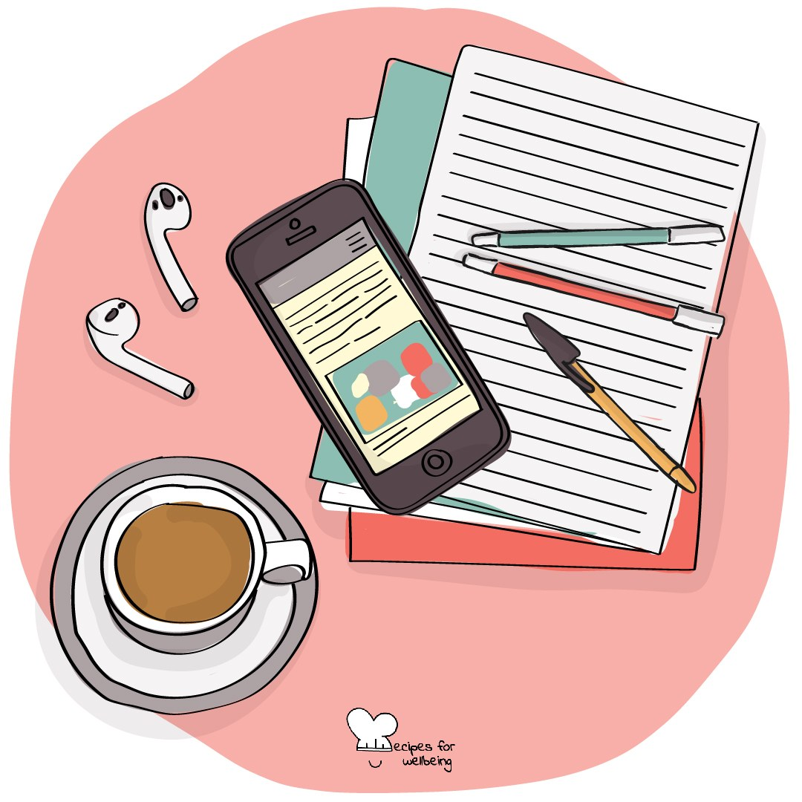
WHOLEBEING FOR EDUCATORS · LESSON
Deciding when technology gets your attention
The skill of digital boundaries · one class period · ages 13 to 18
Project or adapt these slides freely — the full plan is in the DOCX.
Recipes for Wellbeing · CC BY-NC 4.0 · free for classroom use

Slide 2
THE BIG IDEA
Technology can be valuable and still need a boundary. Choosing when and where a device gets our attention may protect sleep, focus, relationships or time that matters for something else. A useful boundary responds to real circumstances and can be adjusted without becoming a punishment.
Recipes for Wellbeing · CC BY-NC 4.0 · free for classroom use · rfweducators.netlify.app/lessons/digital-boundaries/

Slide 3
OPENER
The phone across the room
1. Without checking, notice where your phone is right now. If you do not have one with you, choose another object that often calls for your attention.
2. Notice whether part of your attention is keeping track of it, and let the answer be whatever it is.
3. Imagine one short period in which the device is out of sight or harder to reach, and consider what that might make easier or more difficult.
4. You do not need to make a promise. We are only noticing how distance may change the choices available.
Recipes for Wellbeing · CC BY-NC 4.0 · free for classroom use · rfweducators.netlify.app/lessons/digital-boundaries/

Slide 4
TALK ABOUT IT
• Why can a chosen boundary feel different from a rule imposed by someone else?
• What may make a digital boundary difficult to keep?
• How can a boundary protect connection rather than cutting someone off from it?
Recipes for Wellbeing · CC BY-NC 4.0 · free for classroom use · rfweducators.netlify.app/lessons/digital-boundaries/

Slide 5
ACTIVITY · 16 MIN
Design a boundary
1. Give each group one fictional situation, such as a group chat that continues through the night, notifications during revision or videos extending beyond a planned stopping point.
2. Ask what the person is trying to protect and what needs or responsibilities the boundary must still allow.
3. Choose one form: a device-free time, a device-free space or a small transition ritual.
4. Design one realistic and kind boundary, then name what could make it hard to keep.
Recipes for Wellbeing · CC BY-NC 4.0 · free for classroom use · rfweducators.netlify.app/lessons/digital-boundaries/

Slide 6
ACTIVITY · 16 MIN
Design a boundary
5. Adjust the boundary so it includes flexibility, access needs and a way to begin again after it is broken.
6. Each group shares its boundary and the value it protects, without discussing personal phone use.
Recipes for Wellbeing · CC BY-NC 4.0 · free for classroom use · rfweducators.netlify.app/lessons/digital-boundaries/

Slide 7
REFLECT
Which boundary idea could fit a real and busy life? Note a small version, or write why none of today's options would fit your circumstances.
Recipes for Wellbeing · CC BY-NC 4.0 · free for classroom use · rfweducators.netlify.app/lessons/digital-boundaries/

Slide 8
A boundary is a way of deciding where attention will go. The most useful one protects something that matters and leaves enough flexibility for the life around it.
Recipes for Wellbeing · CC BY-NC 4.0 · free for classroom use · rfweducators.netlify.app/lessons/digital-boundaries/

Slide 9
BEFORE YOU GO
Exit ticket
1. How does the lesson define a digital boundary?
a) A punishment for spending too much time online
b) A rule a school sets to take phones away
c) A promise to never check a phone again
d) A limit on when, where or how technology is used
2. The lesson offers three possible ingredients for building a digital boundary. Which of these is one of them?
a) A device-free time or space
b) A weekly screen-time report sent to parents
c) A password added to every app
d) A rota for who holds the phone at break time
3. In the Design a boundary activity, what should a group add after naming what could make its boundary hard to keep?
a) A stricter rule with a penalty for breaking it
b) Flexibility, access needs and a way to begin again after it is broken
c) A weekly check on everyone's screen time
d) A promise that the boundary will never change
Recipes for Wellbeing · CC BY-NC 4.0 · free for classroom use · rfweducators.netlify.app/lessons/digital-boundaries/

