Slide 1

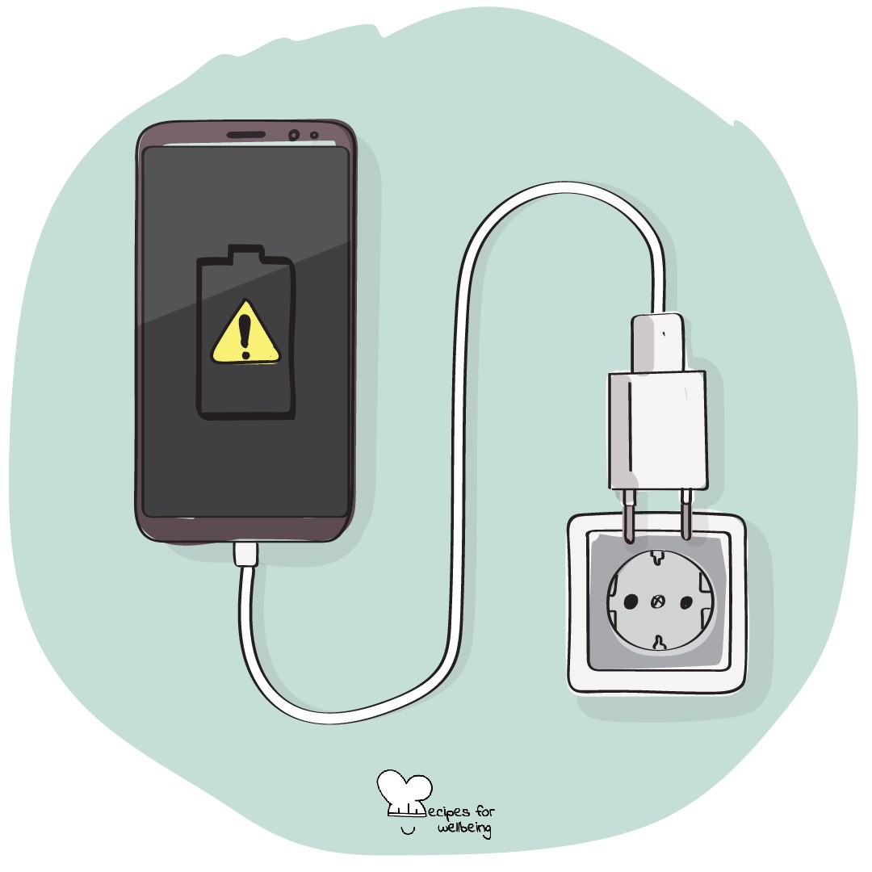
WHOLEBEING FOR EDUCATORS · LESSON
Choosing how you use your phone
The skill of digital agency · one class period · ages 13 to 18
Project or adapt these slides freely — the full plan is in the DOCX.
Recipes for Wellbeing · CC BY-NC 4.0 · free for classroom use

Slide 2
THE BIG IDEA
Phones and online spaces can support friendship, creativity, learning and access. They can also compete for attention in ways that are difficult to notice while they are happening. Digital agency begins with understanding that design influences behaviour and remembering that our choices still matter within the limits and pressures we face.
Recipes for Wellbeing · CC BY-NC 4.0 · free for classroom use · rfweducators.netlify.app/lessons/digital-agency/

Slide 3
OPENER
The unopened phone
1. Wherever your phone is, leave it there and notice any pull to check it without judging yourself for having the urge.
2. Pay attention to how the pull arrives, perhaps as a thought, a movement of the hand or a question about what you may have missed.
3. Each time you notice it, name it quietly as "pull" and let the moment pass without needing to act on it.
4. If no pull appears, notice that too. The practice is simply to see what is present.
Recipes for Wellbeing · CC BY-NC 4.0 · free for classroom use · rfweducators.netlify.app/lessons/digital-agency/

Slide 4
TALK ABOUT IT
• What do platforms gain when people stay for longer?
• What can make time online feel connecting, useful, tiring or flat?
• Where does personal choice help, and where should designers, schools or governments carry more responsibility?
Recipes for Wellbeing · CC BY-NC 4.0 · free for classroom use · rfweducators.netlify.app/lessons/digital-agency/

Slide 5
ACTIVITY · 16 MIN
A menu of small choices
1. Introduce several common design features, including infinite scroll, autoplay, streaks, notifications, likes and attention-grabbing headlines.
2. Each group chooses two features and asks what behaviour each one encourages and whose interests it may serve.
3. Ask what a person may value in the same moment, such as connection, sleep, focus, creativity, safety or enjoyment.
4. Groups create a menu of four or five small choices that could support those values, such as changing notifications, moving a charger, unfollowing an account or choosing a stopping point.
Recipes for Wellbeing · CC BY-NC 4.0 · free for classroom use · rfweducators.netlify.app/lessons/digital-agency/

Slide 6
ACTIVITY · 16 MIN
A menu of small choices
5. Include choices that do not require owning a newer device, paying for an app or having complete control over the household.
6. Gather one menu item from each group. No student needs to say what they use or intend to change.
Recipes for Wellbeing · CC BY-NC 4.0 · free for classroom use · rfweducators.netlify.app/lessons/digital-agency/

Slide 7
REFLECT
What is one small choice that could bring a part of your digital life closer to something you value? "Nothing for now" is also an honest answer.
Recipes for Wellbeing · CC BY-NC 4.0 · free for classroom use · rfweducators.netlify.app/lessons/digital-agency/

Slide 8
Digital agency can begin before any change is made. We can notice the invitation built into a screen and remember what matters to us before we respond.
Recipes for Wellbeing · CC BY-NC 4.0 · free for classroom use · rfweducators.netlify.app/lessons/digital-agency/

Slide 9
BEFORE YOU GO
Exit ticket
1. According to the lesson, why can it feel hard to put a phone down?
a) Because people naturally lack self-control
b) Because a great deal of thought and design has gone into keeping people scrolling
c) Because most phones are set to only allow short breaks
d) Because human brains have not changed at all in thousands of years
2. Which of these does the lesson name as a feature apps use to hold attention?
a) A screen brightness setting
b) Infinite scroll
c) Aeroplane mode
d) A low battery warning
3. What does the lesson mean by 'digital agency'?
a) Deleting every app and never going online again
b) Letting apps decide automatically what is best for you
c) Noticing how digital design affects you and choosing how you use it accordingly
d) A company that designs apps to be more addictive
Recipes for Wellbeing · CC BY-NC 4.0 · free for classroom use · rfweducators.netlify.app/lessons/digital-agency/

