Slide 1

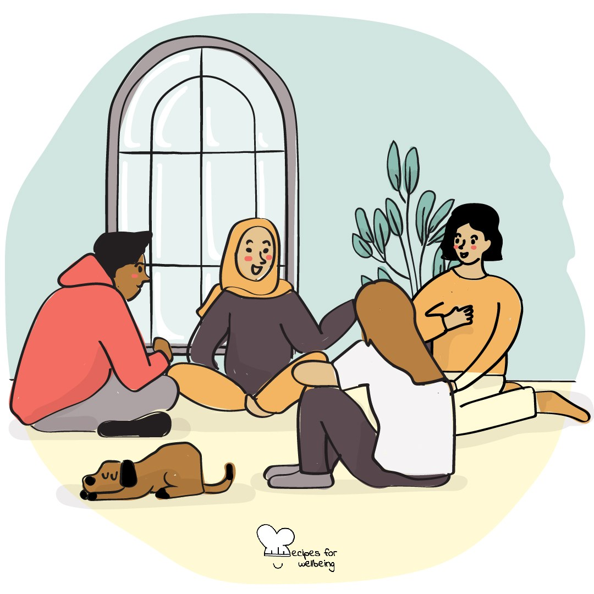
WHOLEBEING FOR EDUCATORS · LESSON
The pleasure of not knowing yet
The skill of awe · one class period · ages 13 to 18
Project or adapt these slides freely — the full plan is in the DOCX.
Recipes for Wellbeing · CC BY-NC 4.0 · free for classroom use

Slide 2
THE BIG IDEA
School often asks for an answer, while curiosity begins with attention to what we do not yet know. Letting a question remain open can make the familiar more interesting and give new ideas time to develop. Not knowing yet is nothing to hide. Curiosity is a way of meeting the world with interest.
Recipes for Wellbeing · CC BY-NC 4.0 · free for classroom use · rfweducators.netlify.app/lessons/curiosity/

Slide 3
OPENER
Questions without answers
1. School often rewards answers, but for the next two minutes we are only going to collect questions.
2. Think of anything you genuinely wonder about, from something ordinary in this room to something much larger.
3. Choose one question and let it stay open without trying to solve it yet.
4. If you would like to, offer your question to the room. We will listen without answering, and passing is always available.
Recipes for Wellbeing · CC BY-NC 4.0 · free for classroom use · rfweducators.netlify.app/lessons/curiosity/

Slide 4
TALK ABOUT IT
• Where do people still make room for wonder outside school?
• What can be lost when every question is treated as a race towards the right answer?
• What helps uncertainty feel interesting rather than threatening?
Recipes for Wellbeing · CC BY-NC 4.0 · free for classroom use · rfweducators.netlify.app/lessons/curiosity/

Slide 5
ACTIVITY · 18 MIN
Making the ordinary unfamiliar
1. Give each group one ordinary object and explain that the first task is to notice rather than identify it.
2. Allow two quiet minutes for close observation of texture, weight, edges, marks and the way light meets the surface.
3. Ask groups to produce as many genuine "I wonder..." questions as they can. No one answers yet, and unusual questions are welcome.
4. Choose one question and follow its connections outward. Where might the object have been, what systems brought it here and what remains unseen?
Recipes for Wellbeing · CC BY-NC 4.0 · free for classroom use · rfweducators.netlify.app/lessons/curiosity/

Slide 6
ACTIVITY · 18 MIN
Making the ordinary unfamiliar
5. Each group offers one or two questions to the room, where they are received without answers.
6. If time allows, swap objects and notice what becomes possible when attention meets something new.
Recipes for Wellbeing · CC BY-NC 4.0 · free for classroom use · rfweducators.netlify.app/lessons/curiosity/

Slide 7
REFLECT
Choose one ordinary thing you pass most days without seeing closely. What might become visible if you gave it the same attention as today's object?
Recipes for Wellbeing · CC BY-NC 4.0 · free for classroom use · rfweducators.netlify.app/lessons/curiosity/

Slide 8
You do not need to leave with an answer. You can carry one open question and allow it to change what you notice next.
Recipes for Wellbeing · CC BY-NC 4.0 · free for classroom use · rfweducators.netlify.app/lessons/curiosity/

Slide 9
BEFORE YOU GO
Exit ticket
1. According to the lesson, how does curiosity differ from the way school often treats questions?
a) School encourages curiosity more than finding the correct answer
b) School and curiosity are always chasing exactly the same goal
c) School often rewards finding the right answer, while curiosity means staying with what you do not yet understand
d) Curiosity means solving a problem as quickly as possible
2. The lesson makes the point that wonder is not only for huge, rare things. What is this idea saying?
a) Real wonder can also be found in small, everyday things, like leaves changing colour
b) Only spectacular events, like a sunrise over the Grand Canyon, count as wonder
c) Wonder should be reserved for scientific discoveries
d) Ordinary objects can never spark genuine curiosity
3. In the activity "Making the ordinary unfamiliar", what happens to the "I wonder..." questions each group offers to the room?
a) The class votes for the best answer
b) The teacher answers each one
c) Each must be answered before the next is asked
d) They are received without answers
Recipes for Wellbeing · CC BY-NC 4.0 · free for classroom use · rfweducators.netlify.app/lessons/curiosity/

