Slide 1

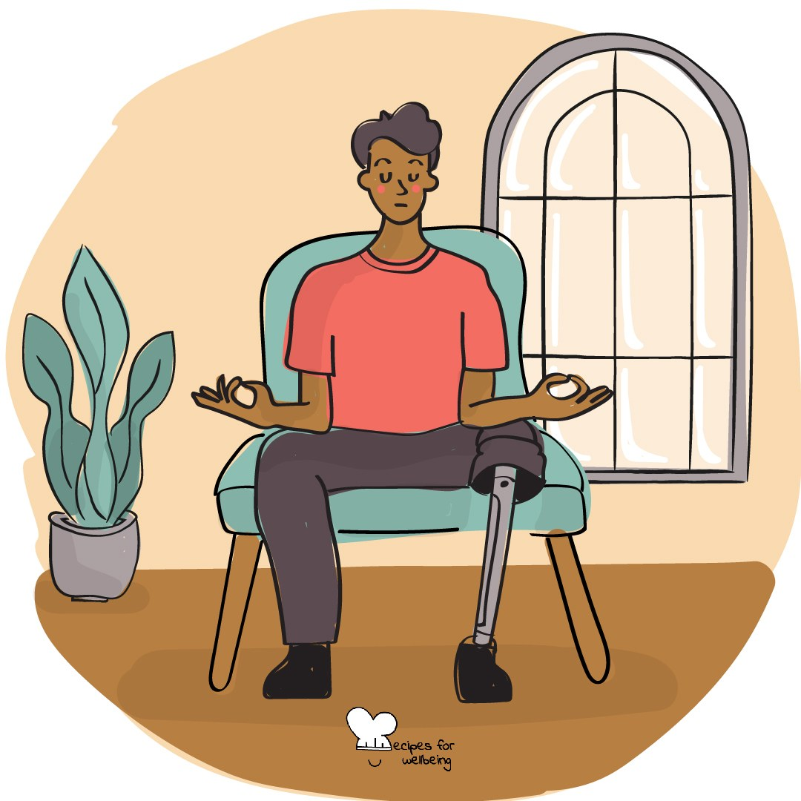
WHOLEBEING FOR EDUCATORS · LESSON
Kindness that responds
The skill of compassion · one class period · ages 13 to 18
Project or adapt these slides freely — the full plan is in the DOCX.
Recipes for Wellbeing · CC BY-NC 4.0 · free for classroom use

Slide 2
THE BIG IDEA
People often carry difficulties that are not visible. Compassion means noticing suffering, including our own, and asking what care or support might bring some relief. We do not have to fix another person's life or carry more than is safe for us.
Recipes for Wellbeing · CC BY-NC 4.0 · free for classroom use · rfweducators.netlify.app/lessons/compassion/

Slide 3
OPENER
Three quiet wishes
1. Take a comfortable breath and offer yourself a simple kind wish for the day ahead, using words that feel natural to you.
2. Bring to mind someone you care about and offer them the same wish, without needing to picture them clearly.
3. If it feels comfortable, widen the wish to the room, including people you do not know well.
4. You can keep the wish with yourself at any point, and nothing needs to be shared aloud.
Recipes for Wellbeing · CC BY-NC 4.0 · free for classroom use · rfweducators.netlify.app/lessons/compassion/

Slide 4
TALK ABOUT IT
• What is the difference between pity, empathy and compassion?
• Why can advice feel unhelpful when it arrives before understanding?
• What can self-compassion sound like without pretending that everything is fine?
Recipes for Wellbeing · CC BY-NC 4.0 · free for classroom use · rfweducators.netlify.app/lessons/compassion/

Slide 5
ACTIVITY · 16 MIN
A response that helps
1. Offer several fictional situations, such as a student being left out, arriving at a new school, regretting an argument or receiving a disappointing mock result.
2. Give each group two situations and ask what the person may need before deciding what anyone should say or do.
3. Name two common traps: minimising the difficulty and offering a solution before listening.
4. Ask groups to write one caring sentence, one practical option and one boundary or route to adult support for each situation.
Recipes for Wellbeing · CC BY-NC 4.0 · free for classroom use · rfweducators.netlify.app/lessons/compassion/

Slide 6
ACTIVITY · 16 MIN
A response that helps
5. Add a self-directed version of one scenario. Students privately write the response they would offer a friend and consider whether they could offer themselves similar care.
6. Gather one sentence from each group without sharing the private reflection, and notice how the response changes when it begins with understanding.
Recipes for Wellbeing · CC BY-NC 4.0 · free for classroom use · rfweducators.netlify.app/lessons/compassion/

Slide 7
REFLECT
Picture one small and realistic act of compassion you could offer in the next few days, to yourself or someone else. What might help, and how could you leave room for the person's own choice?
Recipes for Wellbeing · CC BY-NC 4.0 · free for classroom use · rfweducators.netlify.app/lessons/compassion/

Slide 8
Compassion can be quiet and practical. We can notice what hurts and offer what is safely ours to give.
Recipes for Wellbeing · CC BY-NC 4.0 · free for classroom use · rfweducators.netlify.app/lessons/compassion/

Slide 9
BEFORE YOU GO
Exit ticket
1. How does the lesson describe the difference between empathy and compassion?
a) They mean exactly the same thing
b) Empathy is only for strangers, and compassion is only for friends
c) Empathy helps us sense another person's experience, and compassion includes the wish or action to bring relief
d) Compassion means feeling sorry for someone, and empathy means fixing their problem
2. According to the lesson, what does compassion NOT require?
a) Fixing the entire problem for the other person
b) Noticing that someone is having a hard time
c) Staying near someone's difficulty instead of looking away
d) Doing something, even something small
3. The lesson's activity names two traps to avoid when responding to someone who is struggling. What are they?
a) Speaking too quietly and standing too close
b) Pretending the hard feeling is not there, and jumping straight to fixing it
c) Asking questions and listening carefully
d) Waiting too long to reply and forgetting details
Recipes for Wellbeing · CC BY-NC 4.0 · free for classroom use · rfweducators.netlify.app/lessons/compassion/

