Slide 1

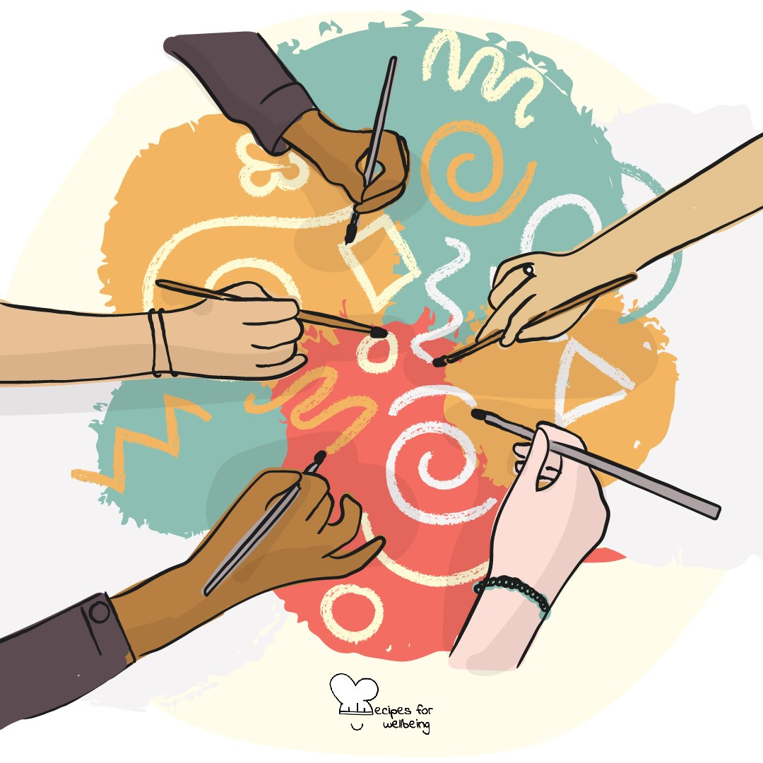
WHOLEBEING FOR EDUCATORS · LESSON
The connections in this room
The skill of community building · one class period · ages 13 to 18
Project or adapt these slides freely — the full plan is in the DOCX.
Recipes for Wellbeing · CC BY-NC 4.0 · free for classroom use

Slide 2
THE BIG IDEA
Belonging is shaped by ordinary moments: who receives a reply, who is welcomed into a conversation and whether there is room for difference. These choices will not remove wider barriers, and no one is responsible for their own inclusion. They still shape how a group feels and who gets to take part.
Recipes for Wellbeing · CC BY-NC 4.0 · free for classroom use · rfweducators.netlify.app/lessons/community-building/

Slide 3
OPENER
Make it rain
1. We are going to make the sound of a rainstorm together. This one gets loud, so if that is hard today you can rub your palms only, or just watch. Begin by rubbing your palms as the wind starts to rise.
2. Add the first drops by clicking your fingers, move into steady rain by clapping, and then pat your legs for the downpour.
3. Follow me back through the sounds until the room is quiet again.
4. Take a moment to notice what the group created by paying attention to one another.
Recipes for Wellbeing · CC BY-NC 4.0 · free for classroom use · rfweducators.netlify.app/lessons/community-building/

Slide 4
TALK ABOUT IT
• What small actions help a group feel welcoming without asking everyone to be the same?
• What can make joining a group difficult, even when individuals intend to be friendly?
• How can a group respond when someone is repeatedly left out?
Recipes for Wellbeing · CC BY-NC 4.0 · free for classroom use · rfweducators.netlify.app/lessons/community-building/

Slide 5
ACTIVITY · 18 MIN
Finding points of connection
1. Fill each square with a low-disclosure prompt, such as enjoying a comfort programme, learning another language, preferring rain to sunshine or having a song to recommend.
2. Invite students to find a different classmate for each square. They may write a first name only with permission, leave squares blank or pass on any prompt.
3. Give the class seven minutes and encourage one follow-up question before moving on. Filling the grid is not a race or a requirement.
4. Make alternatives available for anyone who cannot or does not want to move around, such as partners coming to them, seated groups or a show of hands.
Recipes for Wellbeing · CC BY-NC 4.0 · free for classroom use · rfweducators.netlify.app/lessons/community-building/

Slide 6
ACTIVITY · 18 MIN
Finding points of connection
5. Bring the group back and ask what common ground appeared in unexpected places. Do not invite comments about individual students.
6. Close by naming the actions that made connection easier and any design changes that would make the activity more inclusive next time.
Recipes for Wellbeing · CC BY-NC 4.0 · free for classroom use · rfweducators.netlify.app/lessons/community-building/

Slide 7
REFLECT
Think of a group you are part of without naming it. What is one small action you could offer, and what is one change the group itself could make, to support belonging?
Recipes for Wellbeing · CC BY-NC 4.0 · free for classroom use · rfweducators.netlify.app/lessons/community-building/

Slide 8
Today's connections were ordinary, and that is where much of community is made. Belonging grows when people offer care and when groups remove the barriers that keep care from reaching everyone.
Recipes for Wellbeing · CC BY-NC 4.0 · free for classroom use · rfweducators.netlify.app/lessons/community-building/

Slide 9
BEFORE YOU GO
Exit ticket
1. According to the lesson, what shapes belonging in a group?
a) Everyone having the same interests and opinions
b) Ordinary moments, such as who receives a reply and who is welcomed into a conversation
c) Being naturally popular
d) One leader who organises every activity
2. The lesson says saving a seat can welcome someone. What does it say a small action like this cannot do?
a) Help anyone feel welcome
b) Change how a group feels
c) Happen during a lesson
d) Repair discrimination or replace the responsibility of adults and institutions
3. Which statement best reflects the lesson's point about difference within a community?
a) A good group has room for people who are different and do not always agree
b) A strong community requires everyone to think the same way
c) Belonging only happens between people who already have lots in common
d) Disagreement always breaks down a sense of belonging
Recipes for Wellbeing · CC BY-NC 4.0 · free for classroom use · rfweducators.netlify.app/lessons/community-building/

