Slide 1

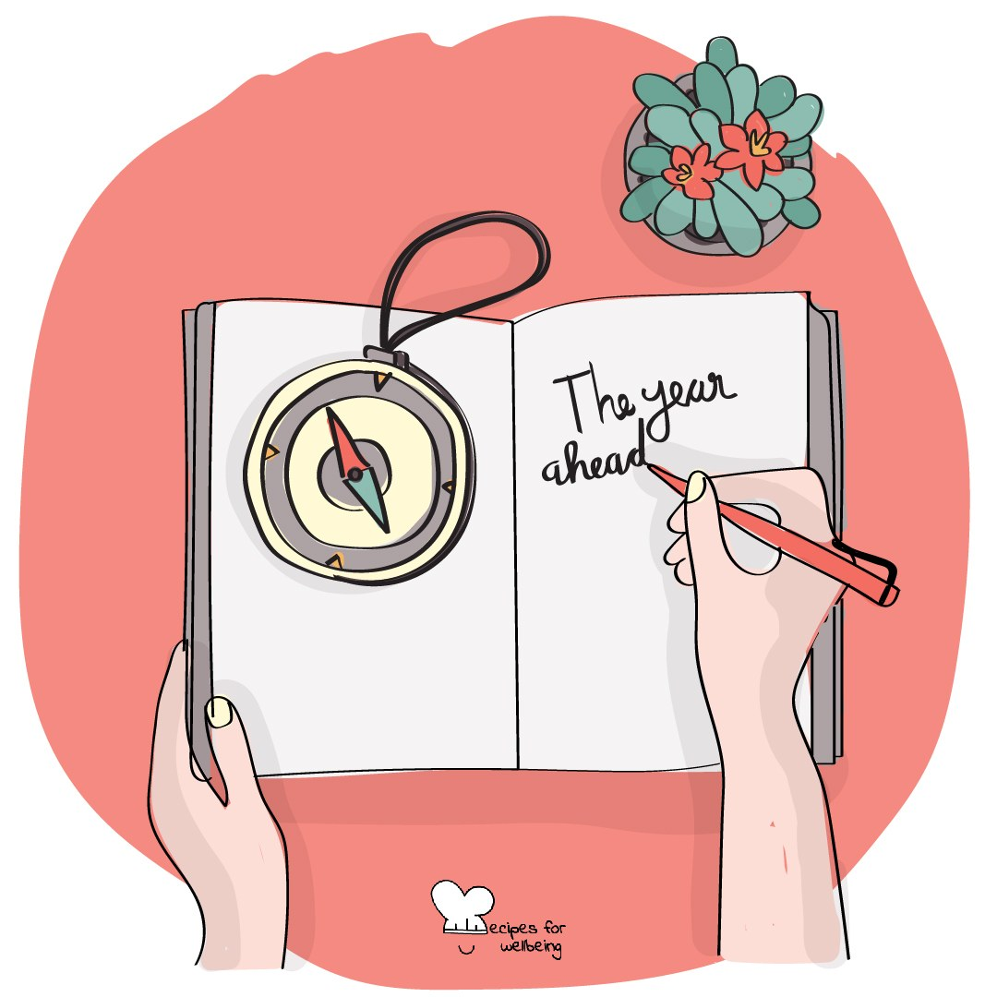
WHOLEBEING FOR EDUCATORS · LESSON
What you keep coming back to
The skill of commitment · one class period · ages 13 to 18
Project or adapt these slides freely — the full plan is in the DOCX.
Recipes for Wellbeing · CC BY-NC 4.0 · free for classroom use

Slide 2
THE BIG IDEA
Commitment is the choice to keep returning to something we value, including after distraction, difficulty or rest. Motivation comes and goes, and plans change. Knowing why something matters can help us change the way we continue without losing the care beneath it.
Recipes for Wellbeing · CC BY-NC 4.0 · free for classroom use · rfweducators.netlify.app/lessons/commitment/

Slide 3
OPENER
Carrying it forward
1. Look back over the year and find one moment you are glad happened, however small it may seem.
2. Choose one thing you would like to carry forward, such as a habit, a friendship or words that stayed with you.
3. A few volunteers can complete the sentence "I am taking... with me," while the rest of us listen without responding. Passing is always available.
4. The difficult and unfinished parts may travel with you too, and there is no need to resolve them before we continue.
Recipes for Wellbeing · CC BY-NC 4.0 · free for classroom use · rfweducators.netlify.app/lessons/commitment/

Slide 4
TALK ABOUT IT
• What is the difference between repeating something and choosing to return to it?
• How can more options make commitment harder?
• When might changing a plan protect the value underneath it?
Recipes for Wellbeing · CC BY-NC 4.0 · free for classroom use · rfweducators.netlify.app/lessons/commitment/

Slide 5
ACTIVITY · 17 MIN
Staying with what matters
1. Give each group a fictional student who is trying to continue with a friendship, hobby, team, revision plan or personal goal.
2. Ask the group to identify the value beneath the commitment, such as belonging, learning, health or loyalty.
3. Name two things that may pull the person away, including changing circumstances, tiredness, distraction or another person's expectations.
4. Keeping the value in view, design a smaller or different way for the person to continue. Include a version in which pausing or asking for help is the responsible choice.
Recipes for Wellbeing · CC BY-NC 4.0 · free for classroom use · rfweducators.netlify.app/lessons/commitment/

Slide 6
ACTIVITY · 17 MIN
Staying with what matters
5. Each group shares its underlying value and one possible adaptation.
6. Students privately note one small way they could support something they care about, without being asked to name the commitment.
Recipes for Wellbeing · CC BY-NC 4.0 · free for classroom use · rfweducators.netlify.app/lessons/commitment/

Slide 7
REFLECT
Without naming anything private, note what helps you return to something you care about on a difficult or distracting day. It may be a person, reminder, reason, rest or a change of plan.
Recipes for Wellbeing · CC BY-NC 4.0 · free for classroom use · rfweducators.netlify.app/lessons/commitment/

Slide 8
Commitment does not require a perfect record. When we notice we have drifted, we can remember what matters and decide whether, and how, we want to return.
Recipes for Wellbeing · CC BY-NC 4.0 · free for classroom use · rfweducators.netlify.app/lessons/commitment/

Slide 9
BEFORE YOU GO
Exit ticket
1. According to the lesson, what is the key difference between a habit and a commitment?
a) A habit only takes a few minutes, while a commitment always takes years to build
b) A habit is something you do automatically, while a commitment is something you choose because it matters and keep choosing
c) A habit is done alone, while a commitment always involves other people
d) A habit is bad for you, while a commitment is always good for you
2. In the activity "Staying with what matters", what do groups identify first for their fictional student?
a) The quickest way to finish the goal
b) Who else should take over the commitment
c) How long the commitment should last
d) The value beneath the commitment, such as belonging or learning
3. According to the lesson, how can we respond when circumstances change?
a) Keep the original method at any cost
b) Give up as soon as the first plan stops working
c) Stay close to the reason while changing the method
d) Change the reason so the plan stays exciting
Recipes for Wellbeing · CC BY-NC 4.0 · free for classroom use · rfweducators.netlify.app/lessons/commitment/

