Slide 1

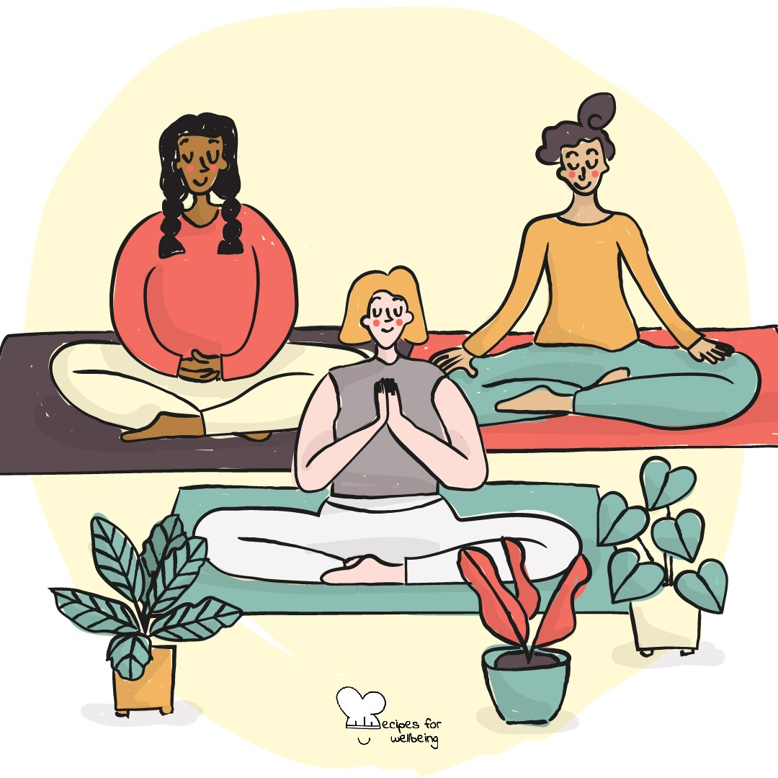
WHOLEBEING FOR EDUCATORS · LESSON
A pause you carry with you
The skill of breathing · one class period · ages 13 to 18
Project or adapt these slides freely — the full plan is in the DOCX.
Recipes for Wellbeing · CC BY-NC 4.0 · free for classroom use

Slide 2
THE BIG IDEA
The breath is always present, although most of the time we do not notice it. Paying attention to its pace can create a small pause during pressure, before a test or after a difficult moment. Breath practices do not work in the same way for everyone, so this lesson offers options rather than a single correct technique.
Recipes for Wellbeing · CC BY-NC 4.0 · free for classroom use · rfweducators.netlify.app/lessons/breathing/

Slide 3
OPENER
Four, seven, eight
1. We are going to try a counted breath, and you can breathe normally or simply listen if focusing on the breath does not feel comfortable today.
2. If you are joining in, breathe in gently for four, pause for up to seven, and breathe out slowly for up to eight. The counts are guides, so shorten them or leave out the pause whenever you need to.
3. We will try three more rounds at an easy pace, without forcing the breath to become deeper than it wants to be.
4. Return to your usual breathing and notice what the practice was like for you, including if it made no difference or was not comfortable.
Recipes for Wellbeing · CC BY-NC 4.0 · free for classroom use · rfweducators.netlify.app/lessons/breathing/

Slide 4
TALK ABOUT IT
• What can make a breathing practice feel supportive, uncomfortable or distracting?
• Why is it useful to have more than one way of pausing?
• Where might a brief breath practice help, and where would practical action or another person's support matter more?
Recipes for Wellbeing · CC BY-NC 4.0 · free for classroom use · rfweducators.netlify.app/lessons/breathing/

Slide 5
ACTIVITY · 16 MIN
Draw your breath
1. Invite each student to draw a simple continuous shape they can trace with one finger, such as a square, triangle, wave or circle.
2. Demonstrate on a square: trace one side while breathing in, the next while pausing if comfortable, the third while breathing out, and the last while resting.
3. Give students three quiet rounds with their own shape. They can change the pace, remove the hold, breathe normally while tracing or simply look at the shape.
4. In groups of three or four, invite each person to show their shape and, if they wish, lead one round using only "in, pause, out, rest".
Recipes for Wellbeing · CC BY-NC 4.0 · free for classroom use · rfweducators.netlify.app/lessons/breathing/

Slide 6
ACTIVITY · 16 MIN
Draw your breath
5. Ask groups to discuss which pace felt easiest to follow and why different people may prefer different patterns.
6. Invite one willing group to lead a final round, with watching or passing treated as full participation.
Recipes for Wellbeing · CC BY-NC 4.0 · free for classroom use · rfweducators.netlify.app/lessons/breathing/

Slide 7
REFLECT
Which version of today's practice felt most usable, including ordinary breathing or not taking part? Note one situation in which it might offer a pause, and one situation in which you would need a different kind of support.
Recipes for Wellbeing · CC BY-NC 4.0 · free for classroom use · rfweducators.netlify.app/lessons/breathing/

Slide 8
The breath is one possible place to pause, and it will not remove the thing causing pressure. If it gives you a little more room, you can use that room to choose what you need next.
Recipes for Wellbeing · CC BY-NC 4.0 · free for classroom use · rfweducators.netlify.app/lessons/breathing/

Slide 9
BEFORE YOU GO
Exit ticket
1. According to the lesson, what can a slightly longer out-breath do for some people?
a) It speeds up the heart rate
b) It can help the body settle, although it does not work the same way for everyone
c) It has no real effect on the body
d) It increases alertness before a test
2. In the "four, seven, eight" pattern, what do the numbers 4, 7, and 8 represent?
a) Minutes for a full breathing session
b) Counts for breathing in, holding, and breathing out
c) The number of rounds to repeat
d) Degrees to tilt the head while breathing
3. In "Draw your breath", what does tracing a shape with a finger help someone do?
a) Improve their drawing skills
b) Pace their breathing gently by following the shape
c) Distract them from breathing altogether
d) Measure their heart rate exactly
Recipes for Wellbeing · CC BY-NC 4.0 · free for classroom use · rfweducators.netlify.app/lessons/breathing/

