Slide 1

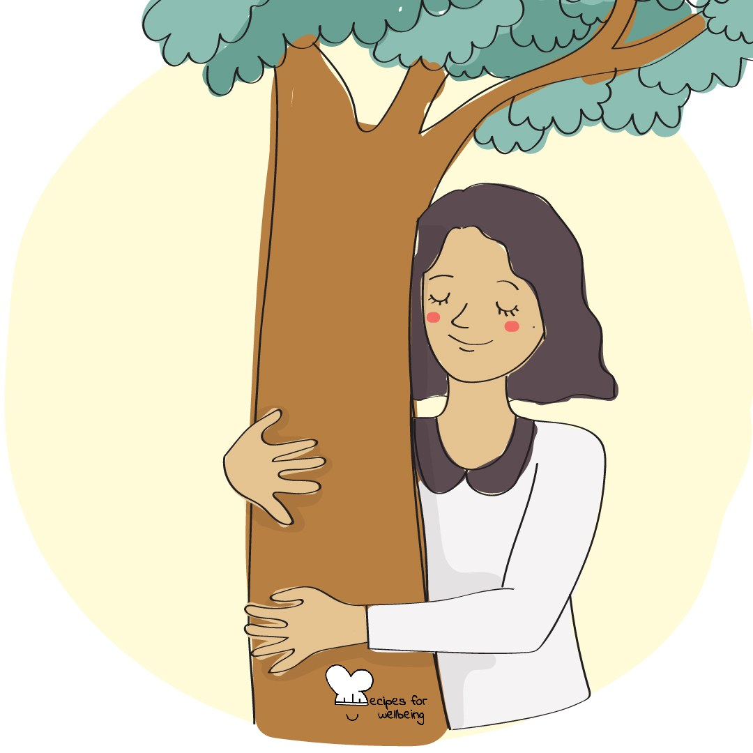
WHOLEBEING FOR EDUCATORS · LESSON
What would a forest do?
The skill of bioinspiration · one class period · ages 13 to 18
Project or adapt these slides freely — the full plan is in the DOCX.
Recipes for Wellbeing · CC BY-NC 4.0 · free for classroom use

Slide 2
THE BIG IDEA
Living systems have developed many ways to adapt, cooperate and recover. Paying closer attention to these patterns can widen our thinking when the usual human answer is not enough. Nature will not hand us instructions. It can offer questions and principles worth testing.
Recipes for Wellbeing · CC BY-NC 4.0 · free for classroom use · rfweducators.netlify.app/lessons/bioinspiration/

Slide 3
OPENER
What the trees are doing
1. At this time of year, many trees are letting go of leaves that have reached the end of their season.
2. Look through the window if you can see a tree, or bring to mind one that you know, and spend a moment noticing it.
3. Ask yourself quietly whether there is something small from this week that you are ready to put down, such as a worry you no longer need to carry or a plan that has already changed.
4. You do not need to find an answer or share anything aloud, because the question is enough for today.
Recipes for Wellbeing · CC BY-NC 4.0 · free for classroom use · rfweducators.netlify.app/lessons/bioinspiration/

Slide 4
TALK ABOUT IT
• Where have people already borrowed an idea from nature in design, technology or community life?
• What might a river, flock or forest help us notice about responding to change?
• What are the limits of treating nature as a teacher?
Recipes for Wellbeing · CC BY-NC 4.0 · free for classroom use · rfweducators.netlify.app/lessons/bioinspiration/

Slide 5
ACTIVITY · 18 MIN
Nature's advice panel
1. Give each group a natural system to explore, such as a tree in autumn, a river, a flock, an ant colony, a coral reef or a seed in the soil.
2. Ask students to describe what it does before interpreting it. How does it respond to change, share resources or work with its surroundings?
3. Invite the group to name a possible principle in plain language, such as finding another route or sharing effort across a network.
4. Ask where that principle might be useful in an ordinary school week, and where the comparison stops being helpful.
Recipes for Wellbeing · CC BY-NC 4.0 · free for classroom use · rfweducators.netlify.app/lessons/bioinspiration/

Slide 6
ACTIVITY · 18 MIN
Nature's advice panel
5. Each group prepares one sentence beginning "We noticed..." and another beginning "This might invite people to..."
6. Gather the ideas without turning them into instructions. Several interpretations can sit beside one another.
Recipes for Wellbeing · CC BY-NC 4.0 · free for classroom use · rfweducators.netlify.app/lessons/bioinspiration/

Slide 7
REFLECT
Which pattern from today would you like to keep thinking about, and what question does it leave you with?
Recipes for Wellbeing · CC BY-NC 4.0 · free for classroom use · rfweducators.netlify.app/lessons/bioinspiration/

Slide 8
The living world continues around us whether or not we are paying attention. When you need another way of seeing a problem, you can begin by looking closely and asking what nature makes possible.
Recipes for Wellbeing · CC BY-NC 4.0 · free for classroom use · rfweducators.netlify.app/lessons/bioinspiration/

Slide 9
BEFORE YOU GO
Exit ticket
1. How does the lesson define bioinspiration?
a) Copying an animal's exact behaviour in detail
b) Consciously looking to Nature as a source of guidance, insight, and innovation
c) Studying nature purely to collect scientific data
d) Avoiding technology in favour of the outdoors
2. In the activity "Nature's advice panel", what do students do before interpreting their natural system?
a) Describe what it does, such as how it responds to change
b) Look up its scientific name
c) Decide which human rule it proves
d) Draw it from memory
3. In the lesson, what might a forest show us?
a) Speed
b) Competition
c) Interdependence
d) Stillness
Recipes for Wellbeing · CC BY-NC 4.0 · free for classroom use · rfweducators.netlify.app/lessons/bioinspiration/

