Slide 1

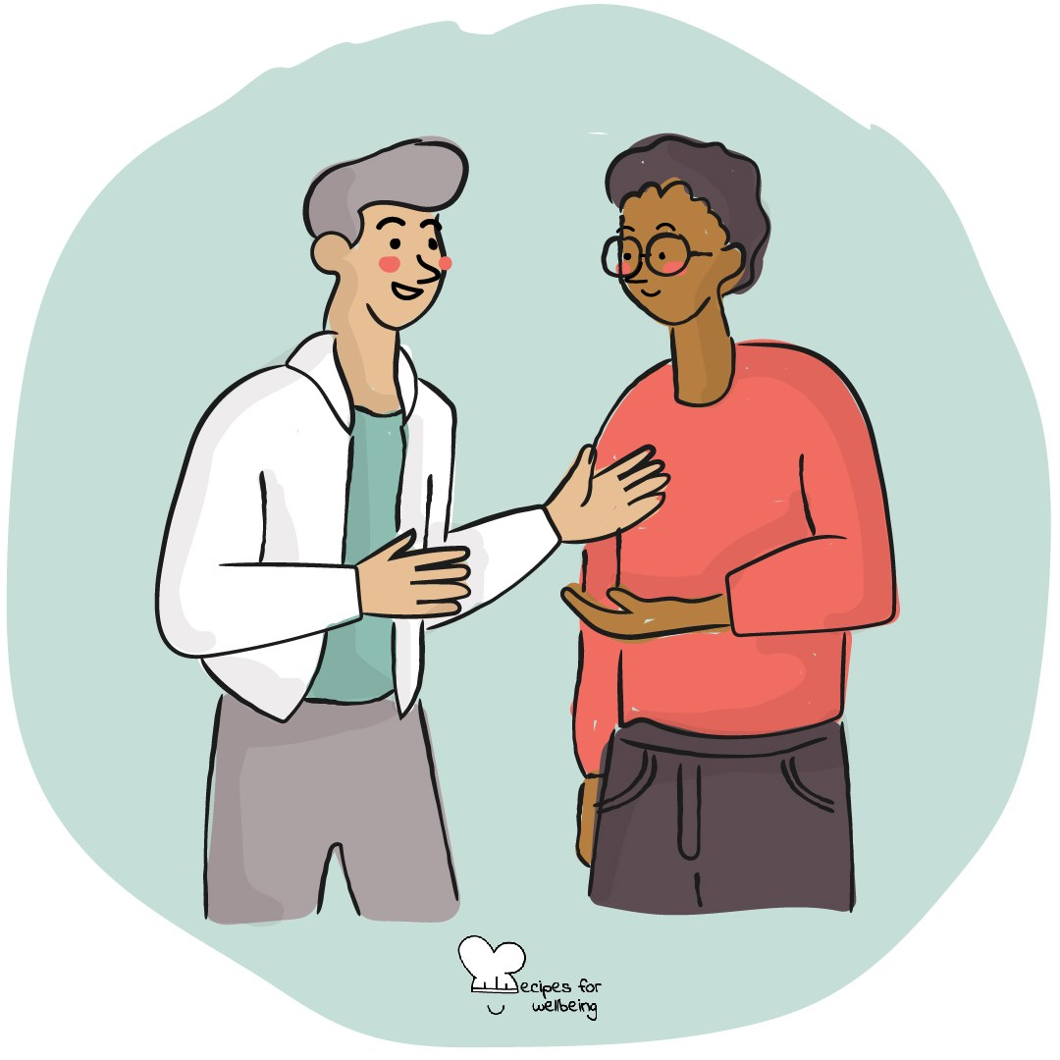
WHOLEBEING FOR EDUCATORS · LESSON
Say the good part out loud
The skill of celebration · one class period · ages 13 to 18
Project or adapt these slides freely — the full plan is in the DOCX.
Recipes for Wellbeing · CC BY-NC 4.0 · free for classroom use

Slide 2
THE BIG IDEA
A general compliment can be pleasant, but a specific affirmation helps someone understand what we noticed and valued. Naming a thoughtful action, a useful contribution or a quality we have genuinely seen can help appreciation feel sincere rather than automatic.
Recipes for Wellbeing · CC BY-NC 4.0 · free for classroom use · rfweducators.netlify.app/lessons/affirmation/

Slide 3
OPENER
Good gossip
1. Turn to the person beside you for a different kind of gossip: something kind and true about someone who is not in your pair.
2. Take 60 seconds each to name an action or quality you genuinely appreciate. You can pass, or speak about someone outside this class if that feels more comfortable.
3. Keep private information out of the conversation and allow your partner to finish without adding a judgement of your own.
4. As we come back together, notice what it was like to speak about someone with care when they were not there to hear it.
Recipes for Wellbeing · CC BY-NC 4.0 · free for classroom use · rfweducators.netlify.app/lessons/affirmation/

Slide 4
TALK ABOUT IT
• What makes an affirmation feel sincere?
• Why can comparison weaken a compliment, even when the speaker means well?
• What makes receiving appreciation difficult for some people?
Recipes for Wellbeing · CC BY-NC 4.0 · free for classroom use · rfweducators.netlify.app/lessons/affirmation/

Slide 5
ACTIVITY · 18 MIN
Making appreciation specific
1. Show the class a general compliment and a specific affirmation, such as "Good job" and "Your clear summary helped our group decide what to do next". Ask what makes the second more useful.
2. Agree on three guides: an affirmation is specific, true and offered without wanting anything back.
3. Give groups several fictional examples, such as someone welcoming a new student, admitting a mistake or helping a team stay organised.
4. Ask each group to write an affirmation for the person in each example, then review the wording for assumptions, comparisons or exaggeration.
Recipes for Wellbeing · CC BY-NC 4.0 · free for classroom use · rfweducators.netlify.app/lessons/affirmation/

Slide 6
ACTIVITY · 18 MIN
Making appreciation specific
5. Invite groups to share selected examples and explain why the words feel sincere.
6. Offer an optional final round in which students affirm something they observed in the lesson. They can pass or appreciate the group as a whole, and the receiver only needs to say "thank you".
Recipes for Wellbeing · CC BY-NC 4.0 · free for classroom use · rfweducators.netlify.app/lessons/affirmation/

Slide 7
REFLECT
Think of something helpful or caring that someone does which often goes unnamed. Without identifying them, draft one specific and honest sentence you might offer if the moment feels right.
Recipes for Wellbeing · CC BY-NC 4.0 · free for classroom use · rfweducators.netlify.app/lessons/affirmation/

Slide 8
Appreciation does not need to wait for a celebration. When you notice something you genuinely value, you can name it clearly and allow the other person to receive it in their own way.
Recipes for Wellbeing · CC BY-NC 4.0 · free for classroom use · rfweducators.netlify.app/lessons/affirmation/

Slide 9
BEFORE YOU GO
Exit ticket
1. According to the lesson, what are the three ingredients of an affirmation that actually lands?
a) Loud, funny, and quick
b) Specific, true and offered without wanting anything back
c) Long, detailed, and written down
d) Vague, general, and repeated often
2. Why does "Your clear summary helped our group decide what to do next" tend to land better than "Good job"?
a) It is longer, so it must be more sincere
b) It names what happened and why it mattered
c) It is easier to say in front of a group
d) It compares the person with everyone else
3. According to the lesson, what is enough when someone receives an affirmation?
a) Returning a compliment of their own straight away
b) Agreeing with every word that was said
c) Explaining why it is not really true
d) A simple "thank you"
Recipes for Wellbeing · CC BY-NC 4.0 · free for classroom use · rfweducators.netlify.app/lessons/affirmation/

