Slide 1

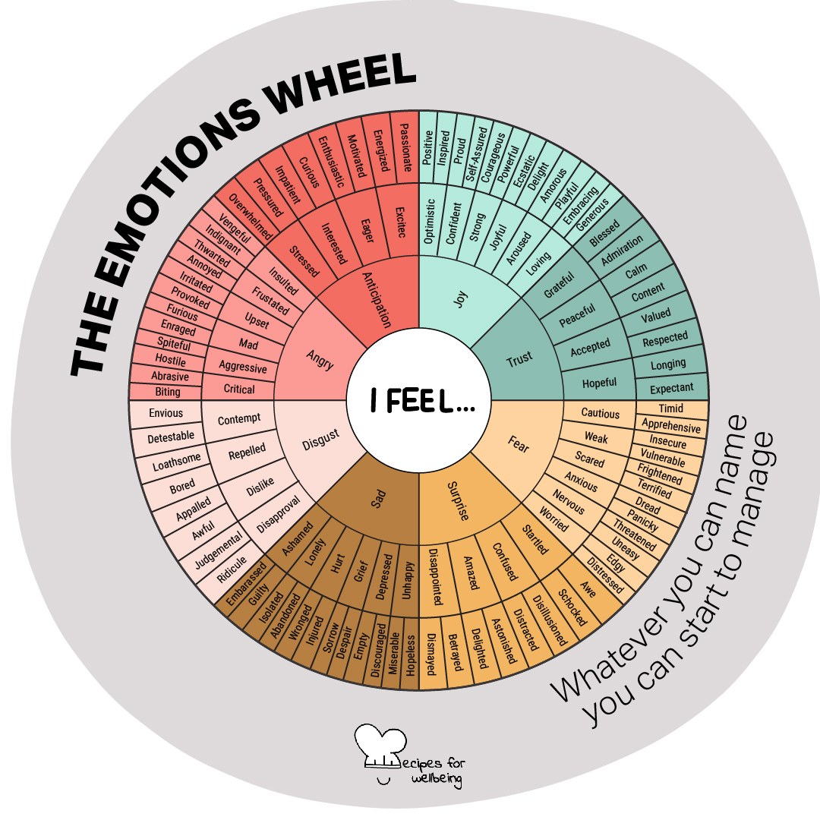
WHOLEBEING FOR EDUCATORS · LESSON
Letting people be who they are
The skill of holding space · one class period · ages 13 to 18
Project or adapt these slides freely — the full plan is in the DOCX.
Recipes for Wellbeing · CC BY-NC 4.0 · free for classroom use

Slide 2
THE BIG IDEA
When someone tells us how they are, it can be tempting to answer with advice or a story of our own. Acceptance begins by staying with the person in front of us and allowing their experience to be what it is. We can still disagree or name harm. We listen first, then decide what should happen next.
Recipes for Wellbeing · CC BY-NC 4.0 · free for classroom use · rfweducators.netlify.app/lessons/acceptance/

Slide 3
OPENER
Inner weather report
1. If the way you feel right now were weather, what would it be: clear, cloudy, warm, windy or something else?
2. Find one word without trying to improve the forecast, because uncomfortable weather belongs here as much as comfortable weather does.
3. When I reach your row, you can offer your word, say "pass", or shake your head, and I will move on. You will not be asked to explain it.
4. Notice how much can be present in one room, and let every answer remain as it is.
Recipes for Wellbeing · CC BY-NC 4.0 · free for classroom use · rfweducators.netlify.app/lessons/acceptance/

Slide 4
TALK ABOUT IT
• What can you see or hear when someone is giving another person their full attention?
• Why might we rush to offer advice before we know whether it is wanted?
• How can we accept someone's feelings while still keeping a boundary or disagreeing with their behaviour?
Recipes for Wellbeing · CC BY-NC 4.0 · free for classroom use · rfweducators.netlify.app/lessons/acceptance/

Slide 5
ACTIVITY · 15 MIN
Just listen
1. Arrange pairs, with a trio if needed, and explain that the listener's task is to pay attention without giving advice, comparing experiences or taking over.
2. Offer a low-disclosure topic, such as something ordinary you are looking forward to. Students can keep it light, choose another safe topic or pass.
3. Partner A speaks for 90 seconds while Partner B listens. Keep the time and give a gentle signal at the end.
4. Swap roles, inviting each listener to notice any urge to interrupt, fix or compare without acting on it.
Recipes for Wellbeing · CC BY-NC 4.0 · free for classroom use · rfweducators.netlify.app/lessons/acceptance/

Slide 6
ACTIVITY · 15 MIN
Just listen
5. Ask pairs to discuss the experience rather than repeat the content. What helped the listening feel attentive, and what made it difficult?
6. Gather general observations, then ask what a listener could say if they were unsure whether the speaker wanted comfort, advice or practical help.
Recipes for Wellbeing · CC BY-NC 4.0 · free for classroom use · rfweducators.netlify.app/lessons/acceptance/

Slide 7
REFLECT
Bring to mind a time when someone listened without trying to change how you felt. Without recording any private details, note what they did and where you might offer the same quality of attention this week.
Recipes for Wellbeing · CC BY-NC 4.0 · free for classroom use · rfweducators.netlify.app/lessons/acceptance/

Slide 8
The weather in someone else's day is theirs. We can make room for them to describe it, and ask what kind of support would be welcome before we offer an answer.
Recipes for Wellbeing · CC BY-NC 4.0 · free for classroom use · rfweducators.netlify.app/lessons/acceptance/

Slide 9
BEFORE YOU GO
Exit ticket
1. What does "holding space" for someone mean?
a) Giving them advice as soon as possible
b) Being properly present with someone without judging, fixing, or making it about you
c) Waiting for them to finish so you can share a similar story
d) Telling them what to do to feel better
2. According to the lesson, what can it be tempting to do when someone tells us how they are?
a) Stay silent for the whole conversation
b) Change the subject to something lighter
c) Leave them to work it out alone
d) Answer with advice or a story of our own
3. In the "Just listen" activity, what was the one rule for the listener?
a) Ask as many questions as possible
b) Give quiet, gentle advice
c) Listen only, with no advice, comparing, or fixing
d) Repeat back everything word for word
Recipes for Wellbeing · CC BY-NC 4.0 · free for classroom use · rfweducators.netlify.app/lessons/acceptance/

