Slide 1

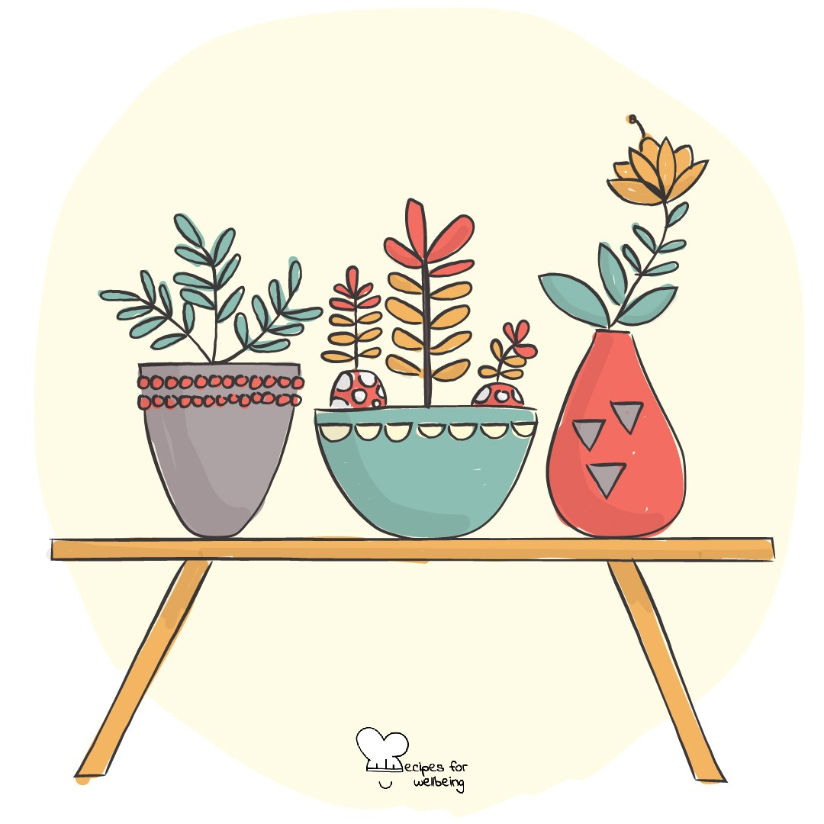
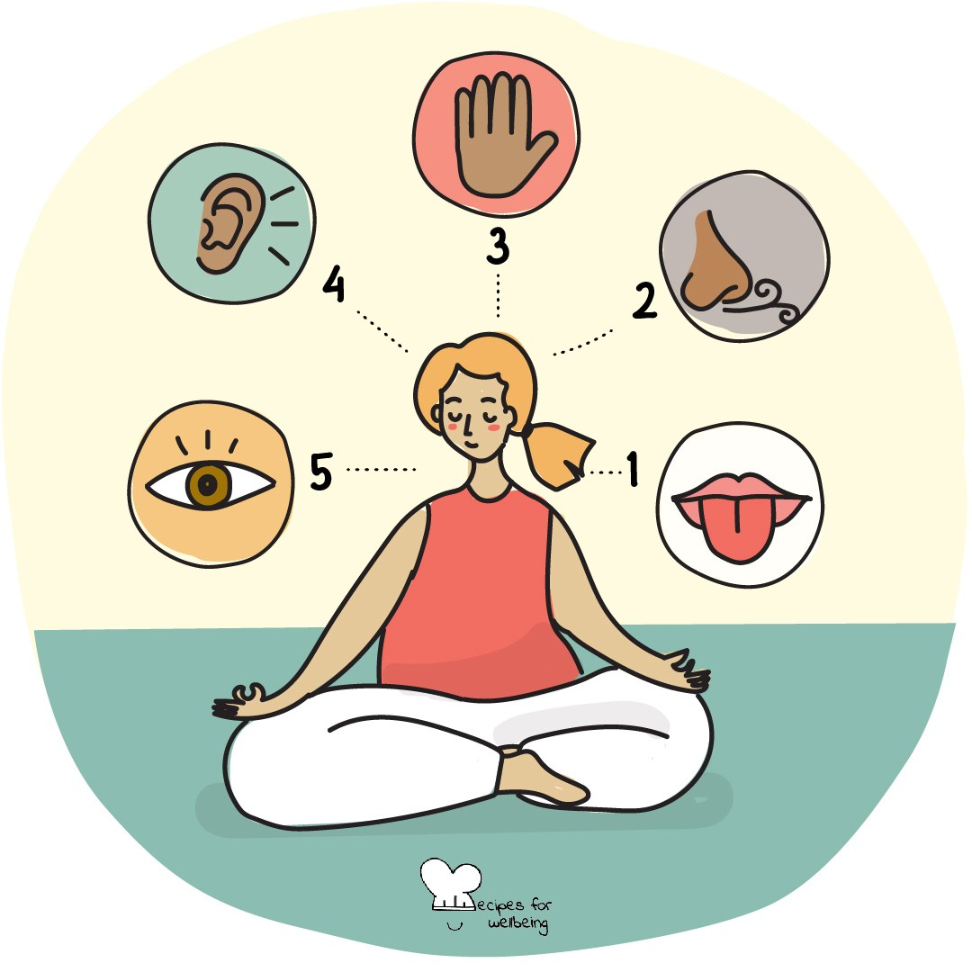
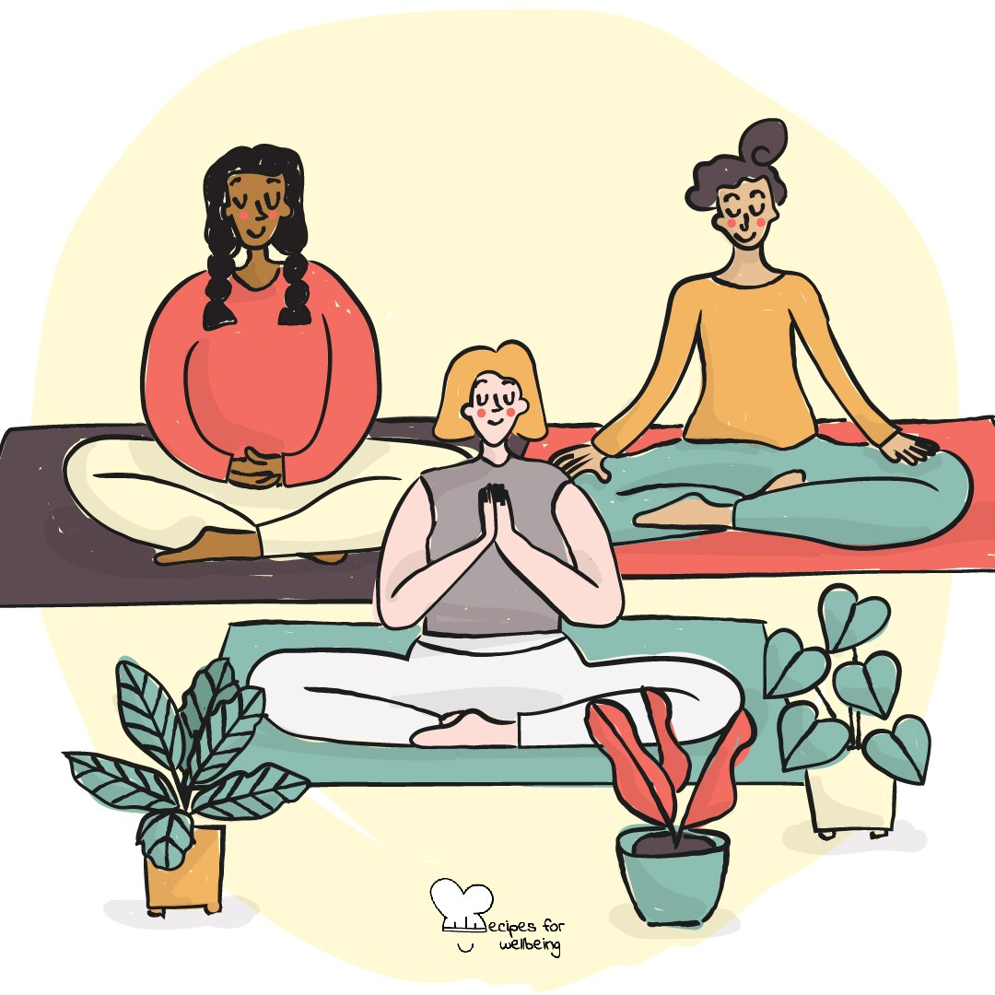
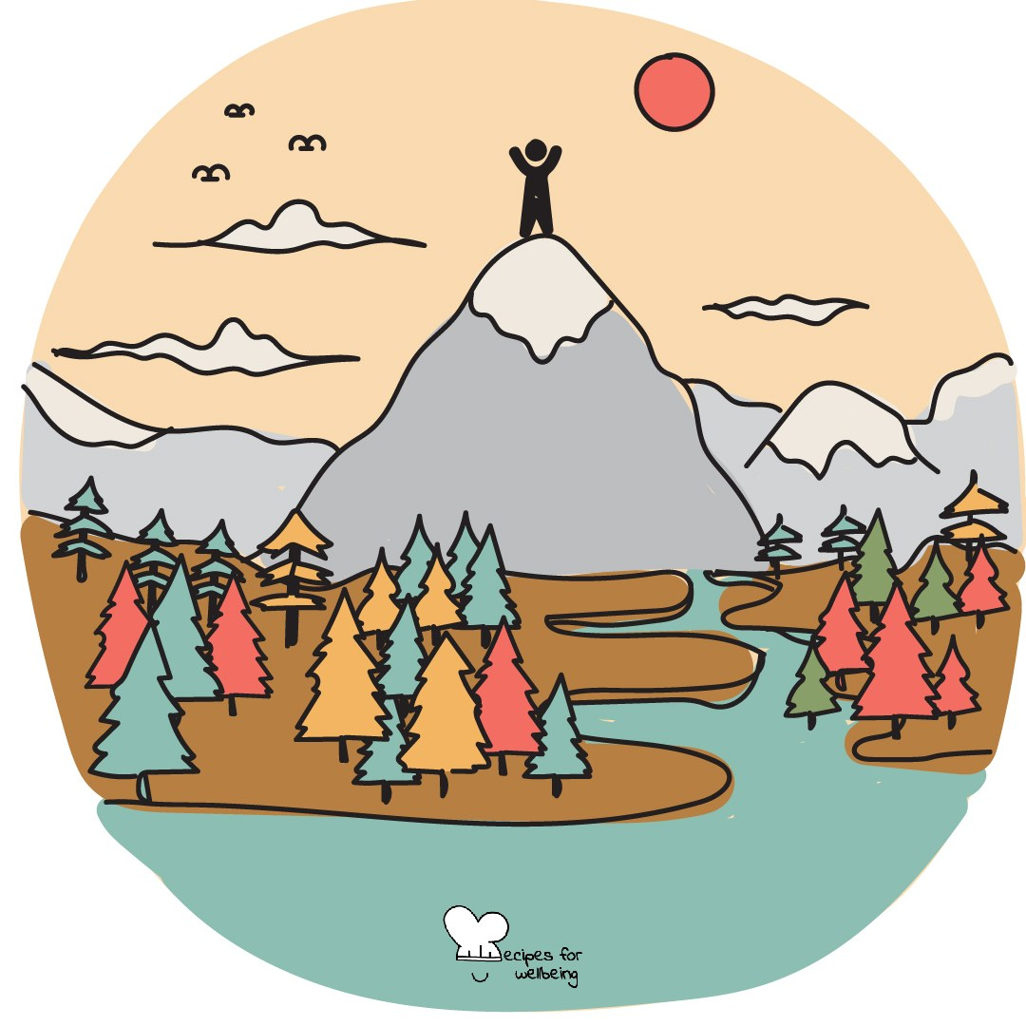
Five-Minute Practice Cards
52 classroom micro-practices · Recipes for Wellbeing · CC BY-NC 4.0

Slide 2
Holding the room
These practices are chosen to be low-risk: nothing here invites sharing heavier than a word or a sentence.
If a practice surfaces something for a student: pause, normalise, and don't press for detail.
Follow up privately, and use your school's counselor or pastoral pathway. You don't have to hold it alone.
If a card doesn't fit today's room, skip it. There are 51 more.

Slide 3
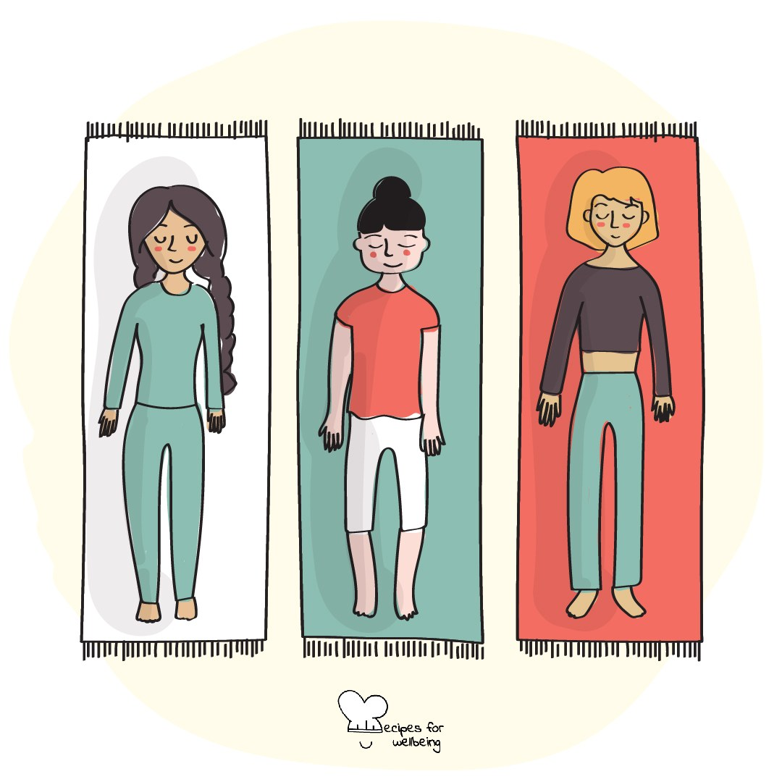
Presence · 4 min opener
Arriving here
1. Welcome back. Before we begin the new term, take a moment to arrive in this room. Sit in whatever way feels comfortable.
2. Let your attention rest on three things: a sound in the room, a feeling in your body and a thought passing through your mind.
3. You do not need to change what you notice. Paying attention to it is the whole practice.
4. When you are ready, bring your attention back to the room and look up.

Slide 4
Gratitude · 5 min closer
Three good things
1. Before we pack up, bring to mind three small things that went well today. Ordinary moments count, and they do not need to matter to anyone else.
2. If you are comfortable, share one of them with the person next to you and listen to one of theirs.
3. Keep the other two for yourself. Taking part silently also counts.

Slide 5
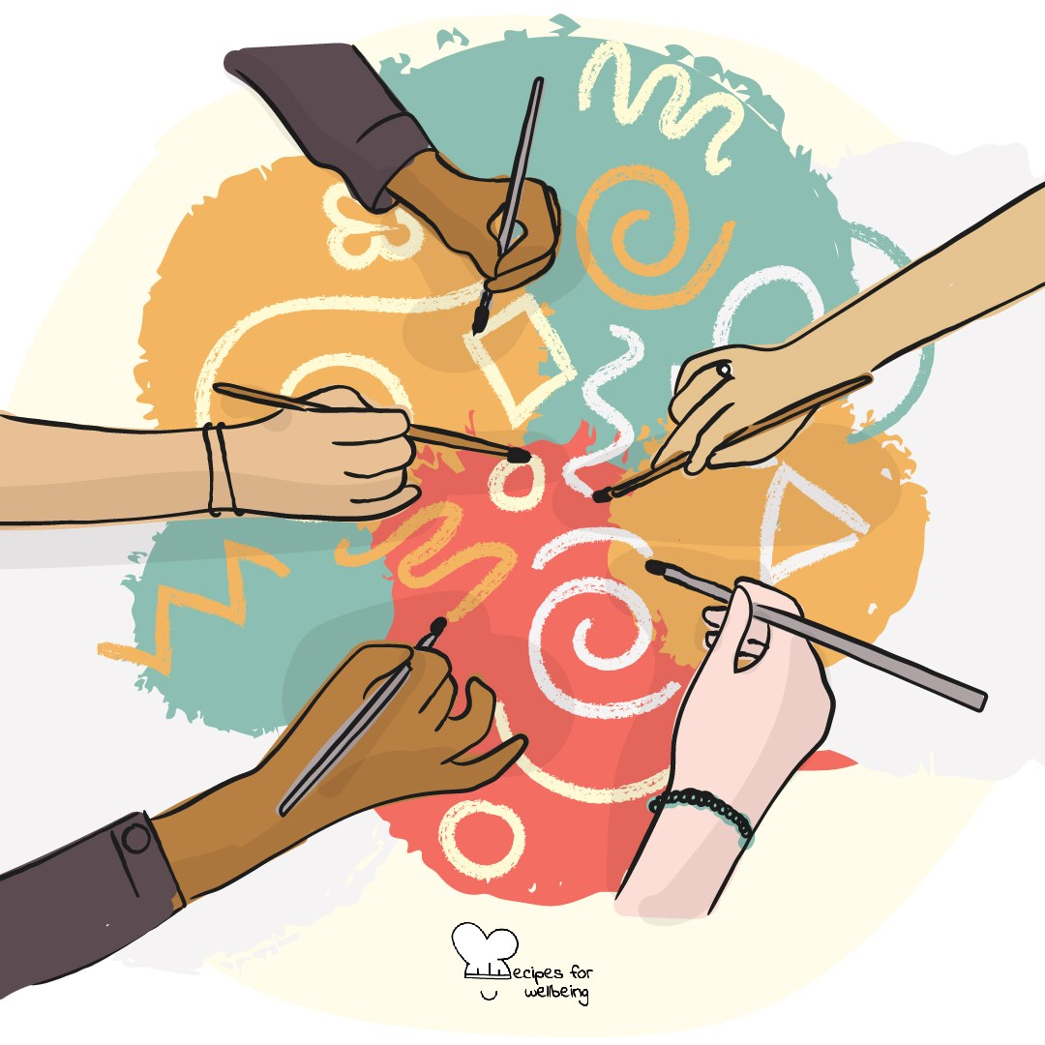
Community-building · 4 min opener
Make it rain
1. Autumn is here, so let's make a rainstorm together. It gets loud: if that is hard today, rub your palms only or just watch. Follow my hands and rub your palms as the wind rises.
2. Add the first drops by clicking your fingers, move into steady rain by clapping, and then pat your legs to make the sound of a downpour.
3. We will bring the storm down in the opposite order: from patting to clapping, then clicking, then rubbing our palms until the room is quiet again.
4. Take a moment to notice what we made together by listening to one another.

Slide 6
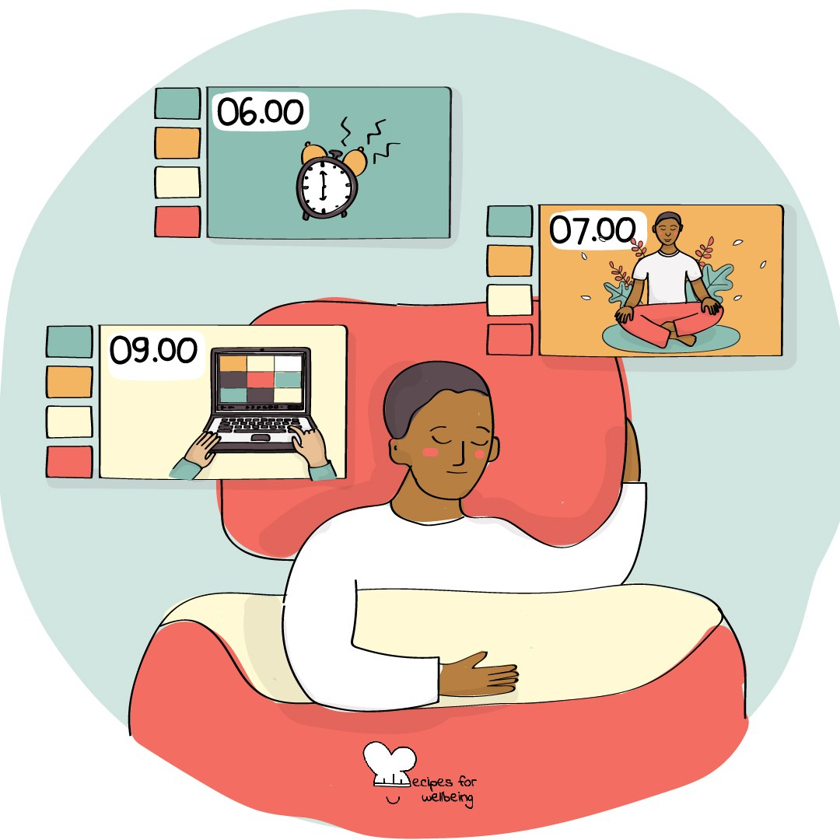
Pausing · 3 min opener
Ninety seconds of nothing
1. For the next ninety seconds, there is nothing you need to produce and nothing you will be asked to show afterwards.
2. Let your eyes rest wherever is comfortable, perhaps on the window or the desk, and let the chair hold some of your weight.
3. Your mind may say this is pointless, or remind you of the next thing on your list. You can notice those thoughts without following them.
4. I will keep the time so that you do not have to. The ninety seconds begin now.

Slide 7
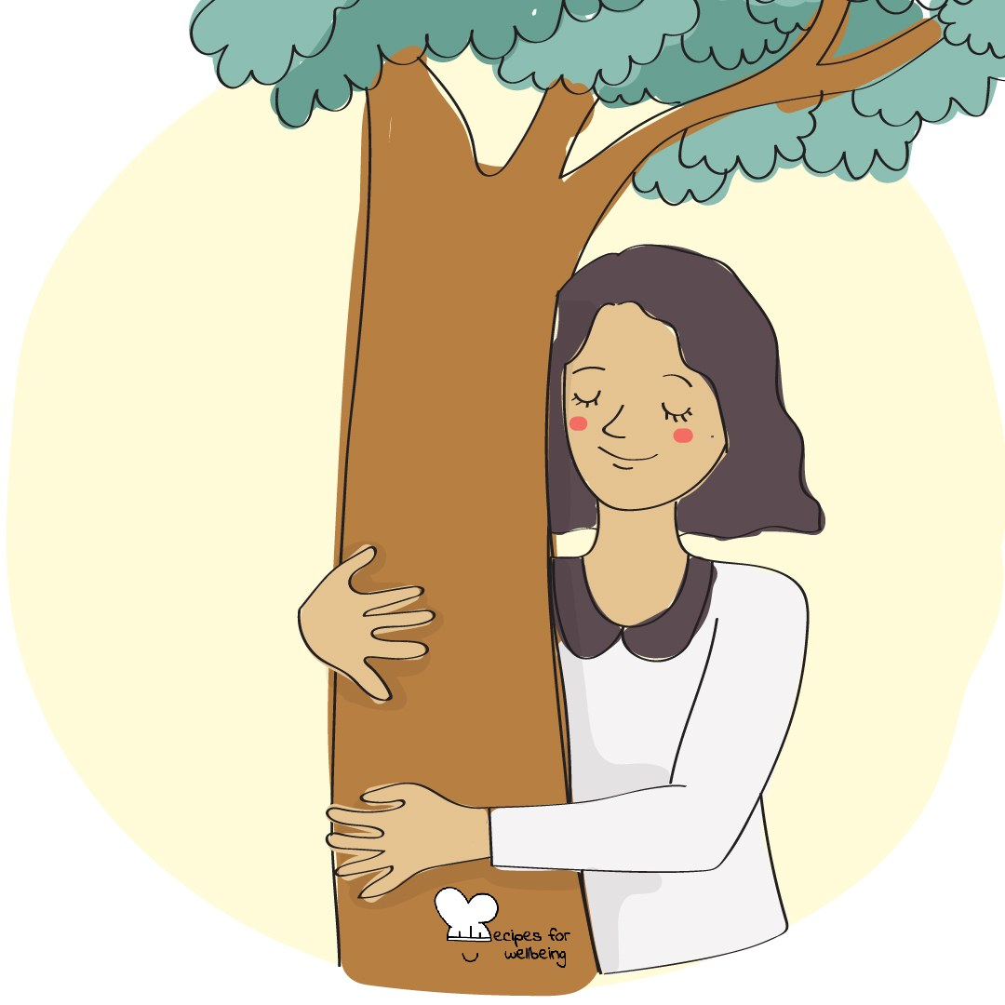
Bioinspiration · 4 min opener
What the trees are doing
1. At this time of year, many trees are letting go of leaves that have reached the end of their season.
2. Look at a tree through the window, or bring to mind one you know, and spend a moment with it.
3. Ask yourself quietly if there is something small from this week you are ready to put down, perhaps a worry you no longer need to carry or a plan that has already changed.
4. You do not need an answer or to share anything. The question is enough for today.

Slide 8
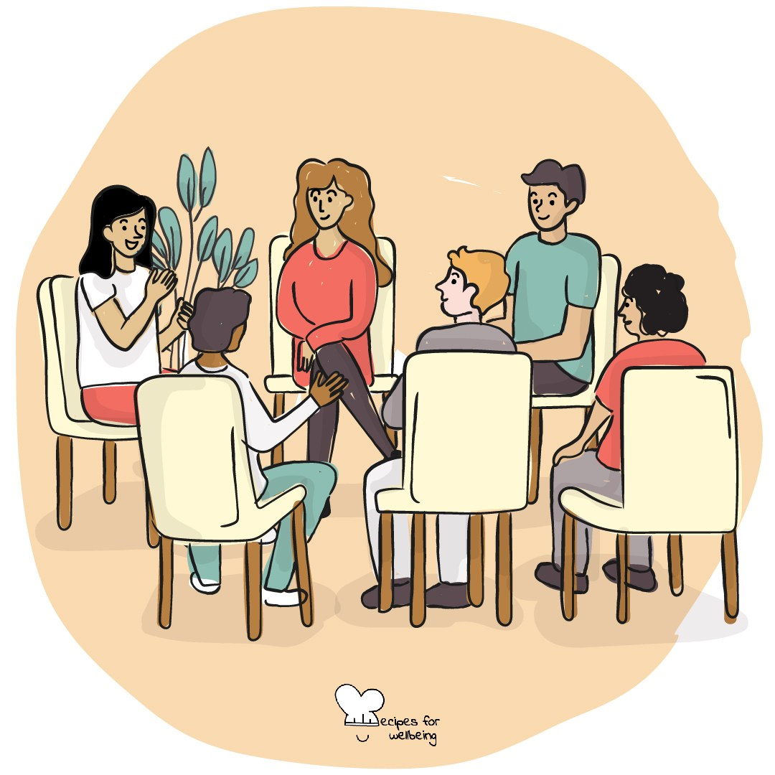
Listening · 4 min closer
One word for the road
1. Before we go, I will invite each person to offer one word for how they are leaving the room. Any honest word is welcome, including "tired" or "hungry".
2. We will receive each word as it is, with no explanation or reply, and a little silence between people.
3. You can say your word, say "pass", or shake your head, and I will move on.
4. I will go first, and then we will make our way around the room.

Slide 9
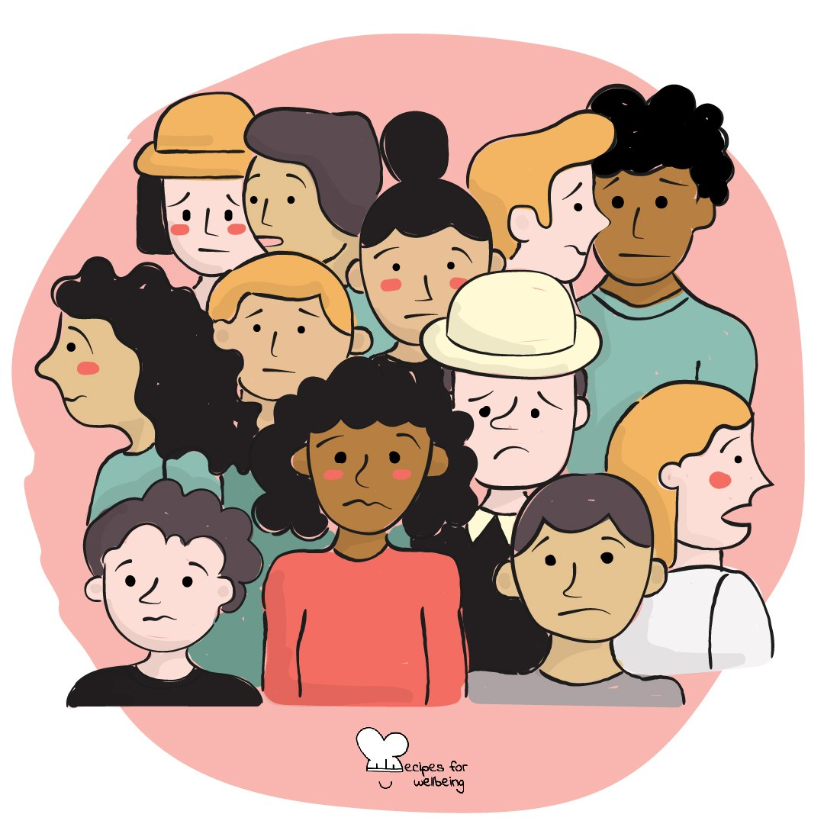
Stress management · 4 min opener
Befriending the flutter
1. As the term gets busier, you may notice a tight or fluttery feeling somewhere in your body.
2. See if you can find where that feeling sits, without needing to explain it. Perhaps your chest, stomach, shoulders or jaw.
3. Let the feeling be there for a moment without fighting it or asking it to go. You do not have to like it.
4. Take one slow breath and notice the space around the feeling. It may stay exactly as it is, and you can still decide what to do next.

Slide 10
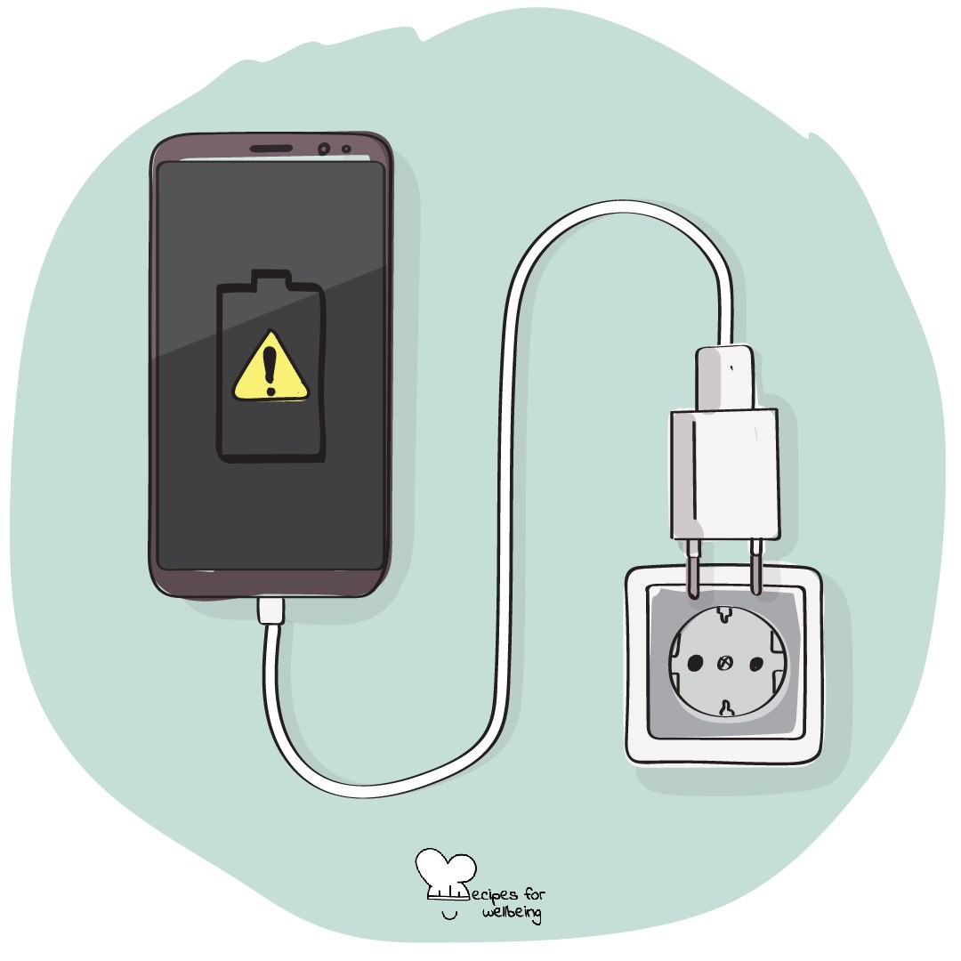
Digital agency · 3 min opener
The unopened phone
1. Wherever your phone is right now, leave it there. For one minute, notice any pull you feel to check it.
2. Notice how the urge shows up, perhaps as a movement in your hands or a thought about something you might be missing.
3. Each time you notice it, name it silently as "the pull" and let it pass without reaching for the phone.
4. When the minute ends, notice what it was like to feel the pull and not follow it straight away.

Slide 11
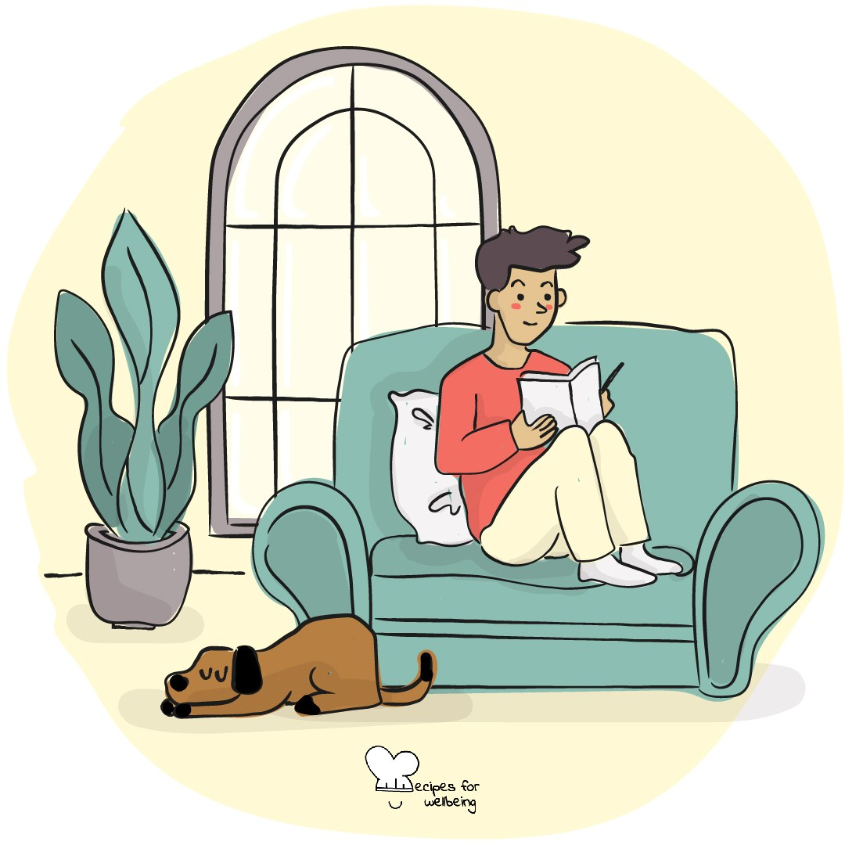
Ordinariness · 4 min closer
The done list
1. A to-do list keeps our attention on what remains. Before we leave, let's notice some of what is already done.
2. Count three things you did today on your fingers. Arriving in the room counts, and so does asking a question or making it through something difficult.
3. Take a moment to recognise the effort behind each one, including anything nobody else noticed.
4. If you would like to, share one with the person next to you in a single sentence.

Slide 12
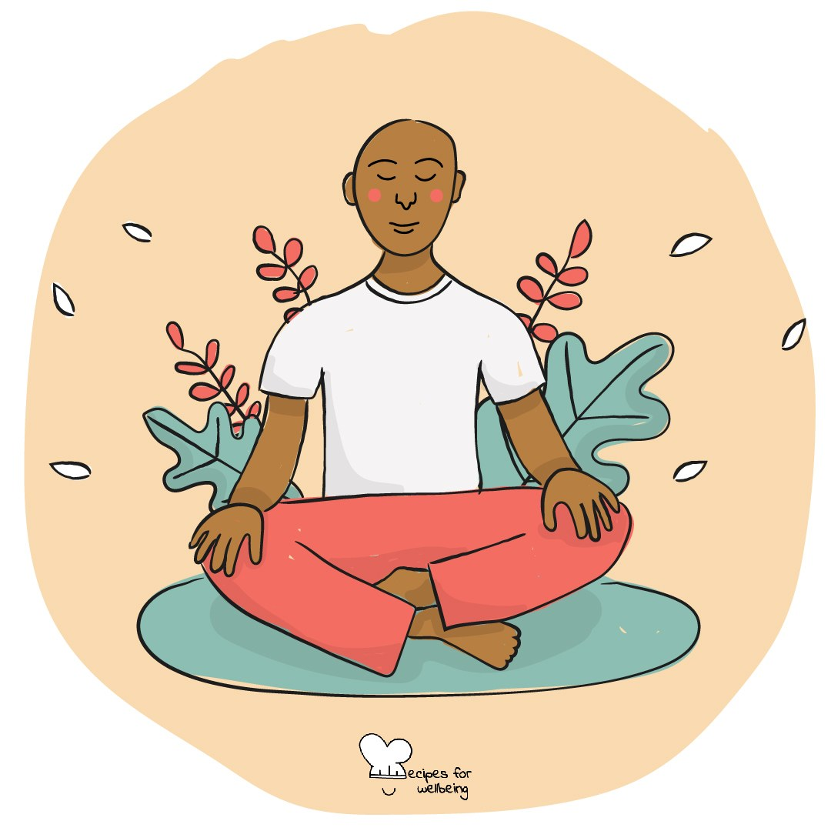
Purpose · 4 min opener
For the sake of what
1. Think quietly about one thing you are doing today that you care about getting right.
2. Ask yourself what makes it matter and who or what your effort is for, then follow the answer one step further if another thought comes.
3. Your reason may reach towards someone you care about or a future you want. It may simply be the satisfaction of doing something with care.
4. Keep the answer nearby through the day, and come back to it if it helps you remember why the effort matters.

Slide 13
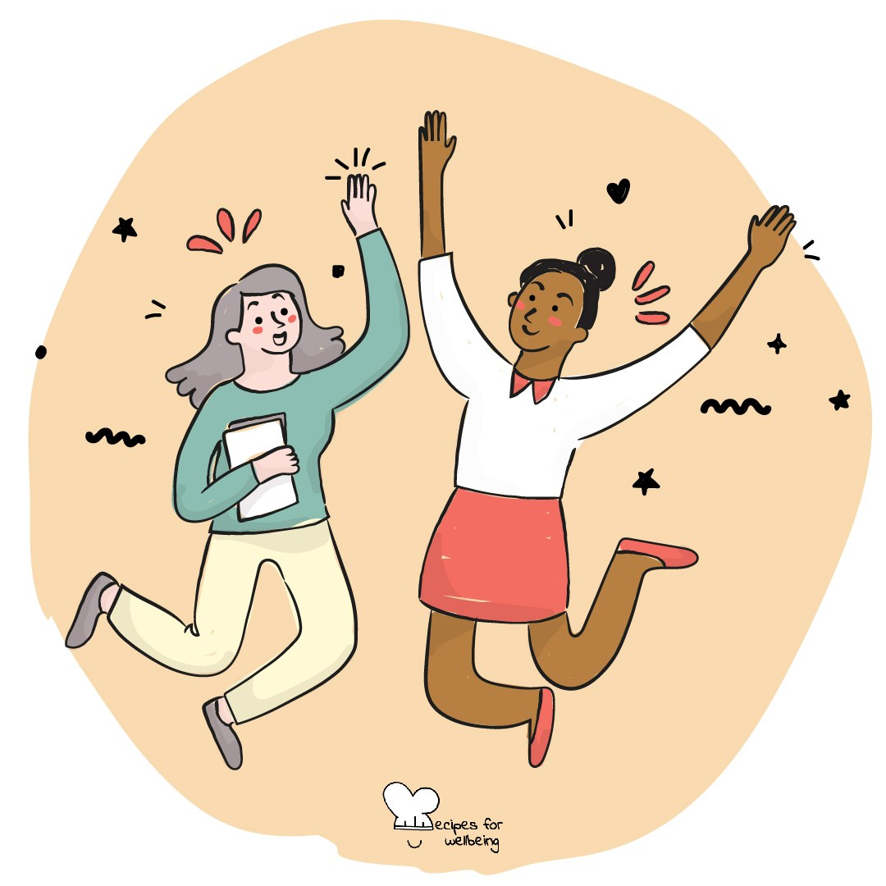
Kindness · 4 min opener
One breath for you, one for them
1. Sit comfortably and take one slow breath for yourself, letting it carry whatever you need right now.
2. Bring to mind someone you would like to send a kind wish to. You do not need to say who, or why.
3. As you breathe out, imagine sending them a quiet wish for the day ahead.
4. Continue for two more rounds, breathing in for yourself and breathing out with a kind wish for them.

Slide 14
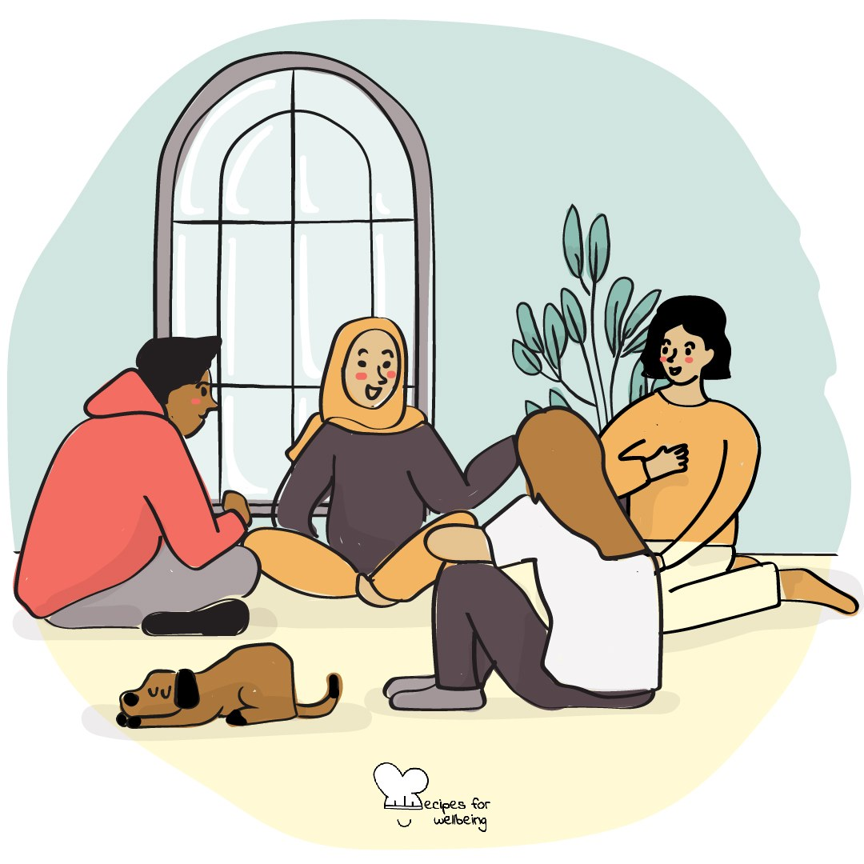
Curiosity · 5 min opener
Questions without answers
1. School gives us many reasons to look for answers. For the next two minutes, we will stay with questions instead.
2. Gather a few questions you genuinely wonder about. They can be serious or completely ordinary.
3. Choose one and resist solving it straight away. Notice what it is like to let a question stay open.
4. If you are willing, offer your question to the room. We will listen without trying to answer it today.

Slide 15
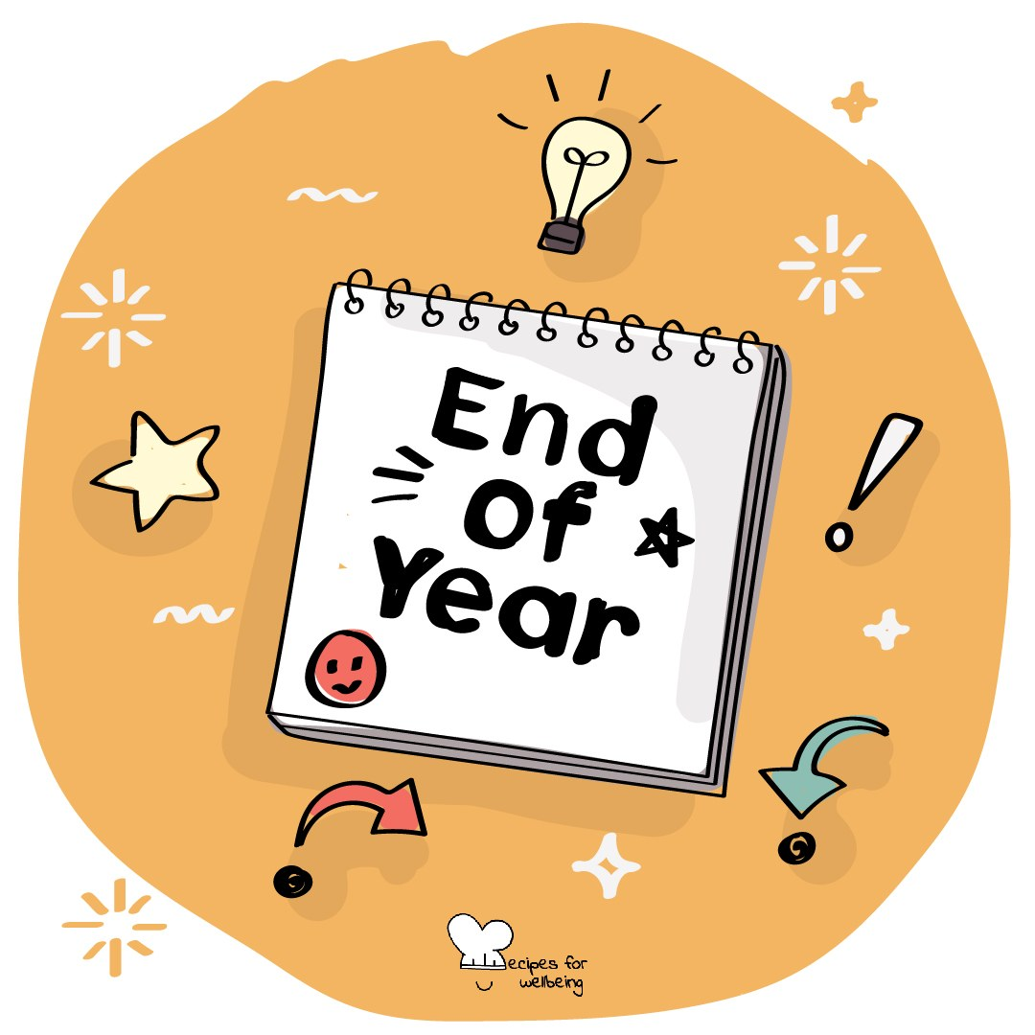
Reflection · 5 min closer
The term, looking back
1. This is our last practice of the term. Take a breath and think back to the first time you walked into this room thirteen weeks ago.
2. Finish three sentences silently by naming something you came through, something that surprised you and something you are ready to leave here.
3. Let the difficult weeks belong in the reflection too. Getting through them counts alongside anything on a report.
4. If you would like to, offer the room one word from your reflection before we close the term together.

Slide 16
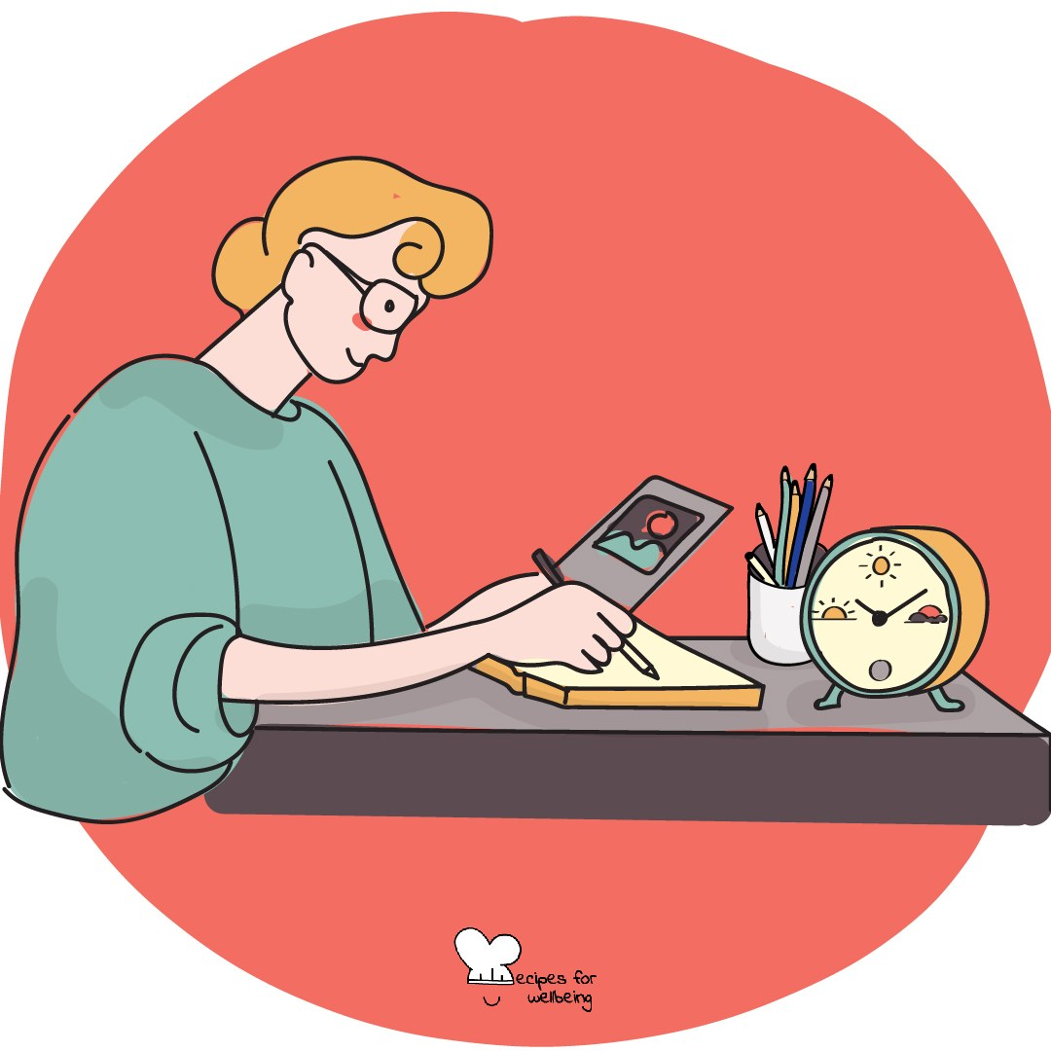
Intention-setting · 4 min opener
Crossing the threshold
1. As a new term begins, feel your feet on the floor and let your hands rest somewhere comfortable.
2. Take one slow breath for the break you are leaving behind, whatever it was like for you.
3. Take another breath for the term ahead, and see if a word comes to mind, such as "steady" or "gentle". It is fine if no word comes.
4. Keep your word private or share it with the person next to you, then bring your attention back to the room as we begin the winter term together.

Slide 17
Breathing · 3 min opener
Four, seven, eight
1. On a busy morning, counting the breath gives your attention one place to rest. You can follow the pattern, shorten any count or breathe as you usually do.
2. Breathe in through your nose for a count of four, hold gently for seven if that is comfortable, and breathe out through your mouth for eight as though you were softly fogging a window.
3. The counts are only a guide. Make them shorter, go back to normal breathing or just watch if holding your breath does not suit you.
4. Carry on for three more rounds at your own pace while I keep the room quiet.

Slide 18
Bioinspiration · 4 min opener
Sit like a mountain
1. The weather changes around a mountain through the year. For the next minute, we will borrow that image while we sit.
2. Sit as upright as feels natural, imagine the weight of the mountain beneath you and picture your head as its summit.
3. Let thoughts and feelings move through the picture like weather crossing the slopes, without holding on to them or pushing them away.
4. Take one more breath with the mountain, remembering that weather and mountains both change over time.

Slide 19
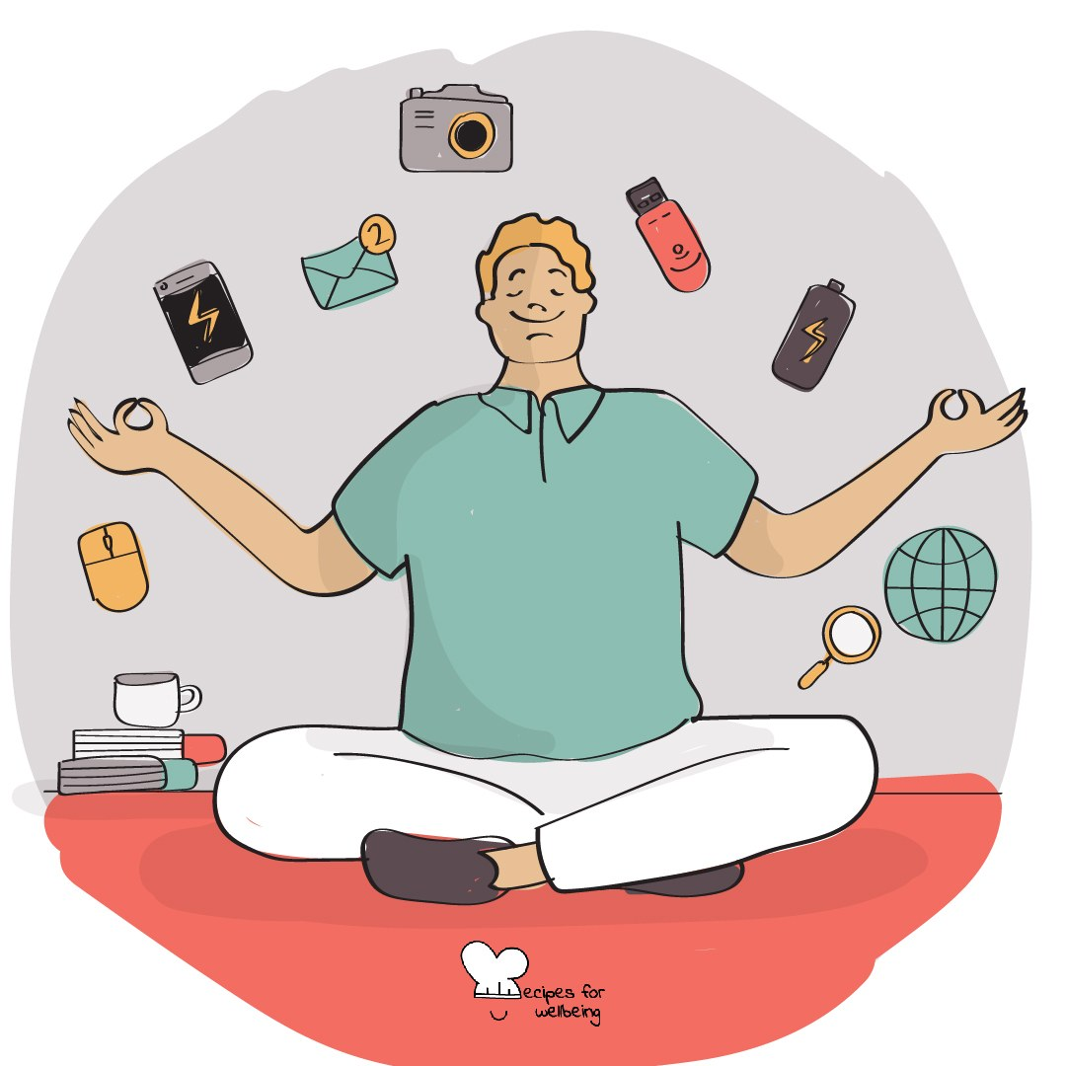
Digital agency · 3 min opener
The unchecked minute
1. Leave your phone wherever it is and spend one minute noticing what it is like not to check anything.
2. Keep your eyes open or let them soften. Notice whether the urge to check shows up in your hands, your body or a thought about what you might be missing.
3. When the urge comes, there is nothing to solve. Notice it, and then decide whether to respond.
4. As the minute ends, keep whatever you noticed private and bring your attention back to the room.

Slide 20
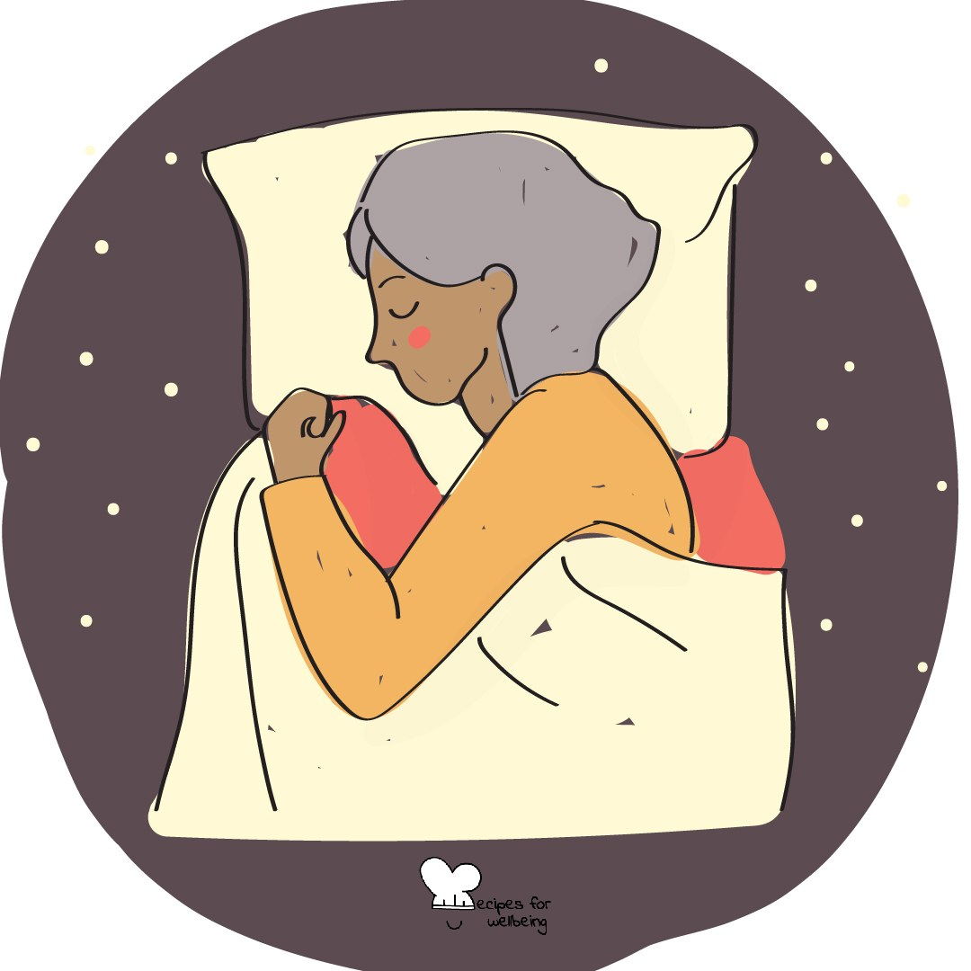
Non-performing · 3 min opener
The do-nothing minute
1. Winter can ask a lot of us, so for the next minute this class will ask nothing of you.
2. There is nothing to improve or get right. Sit, shift, doodle or let your eyes rest. You do not need to look calm or keep still.
3. Thoughts about wasting time may come. Let them pass. You do not have to earn this minute.
4. When the minute ends, take the time you need to come back to the room.

Slide 21
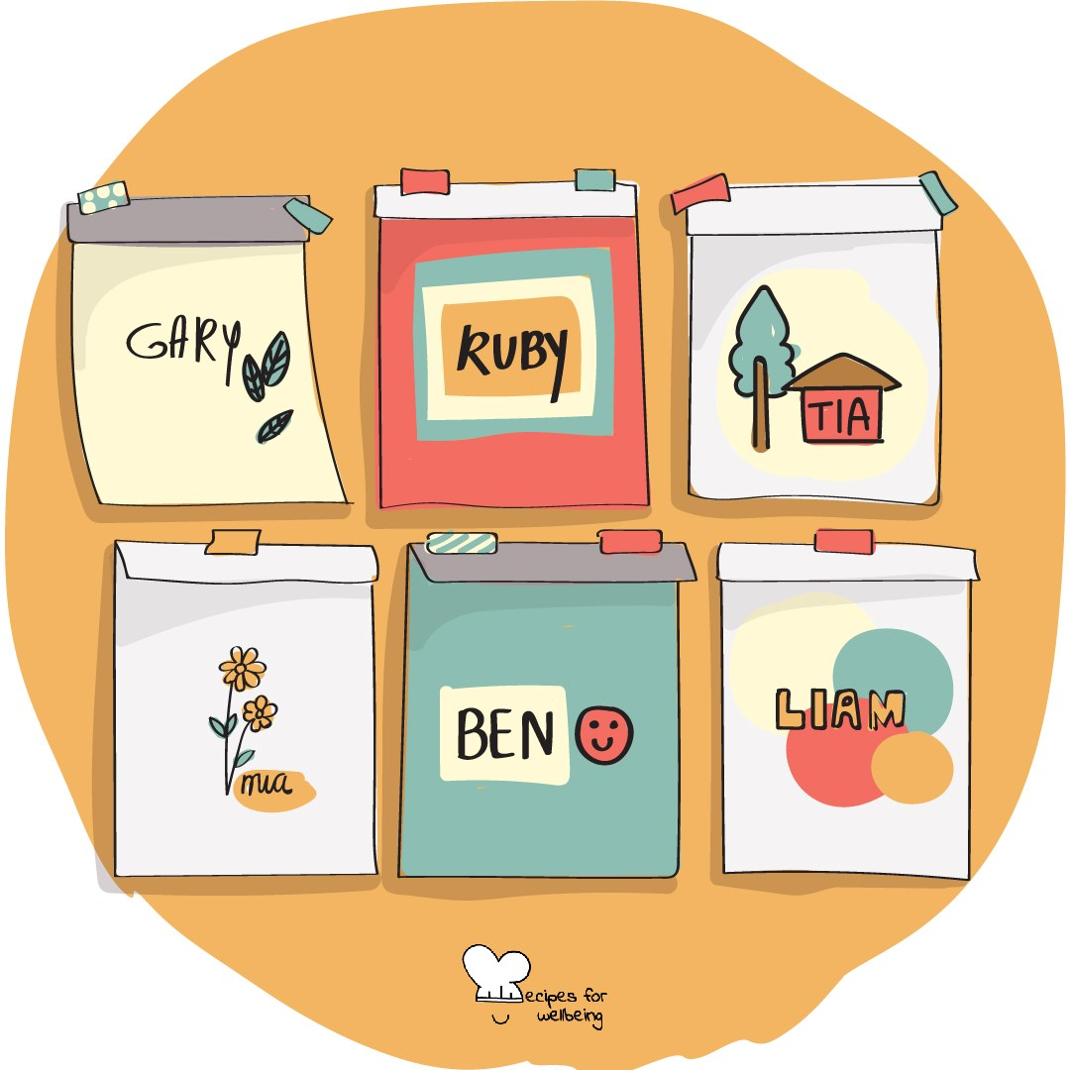
Kindness · 3 min closer
One quiet thank-you
1. Before we go, think of someone in this room whose presence helped you today, through something they did or simply by being here.
2. You do not need to say who. You might offer a quiet thank-you on the way out, or keep it to yourself.
3. If nobody comes to mind today, let the question stay open.

Slide 22
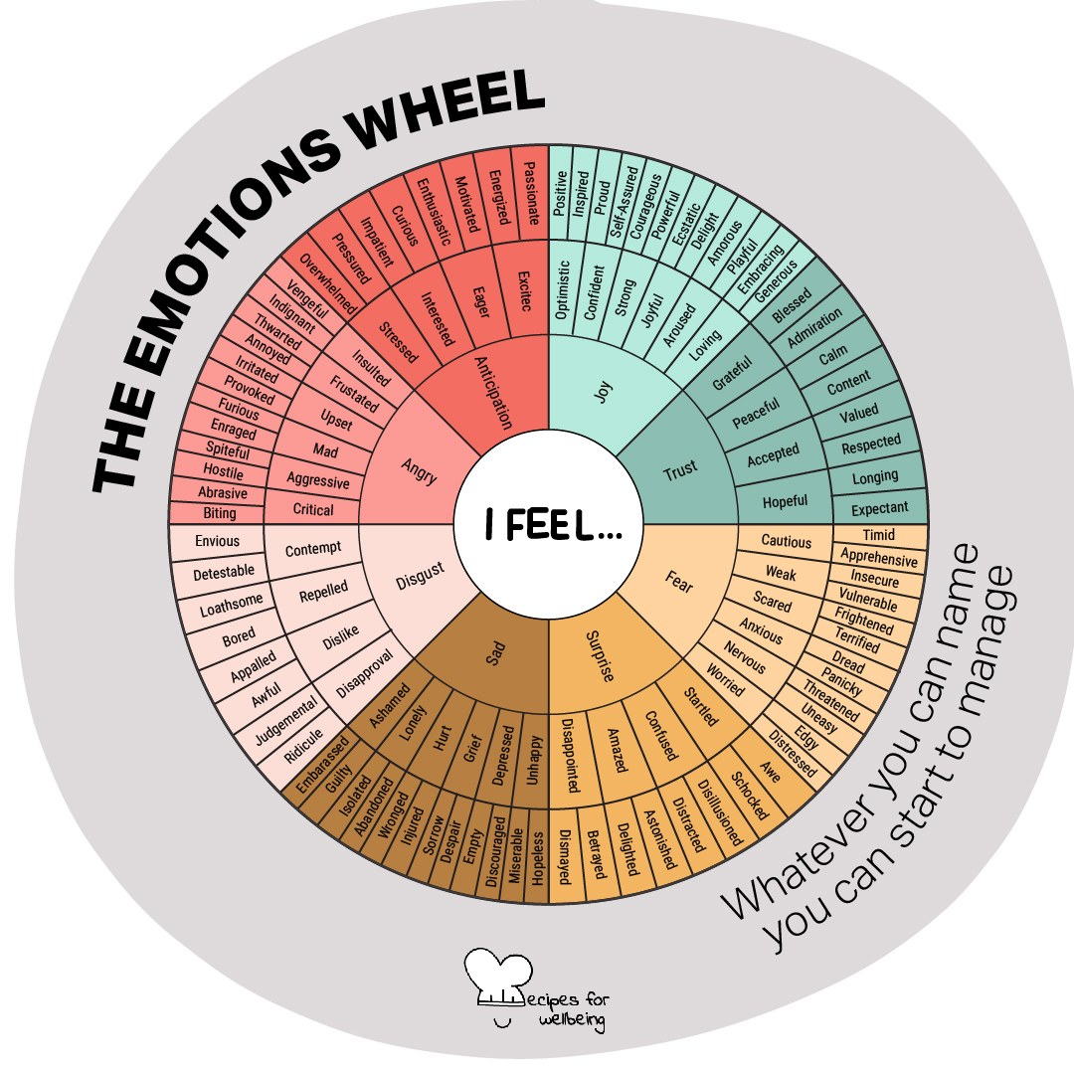
Acceptance · 4 min opener
Inner weather report
1. For a midwinter check-in, imagine the way you feel right now is a kind of weather, and find one word for it.
2. Your weather may be fog, drizzle, a storm or unexpected sunshine. There is no right forecast.
3. When I reach your row, you can offer your word, say "pass", or shake your head, and I will move on.
4. Listen to the range of weather in the room. We carry on together, with all of it present.

Slide 23
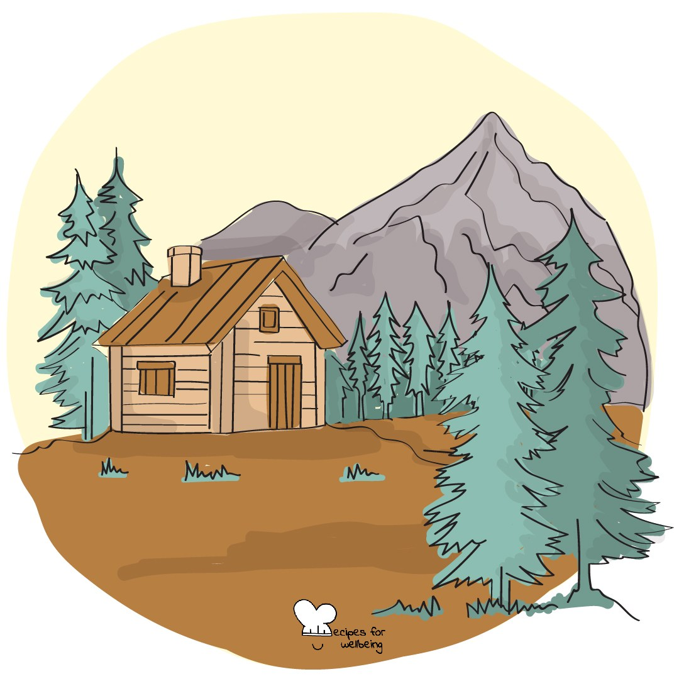
Transcendence · 3 min opener
A minute of sky
1. Before we start, look towards a window, or if you cannot see one, towards the furthest point in the room.
2. Let your eyes rest on the furthest thing you can see for a minute, and let your attention reach a little further than that.
3. Everything out there carries on without needing anything from you. Your worries can stay the same size while the space around them grows.
4. When the minute ends, bring your eyes back to the room and we will begin.

Slide 24
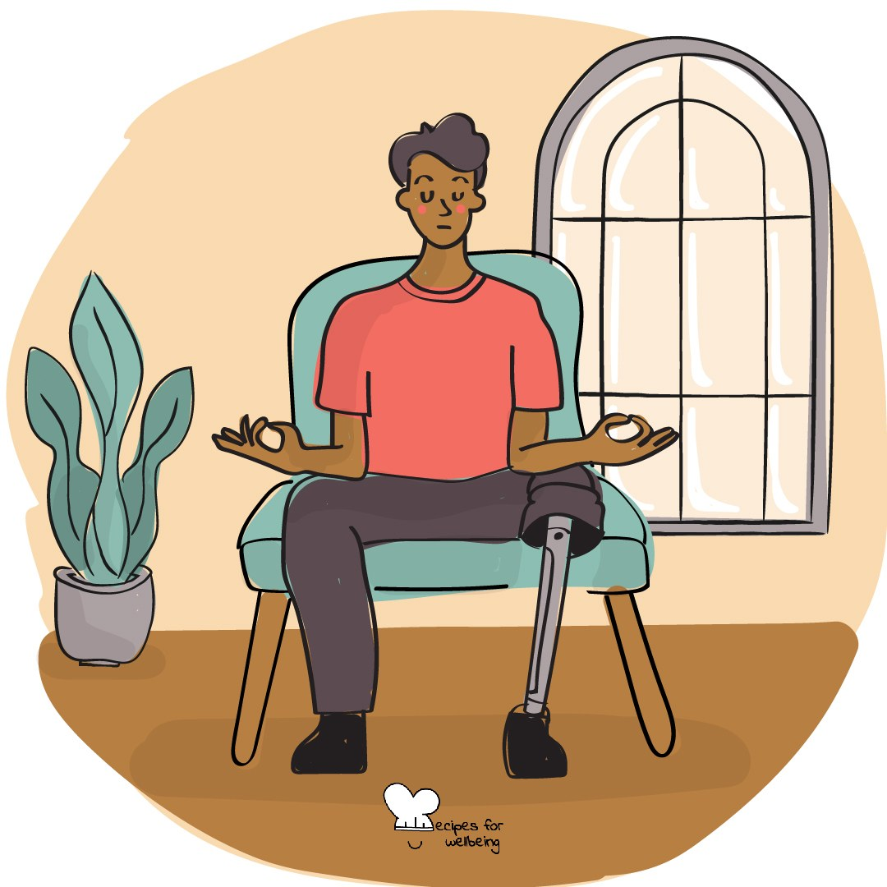
Compassion · 4 min opener
Three quiet wishes
1. Place your hands on the desk or somewhere else that feels comfortable, and take a moment to arrive.
2. Begin with a quiet wish for yourself, in words that feel natural to you, such as "May today feel a little easier."
3. Offer the same wish silently to someone you care about, without needing to say who they are.
4. Finally, send a kind wish to the whole room, including people you do not know well.

Slide 25
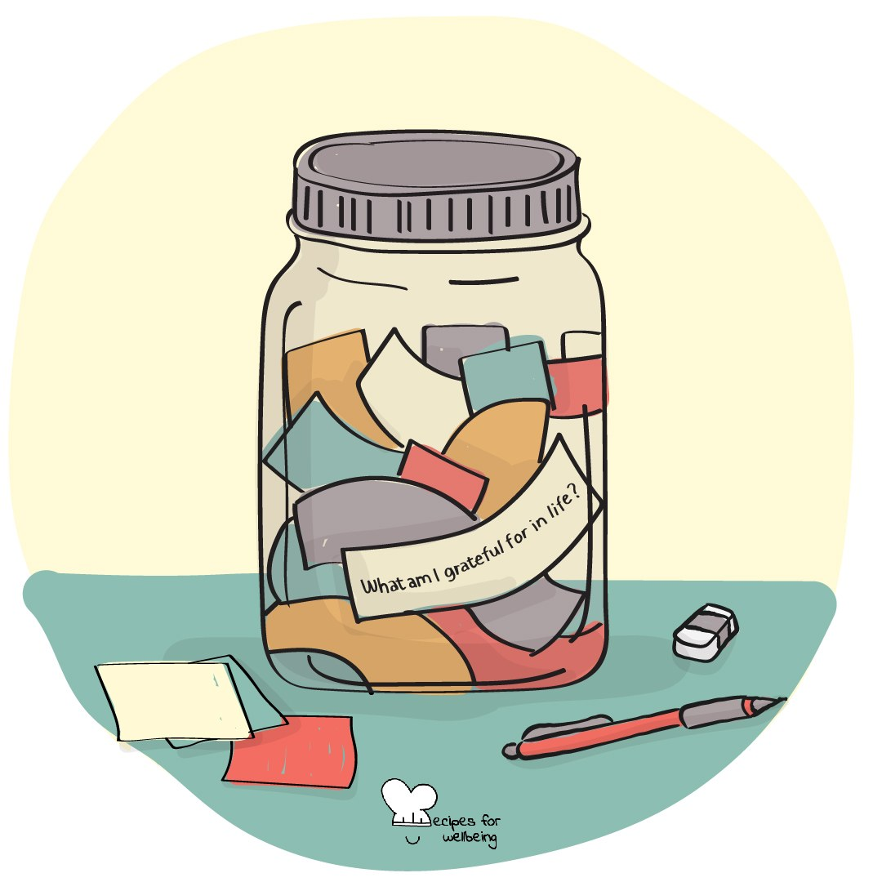
Celebration · 4 min closer
Who helped it happen
1. Before you pack up, think of one thing that got finished recently, however small, such as a piece of work handed in or a hard week that is now behind you.
2. Hold it in mind for a moment, and let it count before you move on.
3. Now think of anyone who helped it happen, perhaps someone who explained something, waited for you or made you laugh on a long day.
4. If you would like to, thank them quietly in your head, or later in your own way. Nobody needs to know what you chose.

Slide 26
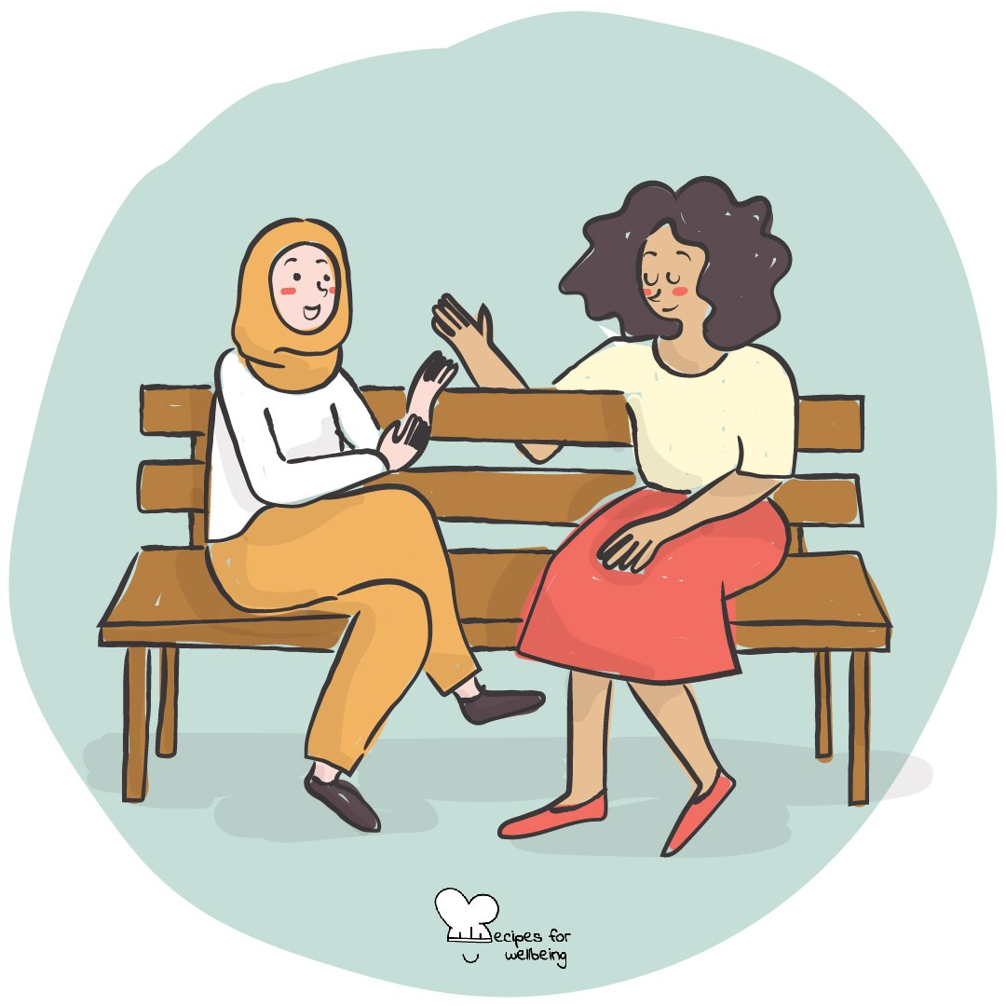
Curiosity · 3 min closer
Leave with a question
1. We are going to close with a question. Think back over the day and notice one thing you are still curious about.
2. It does not have to come from this subject. It might begin with "Why does that work?" or "Who decided that?"
3. You do not need to answer it today. Some questions are worth carrying for a while.
4. If you would like to share yours, tell me on the way out in one sentence. There are no marks attached.

Slide 27
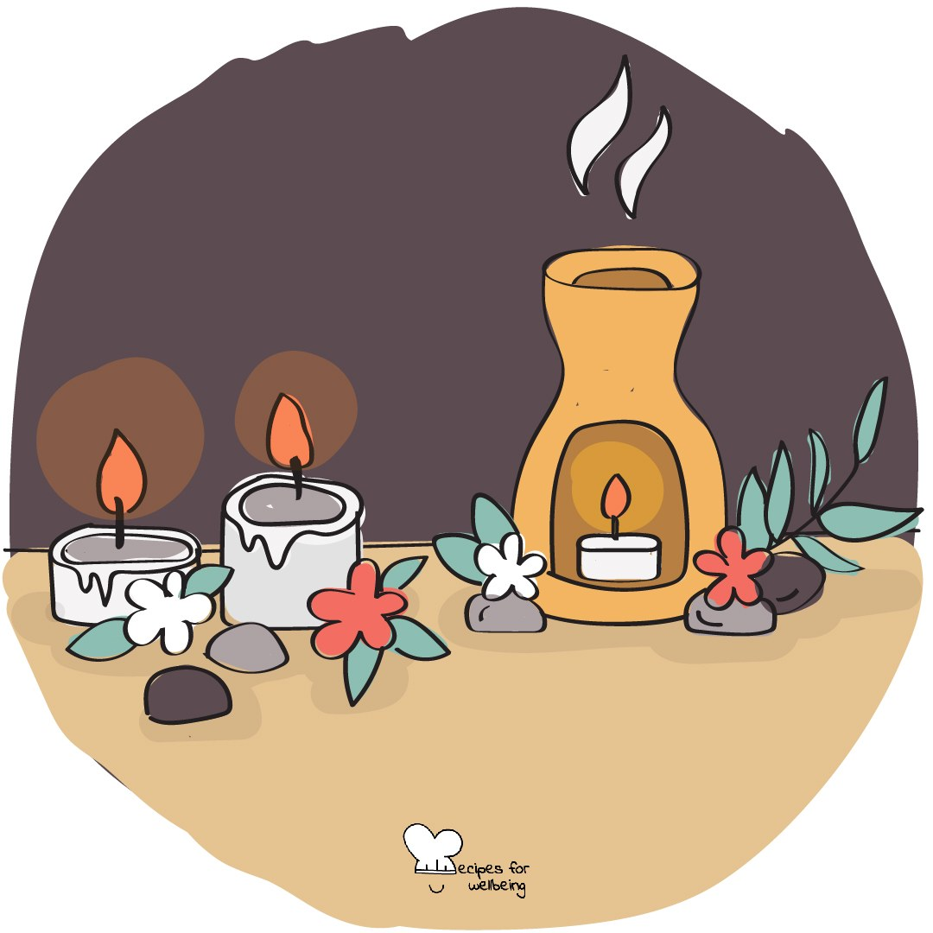
Gratitude · 5 min closer
The gratitude round
1. In these last few minutes, bring to mind three things from this week you feel grateful for. Try to include one that involved another person.
2. If you are comfortable, share that one with your neighbour using the sentence "Someone made my week better when..." and listen to their answer.
3. As you listen, notice the many ordinary ways we affect one another's week.
4. Keep the other two to yourself and take them with you into the weekend.

Slide 28
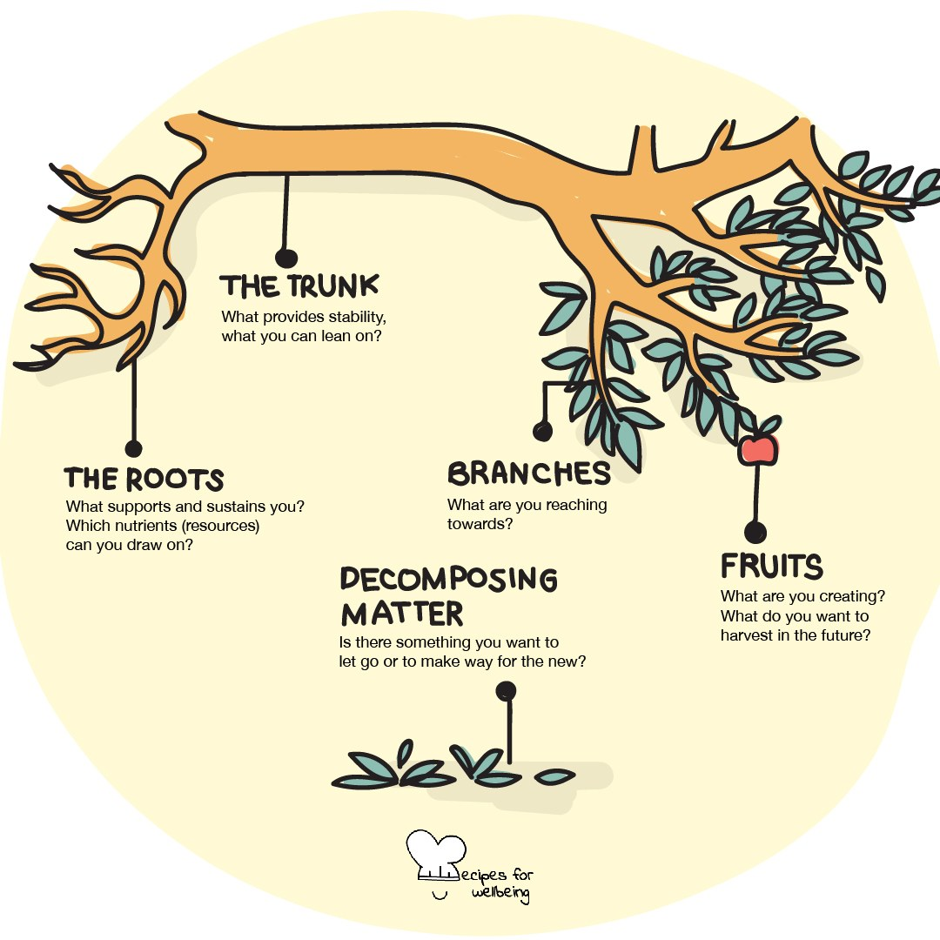
Reflection · 5 min closer
Rings of the term
1. As the term ends, picture it as one of the rings inside a tree, holding a record of the season that has passed.
2. Close your eyes if you like, and imagine where the ring is thick with effort, and where growth was slower or harder to see.
3. Choose one thing from the term that you would like to keep and one thing you are ready to leave in the season behind you.
4. If you are willing, offer one word for the term as you pack up. Then let the reflection end and the break begin.

Slide 29
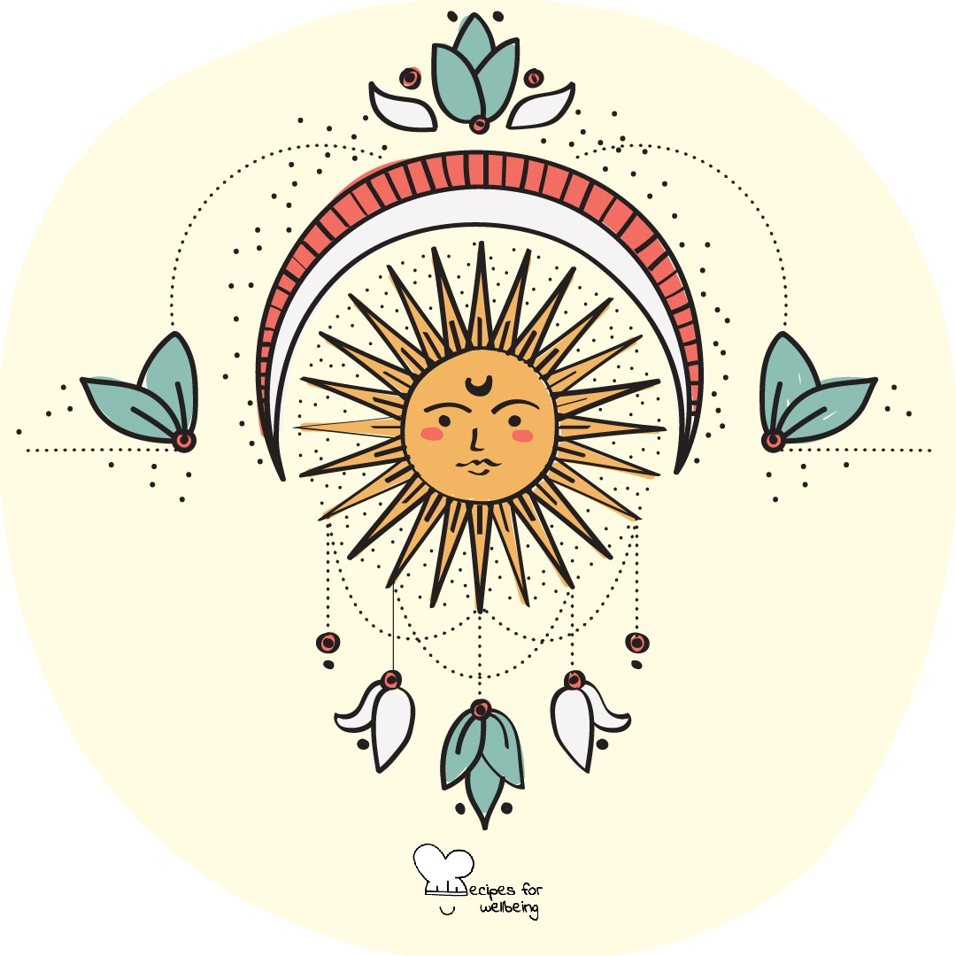
Intention-setting · 4 min opener
Crossing the threshold
1. Welcome back. As we begin a new term together, settle into your seat and let your shoulders drop.
2. Notice one thing that has changed since we last sat here, perhaps the light outside or something you recognise in yourself.
3. Choose one private word for how you would like to meet the term ahead. The word is yours, and nobody will collect it.
4. Hold the word in mind for one quiet breath, then look up when you are ready to begin.

Slide 30
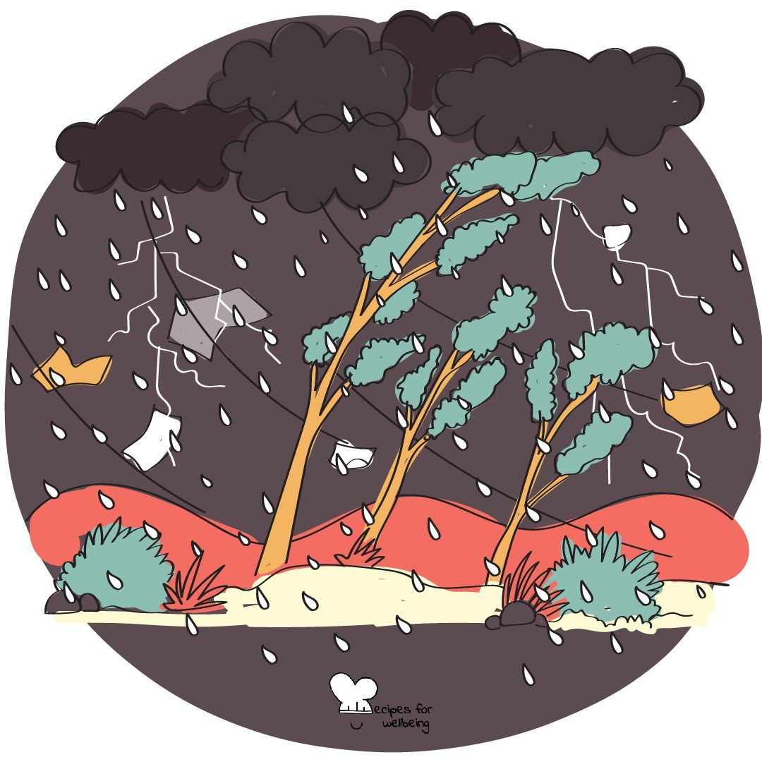
Collaboration · 4 min opener
Rainstorm
1. Let's make the sound of a rainstorm together. It gets loud: if that is hard today, rub your palms only or just watch. Follow my hands and rub your palms as the wind rises.
2. Click your fingers to add the first drops, and listen as the sound travels around the room.
3. Move into steady rain by clapping, then drum your palms gently on the desks as the storm reaches its peak.
4. Follow me back through clapping, clicking and rubbing until the room is quiet again. Notice what we made together without a word.

Slide 31
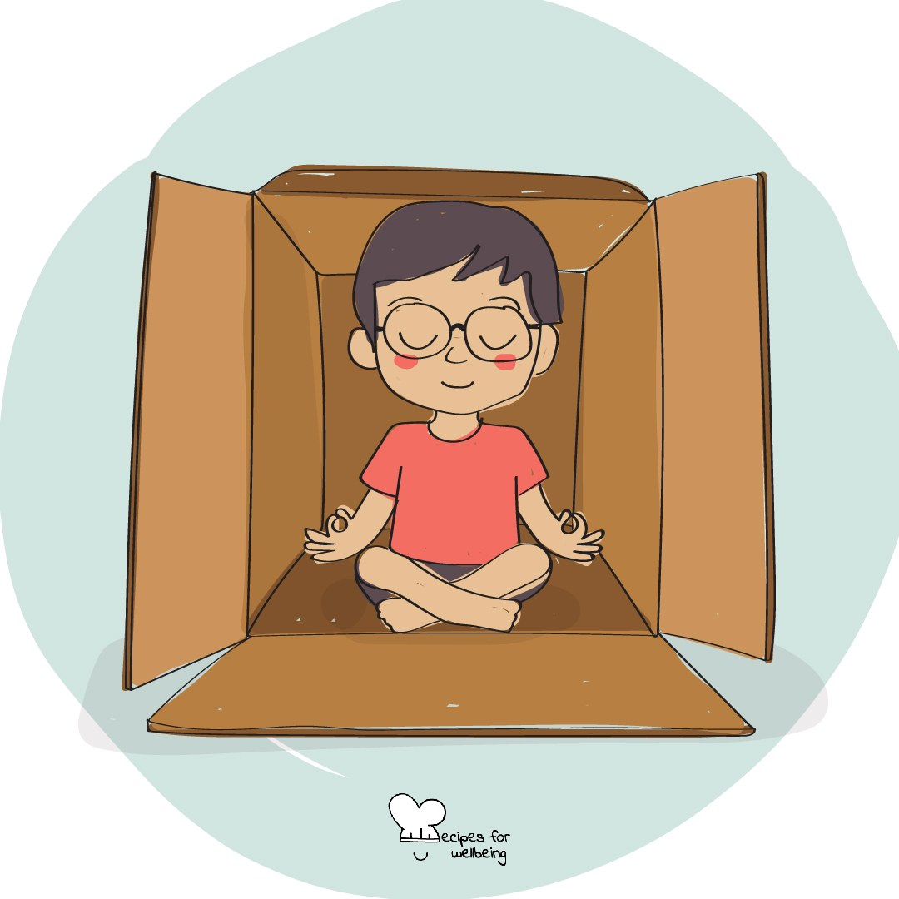
Breathing · 3 min opener
Four sides of a breath
1. A new term can bring a lot at once, so for the next minute we will give our attention to the four sides of a breath.
2. Breathe in for four counts, hold for four if that is comfortable, breathe out for four and pause for four, as though you were drawing a slow square in the air.
3. We will trace three squares together. If you lose count, rejoin on any side. If holding your breath is uncomfortable, shorten the pause or breathe normally.
4. Follow the last square at your own pace, then notice how you feel, without needing anything to be different.

Slide 32
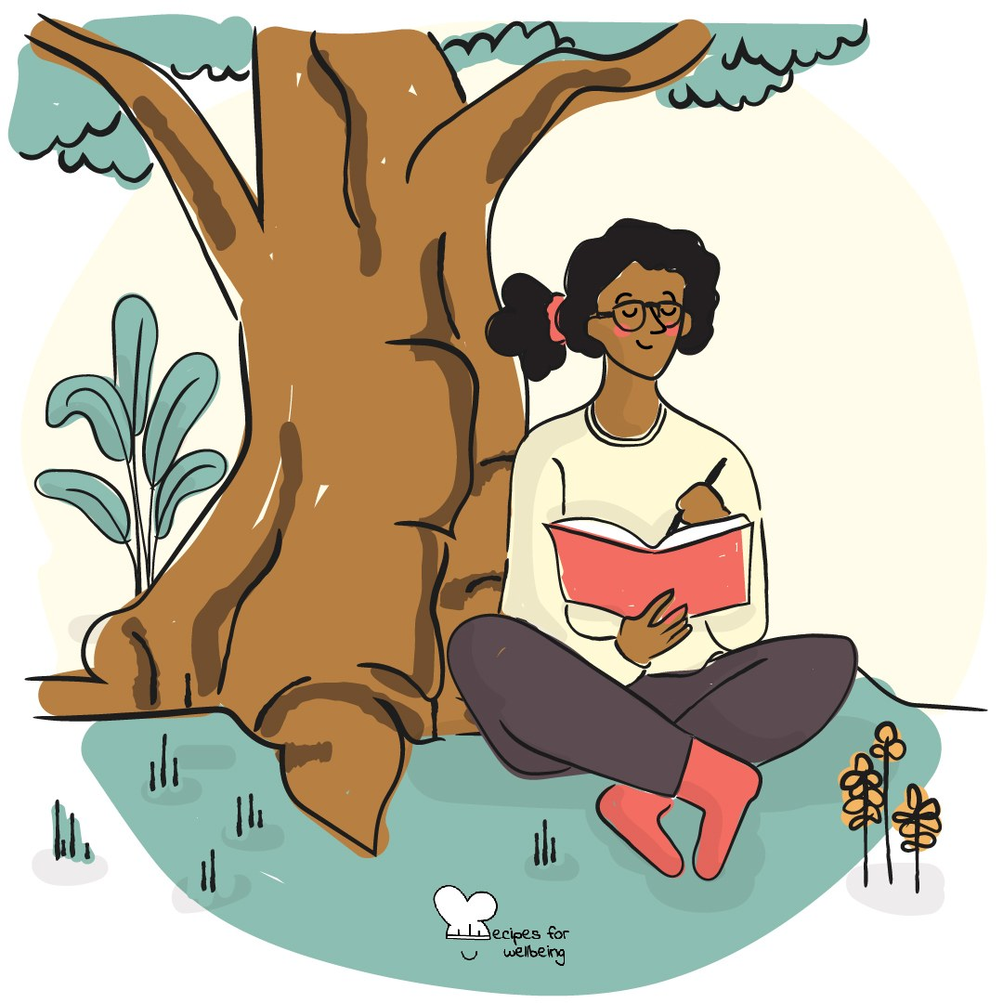
Nature sensitivity · 3 min opener
One sign of spring
1. Outside this room the season is changing. Buds are opening and the light lasts a little longer.
2. Bring to mind one sign of spring that you have noticed recently, or look through the window and find one now.
3. Hold the image for a moment and notice what it tells you about the season arriving.
4. If you would like to, describe your sign to the room in a few words.

Slide 33
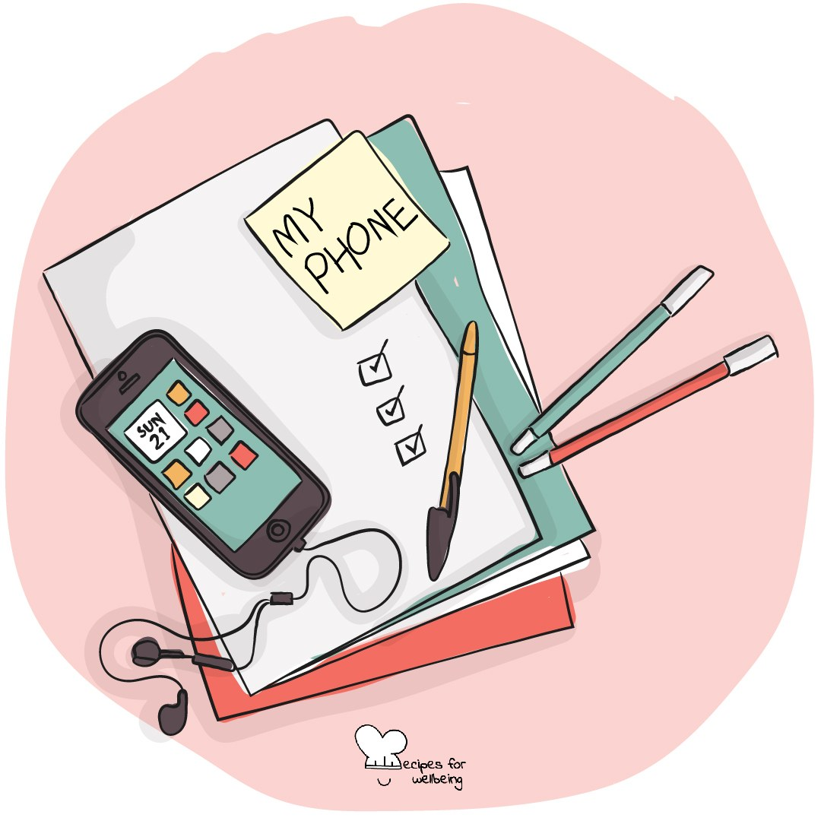
Digital discernment · 3 min opener
Where the scroll left you
1. You do not need your phone for this. Think back to the last time you scrolled, this morning or on the way to school.
2. Find one private word for how you felt afterwards. It does not have to be good or bad.
3. Imagine placing that feeling on a shelf by the door for this lesson. You can pick it up again later if you need to.
4. Take one unhurried breath and bring your attention to the room you are in now.

Slide 34
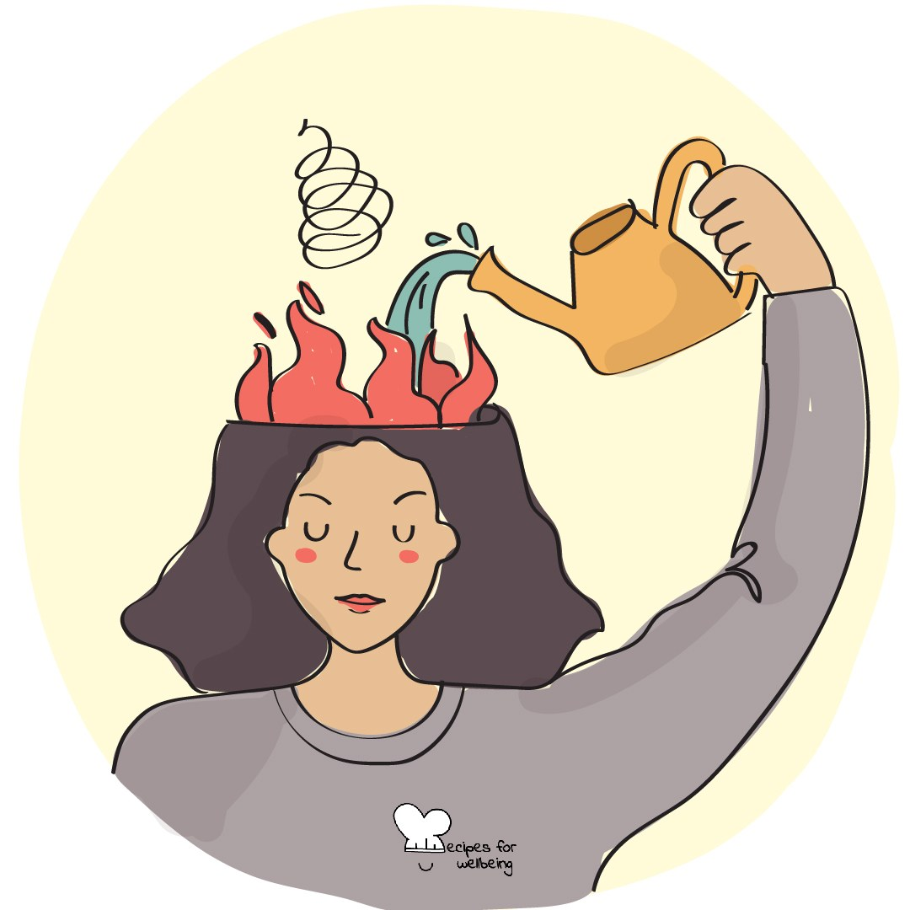
Stress management · 4 min opener
Befriending the wobble
1. Take a quiet moment to notice whether there is a wobble somewhere in your body, perhaps nerves about something coming up.
2. Instead of pushing the feeling away, see if you can turn towards it with a little curiosity. What might it be telling you?
3. Ask yourself privately whether the feeling is connected to something you care about. "I don't know" is a fine answer.
4. You do not need to fix the feeling before we begin, and you can bring your attention back to the room whenever you choose.

Slide 35
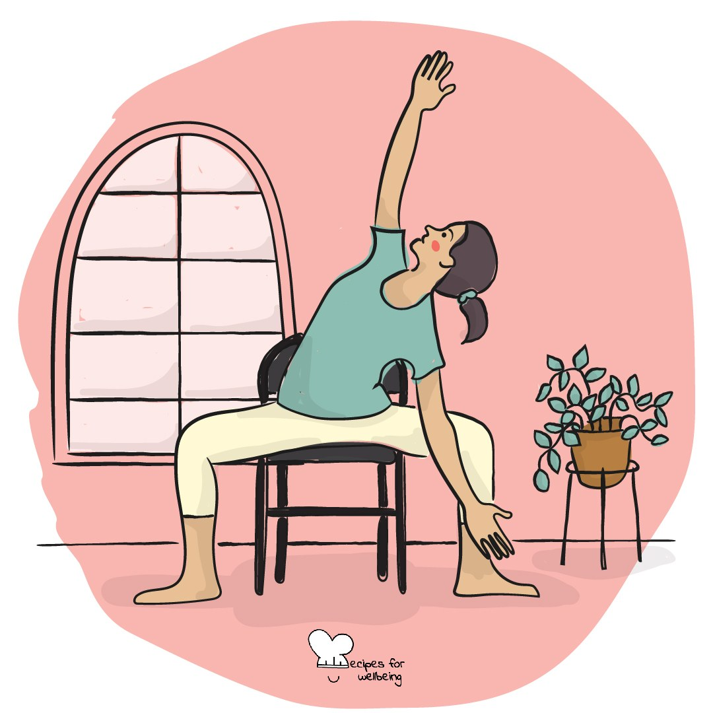
Relaxation · 3 min closer
Softening half a turn
1. Before you pack up, we will take a minute to let go of some of the grip the day has put into your body. You can keep your eyes open.
2. Start with your jaw. If your teeth are pressed together, let them part a little behind closed lips.
3. Now your shoulders. If they have crept up towards your ears, let them drop a small way, only as far as feels easy.
4. Last, your hands. Let them rest open on the desk or in your lap for a few breaths, and notice anything that feels a little softer.

Slide 36
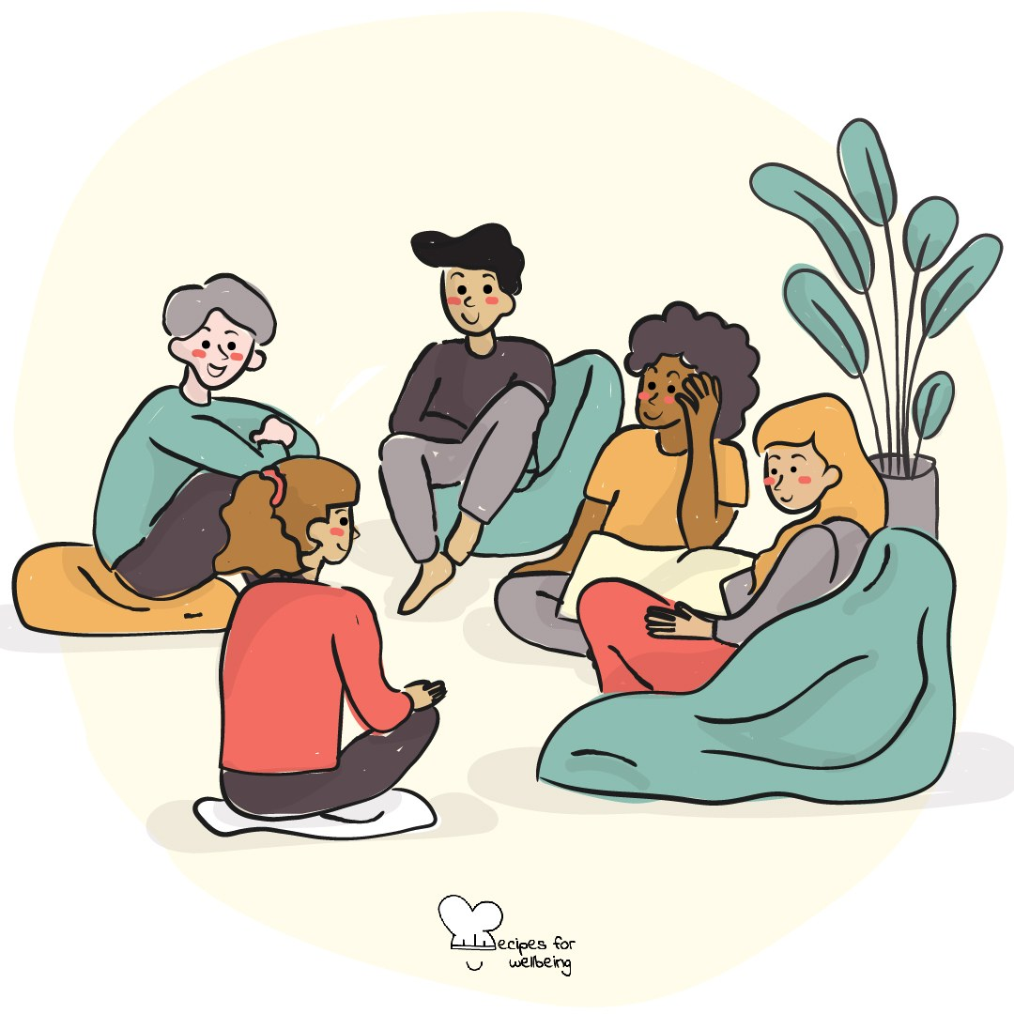
Inquiry · 4 min opener
A question with no answer
1. Here is a question that does not have one correct answer: what is something many people believe that might not be true?
2. Sit with the question quietly. No hands need to go up, and I am not waiting for a particular answer.
3. Notice what your mind does when a question stays unfinished and certainty is not on offer.
4. If you would like to, share one thought with your neighbour, even if it is still taking shape.

Slide 37
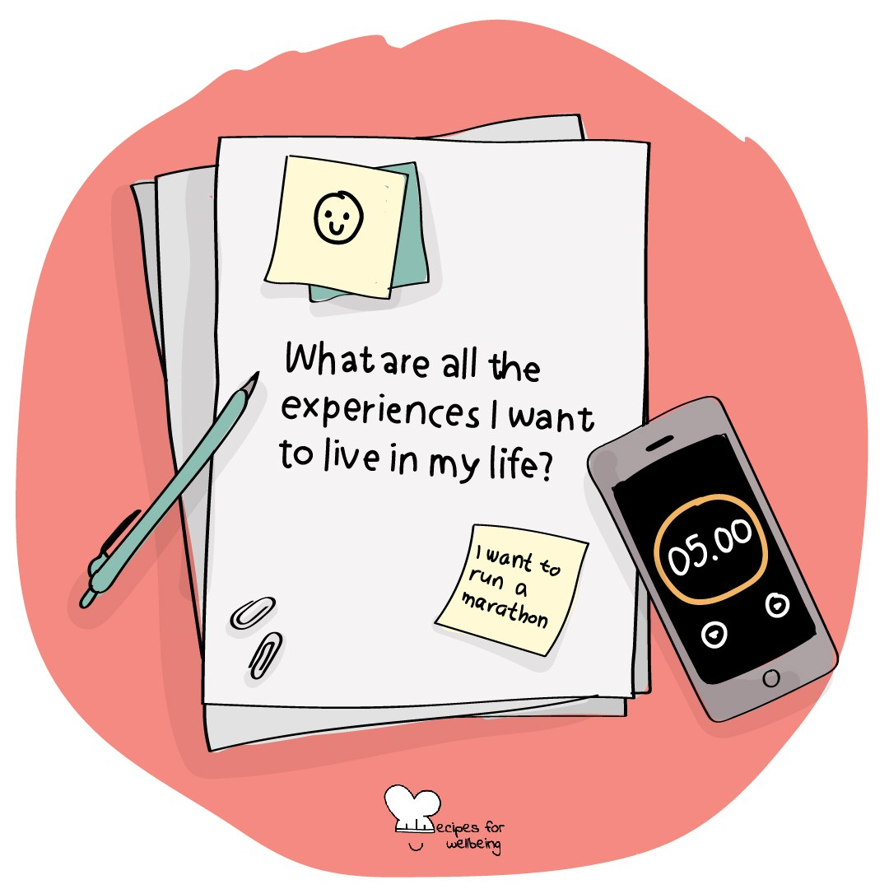
Purpose · 3 min opener
The bigger why
1. Before we start, think about how today's lesson might connect with something beyond this room.
2. Finish the sentence "This could matter to someone because..." silently. The person you picture can be close to you or someone you may never meet.
3. You may not see the connection yet, and that is an honest place to begin.
4. Keep the sentence in mind during the lesson, and come back to it later to see whether your answer has changed.

Slide 38
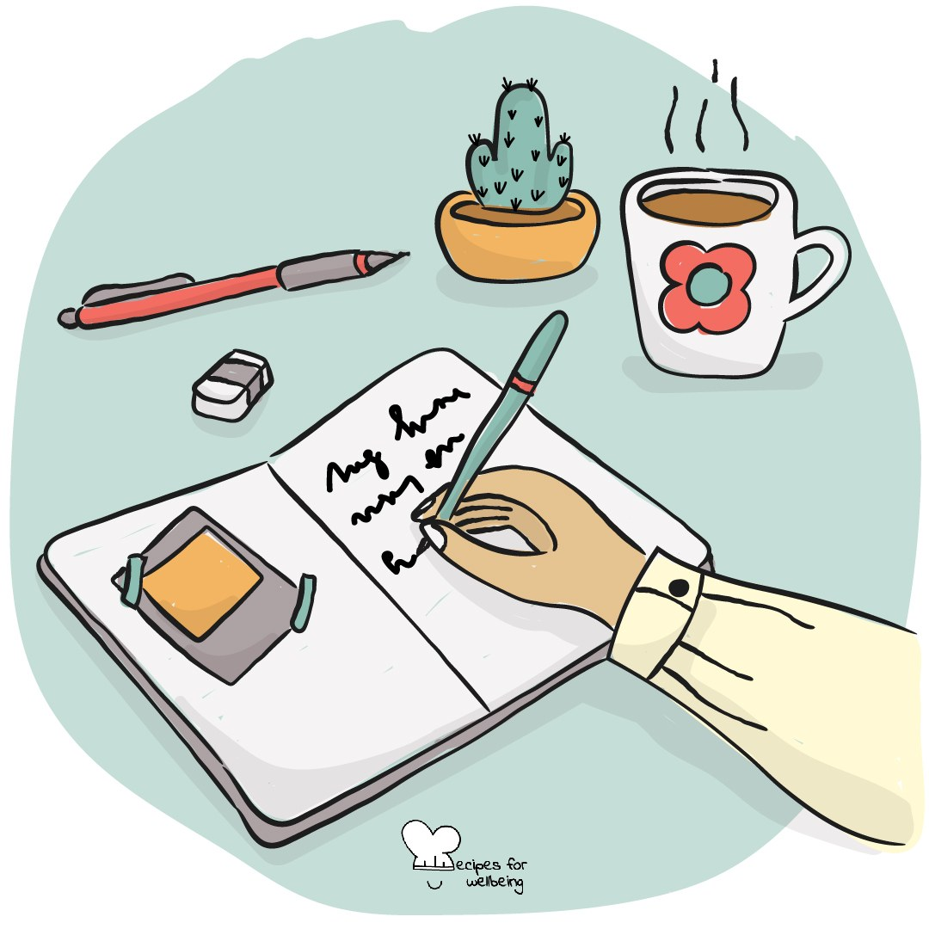
Ordinariness · 3 min closer
The done list
1. To-do lists hold our attention on what remains, so for one minute we will notice what is already done today.
2. Count ordinary things, including arriving, asking a question, staying with something difficult or helping another person.
3. Choose three items and keep the list private, recognising the effort behind each one.
4. Take the list with you as you leave, alongside anything that still needs your attention.

Slide 39
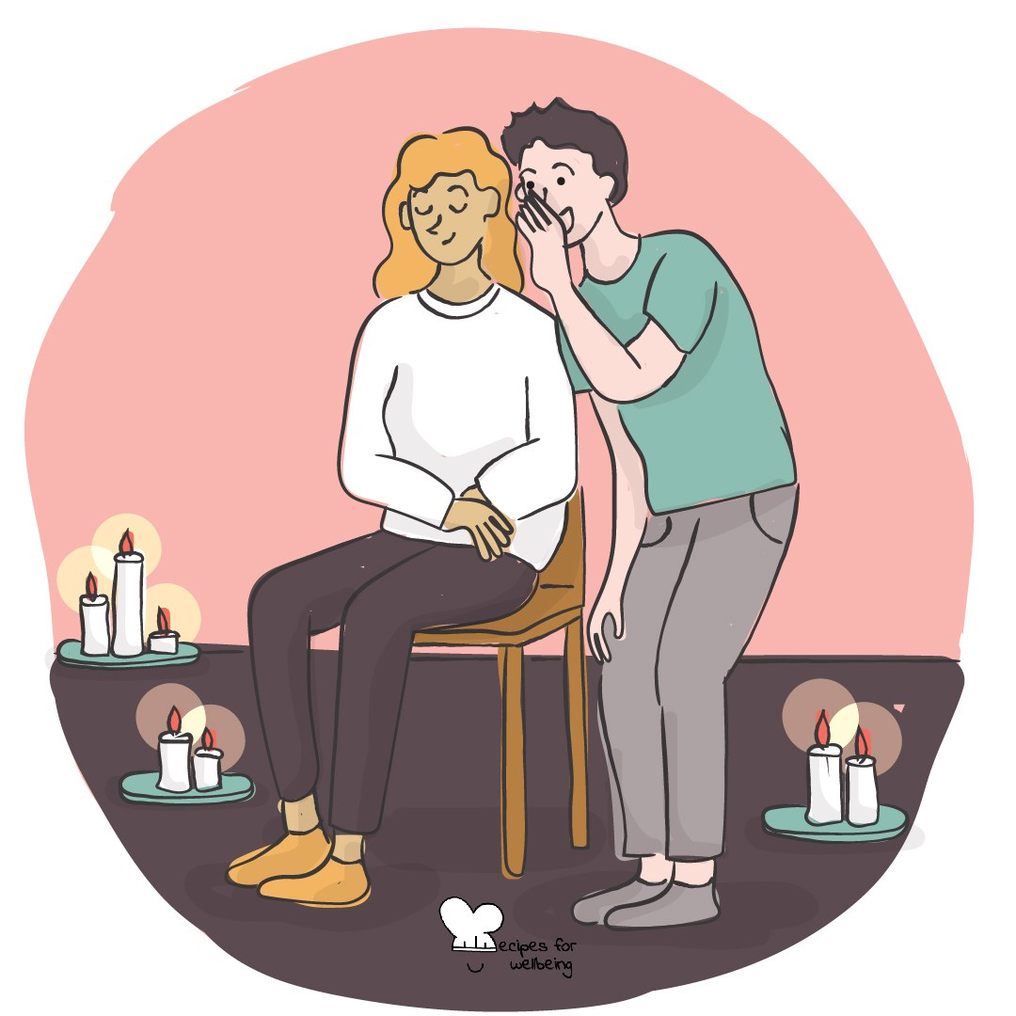
Reciprocity · 5 min closer
Giving and receiving
1. Before we go, we will practise giving an appreciation and receiving one without brushing it away.
2. Think of something small and genuine you appreciate about the person beside you, from something they did today or this week. You can pass, or shake your head, if the pairing does not feel comfortable.
3. Offer it in one sentence, or use "Thank you for sharing this lesson with me" if you need a starting point.
4. When you receive one, say "thank you" and let the words land before you swap roles.
5. Notice privately whether giving or receiving felt less familiar.

Slide 40
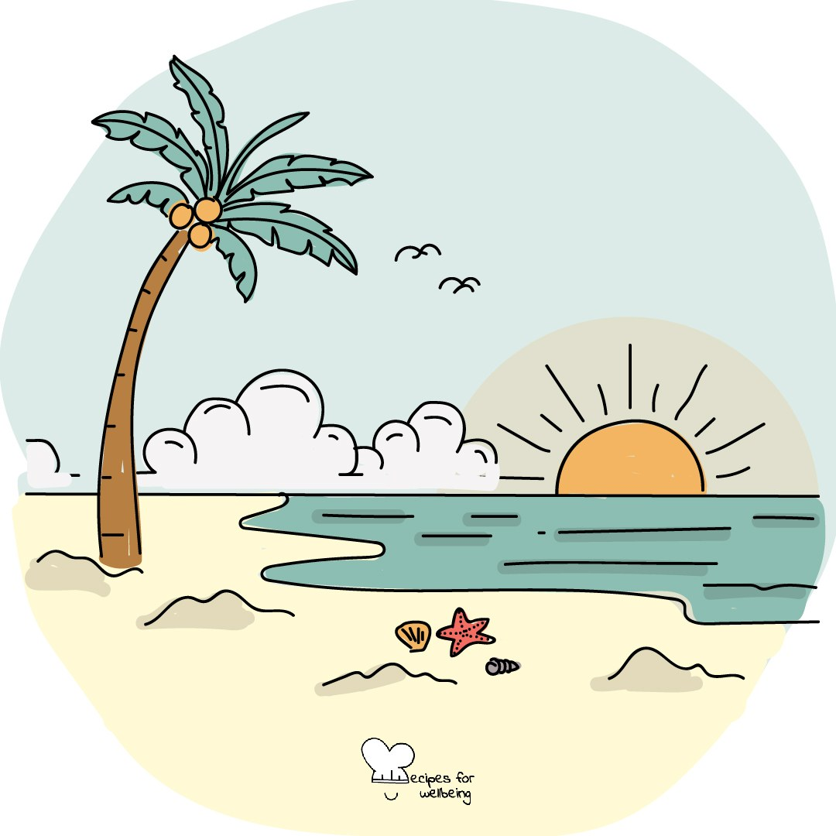
Joy · 3 min opener
Hardwiring the good
1. Our attention can stay with what went wrong while a good moment slips past, so this practice gives one good moment a little more time.
2. Recall something good from the last day or two, such as warmth from the sun or a welcome message.
3. Stay with the moment for twenty seconds. Remember where you were, what happened and what made it feel good.
4. When the time ends, let the memory go and notice what it was like to stay with it a little longer.

Slide 41
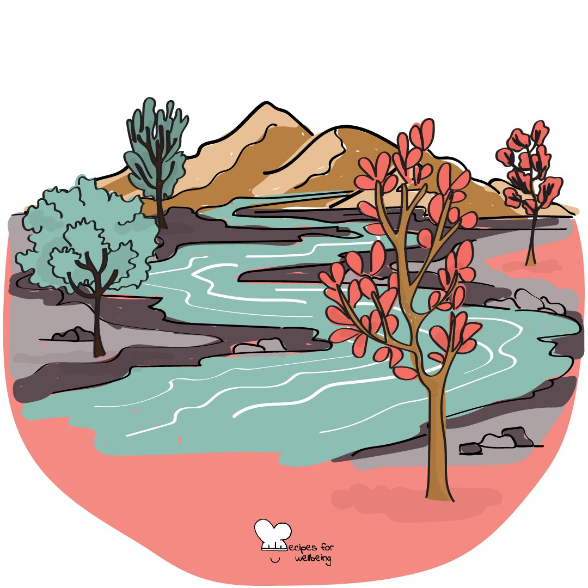
Reflection · 5 min closer
The river of this term
1. In the last five minutes of the term, picture the past thirteen weeks as a river you have travelled.
2. Notice where the river ran fast, where it slowed, and whether there was an obstacle you passed or are still finding your way around.
3. Choose one part of the journey you want to remember. It can hold difficulty, pride or more than one feeling at once.
4. If you would like to, describe your river in one word on the way out, and let the reflection end as the break begins.

Slide 42
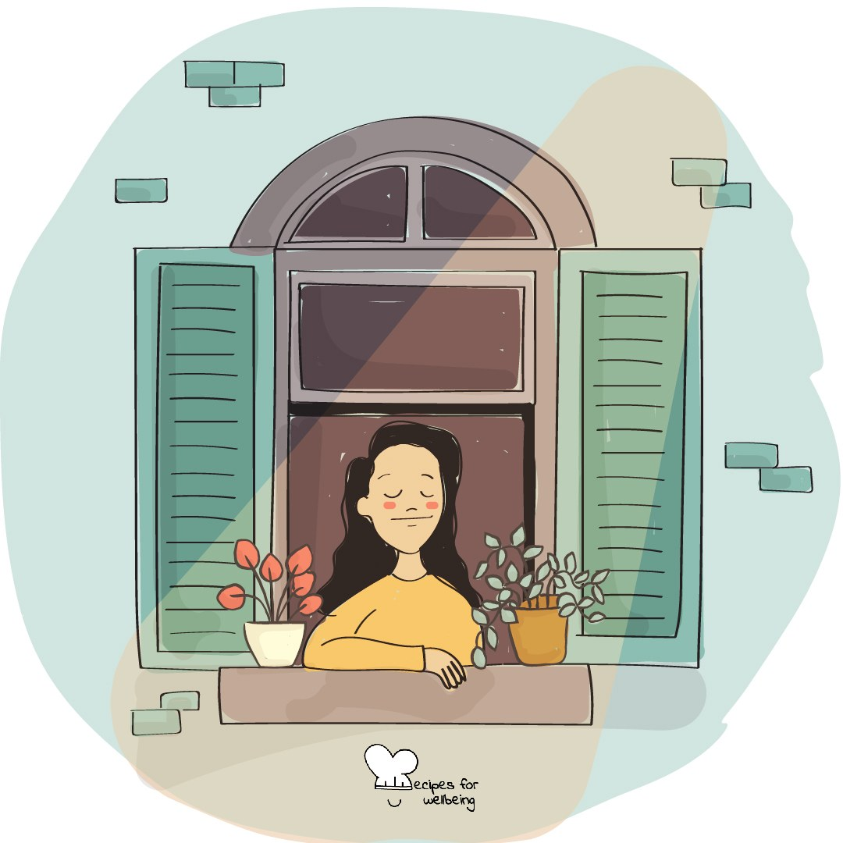
Intention-setting · 4 min opener
Crossing the threshold
1. Welcome to the summer term. Before it gathers pace, settle into your seat and allow your shoulders to rest.
2. Take three unhurried breaths and let your attention move from the corridor into the room.
3. Finish the sentence "This term, I would like a little more..." silently, using one word if that is enough.
4. Keep your word private and hold it for a moment, as something to come back to during the term.
5. When you are ready, look up and we will begin together.

Slide 43

Self-regulation · 5 min opener
The full stop
1. Exam season can make everything feel faster, so today we will practise a short pause called STOPP that you can use anywhere.
2. S means stop where you are. T means take one comfortable breath, with an unhurried out-breath.
3. O means observe what is moving through your mind. You might name it quietly as planning, worrying or replaying.
4. The first P means pull back: picture the moment from another place or time, and notice whether your view of it changes.
5. The last P means proceed, choosing what to do next. You can use the pause in an exam, an argument or any moment you need a little room.

Slide 44
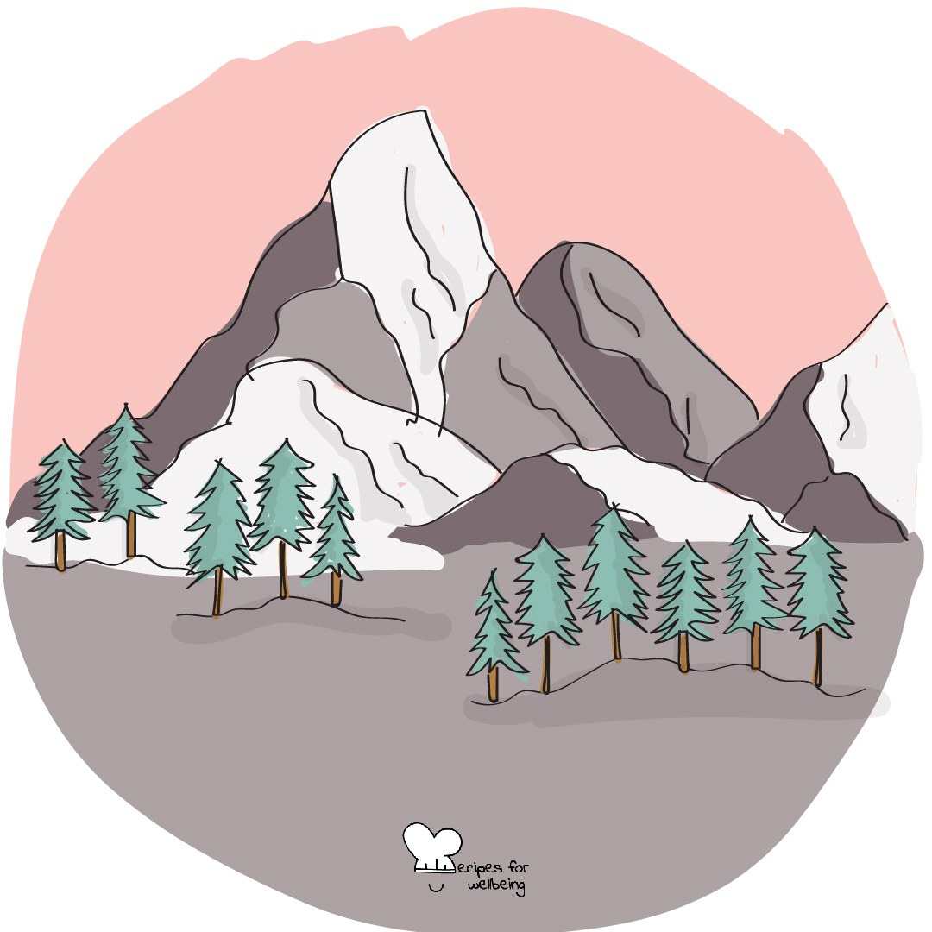
Bioinspiration · 4 min opener
This week's weather
1. Sit as upright as feels natural and imagine your body as a mountain, its base held by the chair and its summit reaching up.
2. Picture this week's thoughts and feelings as weather moving across the mountain: heat, cloud, wind or rain.
3. The mountain does not chase the weather or push it away. Take a few comfortable breaths and let the picture stay for one minute.
4. Before we begin, remember that the weather and the mountain both change, even when the change is slow.

Slide 45
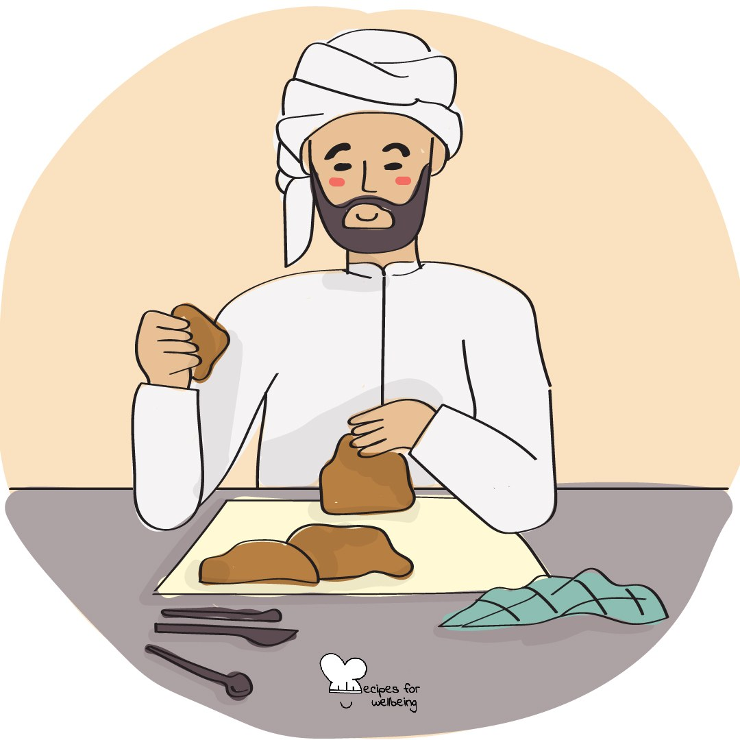
Reframing · 4 min opener
Stress, reintroduced
1. Take a quiet body check and notice whether this term is showing up as a faster heartbeat, a busy stomach or something else.
2. One way to meet these sensations is to consider that your body may be getting ready for something demanding. A sign of stress is not proof that you cannot cope.
3. Take one comfortable breath and try the words "My body is giving me energy". Keep them only if they feel useful and true for you.
4. The sensation may stay, and you can choose your next step without waiting for it to go.

Slide 46
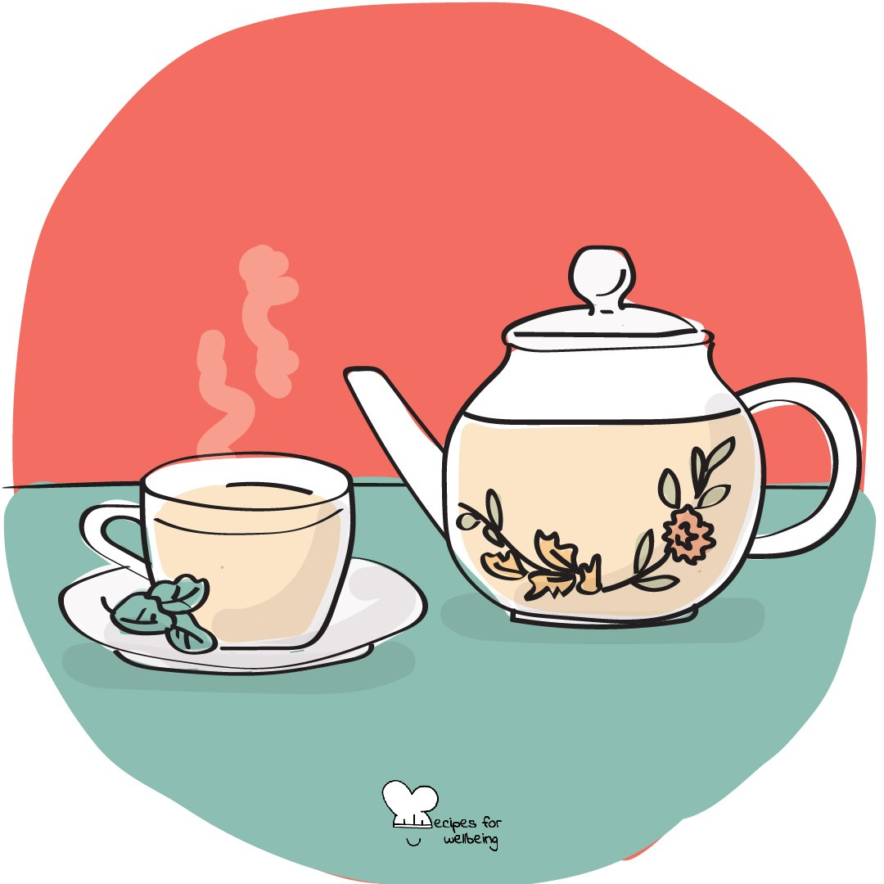
Slowing down · 3 min closer
Slower than feels normal
1. Before the bell, we will take two minutes to let the pace of the day come down a little.
2. Rest one hand on the desk and tap one finger in a slow beat, without a sound, at whatever pace your day has had.
3. Now let each beat come a little later than the one before, until the beat is slower than feels normal.
4. Stop when you are ready, let your hand rest and notice the pace you will carry out of the door.

Slide 47
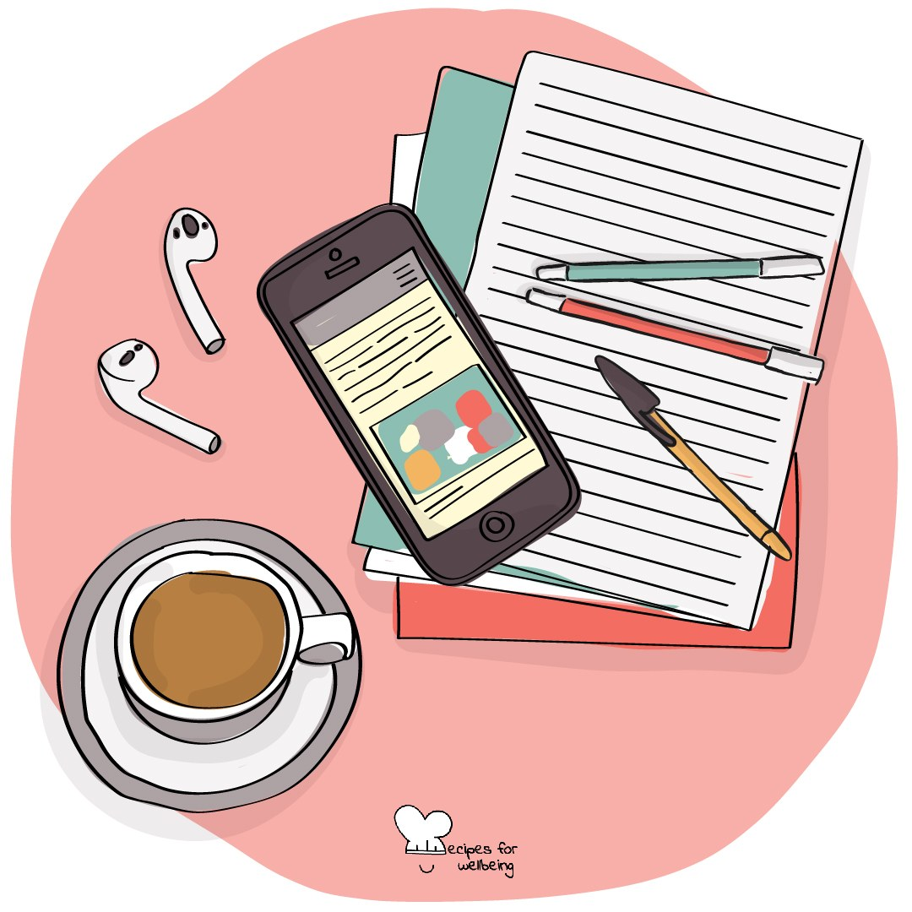
Digital boundaries · 4 min opener
The phone across the room
1. Without checking, notice whether you know where your phone is right now, and how quickly the answer came.
2. A phone within sight can keep drawing some of our attention, even face-down and silent, though people experience this differently.
3. If you would like to experiment during revision, choose one study session when your phone stays in another room, and notice what happens to your attention.
4. You can choose the time privately now. Twenty minutes is enough.

Slide 48
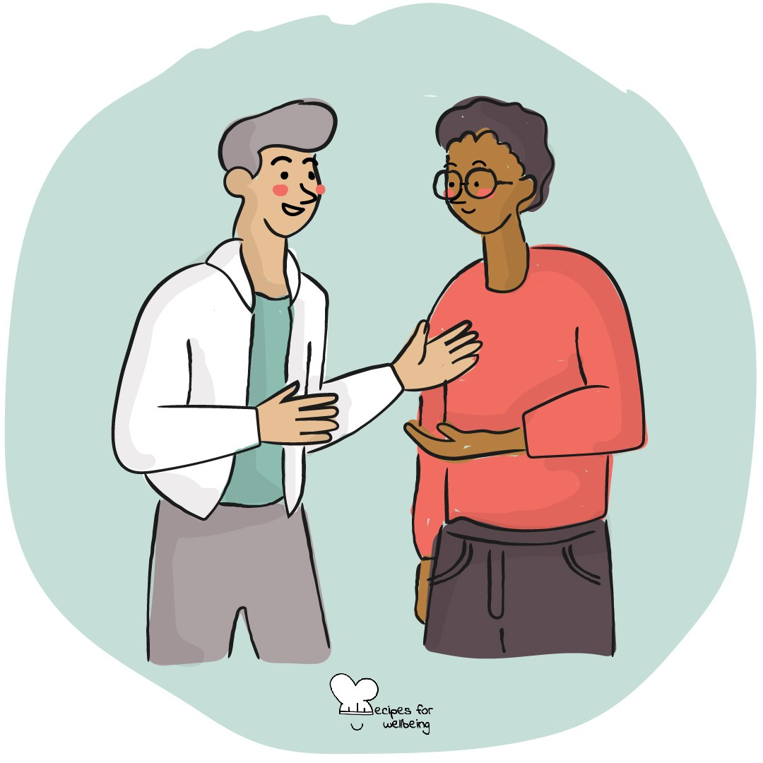
Affirmation · 4 min closer
Good gossip
1. Before we go, turn to the person beside you for a short round of what we might call good gossip.
2. Take turns saying one kind and true thing about someone who is not in your pair, kept respectful. You can pass, or shake your head, if you would rather not take part.
3. Give each person up to sixty seconds, then notice what it was like to speak well of someone who was not there to hear it.
4. Keep the words in the spirit they were offered, or pass them on to the person later if that feels right.

Slide 49

Flow · 4 min opener
Stretch and skill
1. Think of one task you have today, in this lesson or later, and picture it in front of you.
2. Ask yourself two quiet questions: how far does this task stretch me, and how ready do my skills feel for it?
3. We tend to get absorbed when the stretch and the skill are close together. If the task feels far beyond you, find one small part closer to what you can already do.
4. If it feels too easy, think of one way to make it a little more interesting. Keep that part in mind as we begin.

Slide 50
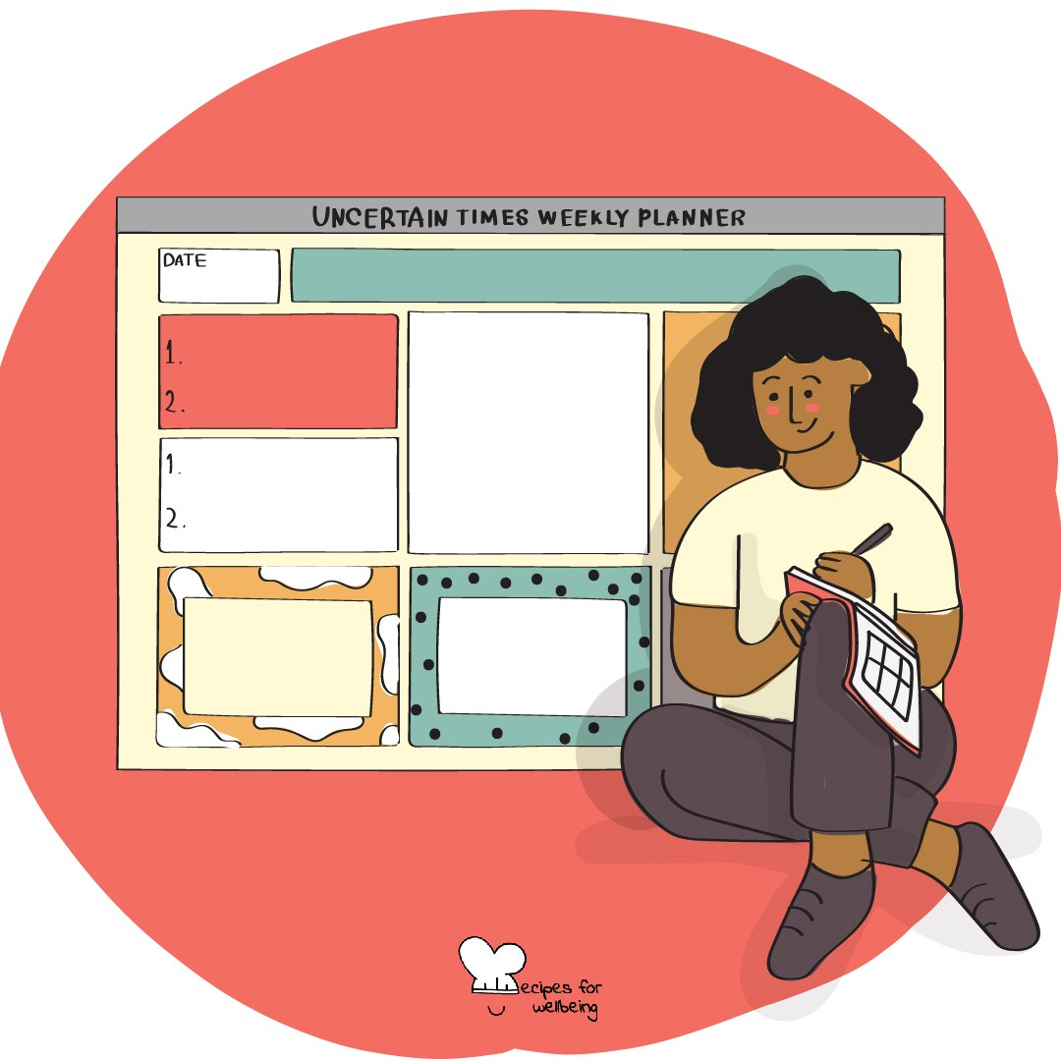
Planning · 4 min closer
A note to later you
1. Before we finish, think about the next time you will sit down to work on something, perhaps tomorrow evening or later this week.
2. Picture yourself arriving then, maybe tired, and choose one small step you could clear for that person now, such as finding the right page or writing the first line.
3. If there is time, take that one step now, or write it as a short note to your later self on the corner of a page.
4. Leave everything else for later. One cleared step is enough to take with you.

Slide 51
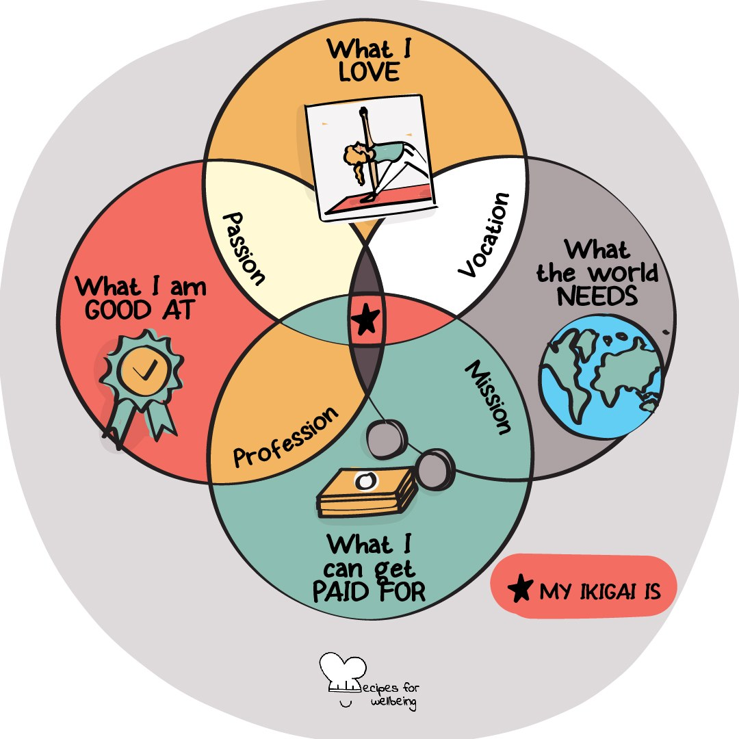
Joy · 4 min opener
Let it land
1. Our attention can stay with a hard moment while a good one slips past, so today we will give one good moment a little more time.
2. Bring to mind something from the last day or two, such as a song, a joke or the sun on your face while you waited for the bus.
3. Stay with the memory for three comfortable breaths. Recall where you were, what happened and how it felt.
4. When the time ends, let the memory go and notice what it was like to stay with it for a moment longer.

Slide 52
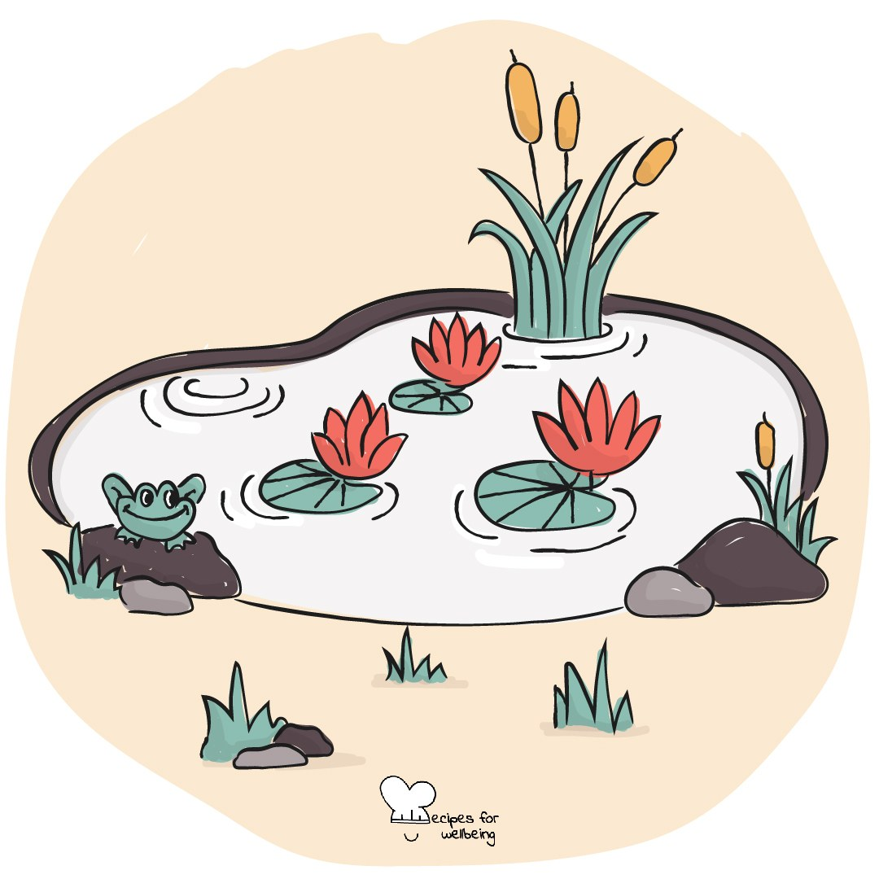
Acknowledgement · 4 min opener
What you saw them do
1. Before we start, think back over the last few days to something useful someone did that nobody thanked them for.
2. It might be small, such as someone holding a door, tidying up after a group task or explaining something twice without a sigh.
3. Choose one of those moments and notice what it made easier for other people.
4. If you would like to, find a moment later to tell that person you noticed. Keeping it to yourself is fine too.

Slide 53
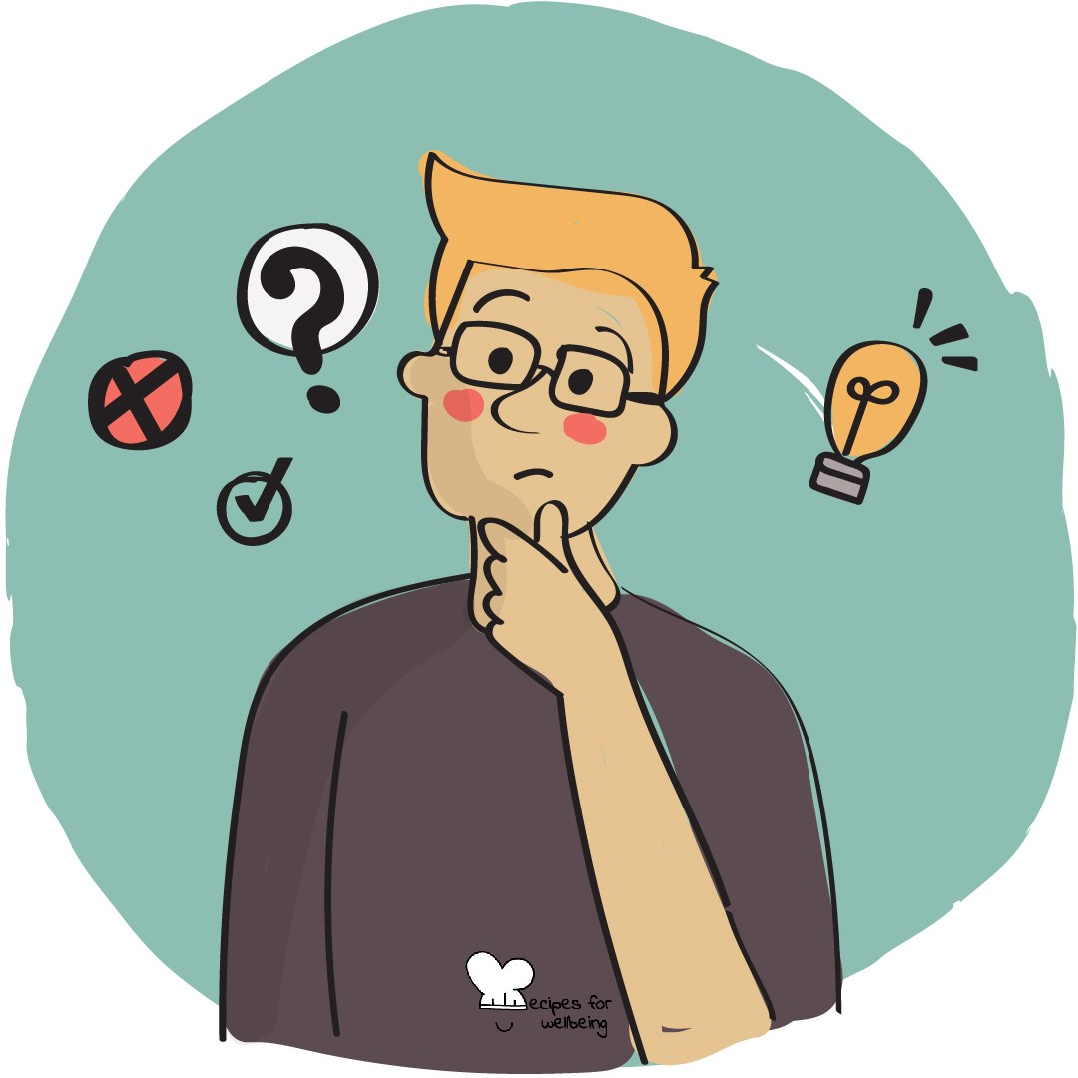
Sense-making · 4 min opener
First attempts
1. Think back to one attempt this year that did not go as you hoped, perhaps a mark, a try-out or a plan that changed.
2. Ask yourself quietly what you know now because you made that attempt, and what you might choose differently another time.
3. An attempt that did not work can still give you information, even while the disappointment or the cost is real.
4. You do not need to share the memory or turn it into a good story. Just notice whether the question changes how you hold it.

Slide 54

Commitment · 5 min closer
Carrying it forward
1. These are our last five minutes together this year. Look back and find one moment you are glad happened, however small.
2. Choose one thing from the year you would like to carry into the summer, such as a habit, a friendship or words that stayed with you.
3. A few volunteers can finish the sentence "I am taking... with me," while the rest of us listen without replying. Passing is always fine.
4. The difficult and unfinished parts of the year can travel with you too. There is no need to resolve them before we leave.
5. Thank you for the days we have begun together. I hope the summer makes room for the rest you need.

